Slide 1
JOURNAL CLUB
MODERATOR PRESENTOR
Col Y Uday Dr Smrithy S Boban
Clinical Hematologist Resident, Medicine

Slide 2
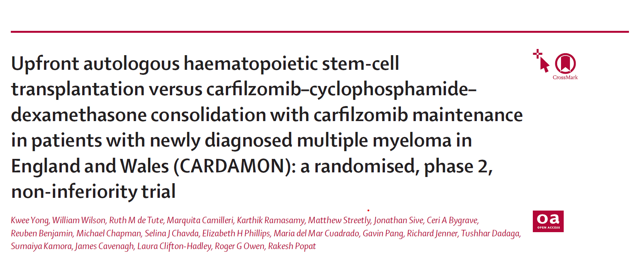
JOURNAL CLUB
Lancet Haematol Vol-10, Feb 2023; e93–106
Published Online - December 15, 2022

Slide 3
AIM
To investigate any detrimental effect of allocating patients to a non-transplantation group using a carfilzomib-based induction, consolidation, and maintenance approach.
Efficacy of the triple regimen KCd as induction in transplantation-eligible patients with newly diagnosed multiple myeloma
To evaluate the non-inferiority of KCd consolidation compared with upfront autologous HSCT in patients with at least a partial response to induction.
Notes:
Carfilzomib, cyclophosphamide, and dexamethasone (KCd)

Slide 4
METHODOLOGY
Phase 2, Randomized, Open label, multicentric clinical trial
Study polulation: 281; from 19 hospitals in England and Wales, UK
Registered with ClinicalTrials.gov
June 16, 2015
July 8, 2019

Slide 5
METHODOLOGY
Inclusion Criteria:
Adults 18years and older
ECOG Scale 0-2
Symptomatic MM eligible for high-dose therapy and HSCT
Measurable disease according to standard criteria
Life expectancy of 3 months or more
Adequate neutrophil count, platelet count, haemoglobin, and creatinine clearance
Notes:
Eastern Cooperative Oncology Group (ECOG) performance status of 0–2 (>2 was permitted if resulting from complications related to myeloma);

Slide 6
METHODOLOGY
Exclusion Criteria:
Previous systemic treatment for Multiple myeloma
(except local palliative radiotherapy or corticosteroids for a maximum of 4 days)
Substantial cardiac comorbidity

Slide 7
Induction therapy
Four 28-day cycles of KCd
Carfilzomib :
20 mg/m² IV on days 1 and 2 of the first cycle
56 mg/m² IV on days 1, 2, 8, 9, 15, and 16 of every cycle
Cyclophosphamide 500 mg - orally on days 1, 8, and 15 of all cycles
Dexamethasone 40 mg - orally on days 1, 8, 15, and 22 of all cycles
FOLLOWED BY
PBSC mobilization, harvesting and randomisation.
Notes:
Step-up dosing in the first cycle of consolidation- introduced halfway through the trial to reduce adverse events. After cases of thrombotic microangiopathy were reported, the protocol was amended to include a step-up carfilzomib dose at the reduced amount of 20 mg/m² for any patient resuming treatment after a break of more than 4 weeks, before returning to the protocol dose of 56 mg/m² (or the last dose amount administered after any reduction)

Slide 8
RANDOMISATION
For patients that had at least a partial response.
Patients were randomly assigned (1:1) to either high-dose melphalan and autologous HSCT or to KCd consolidation
Both group received maintenance with Carfilzomib

Slide 9
Consolidation phase
RESPONDERS POST INDUCTION THERAPY
KCd GROUP | HSCT Group
Four further cycles of KCd (same dose, route, and schedule of administration as the induction protocol) | High dose melphalan according to local protocols and autologous HSCT

Slide 10
MAINTENANCE PHASE
All randomised patients
18 cycles of Carfilzomib 56mg/m2 0n day 1,8 &15

Slide 11
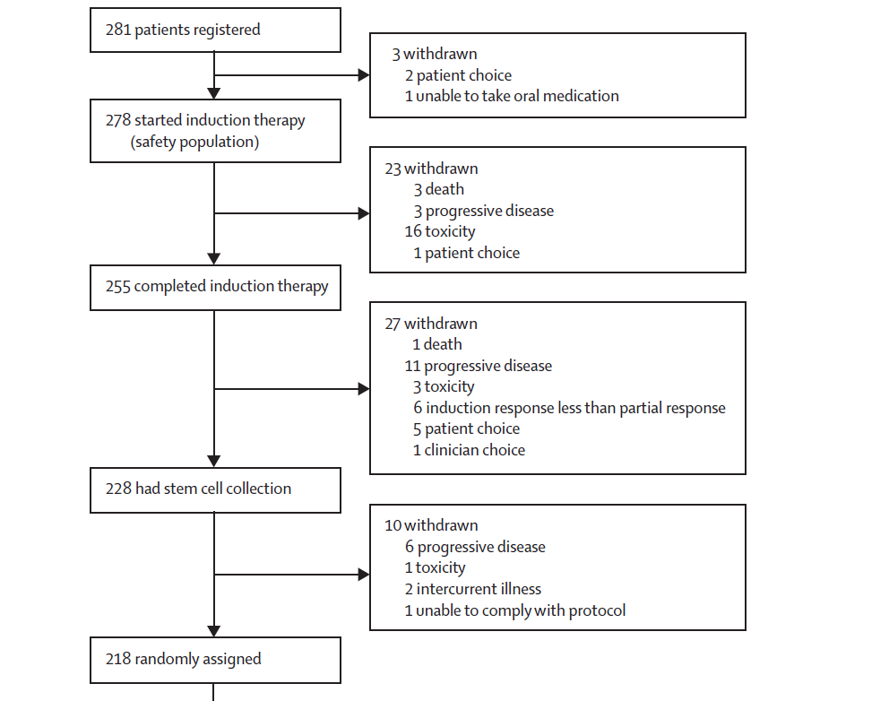

Slide 12
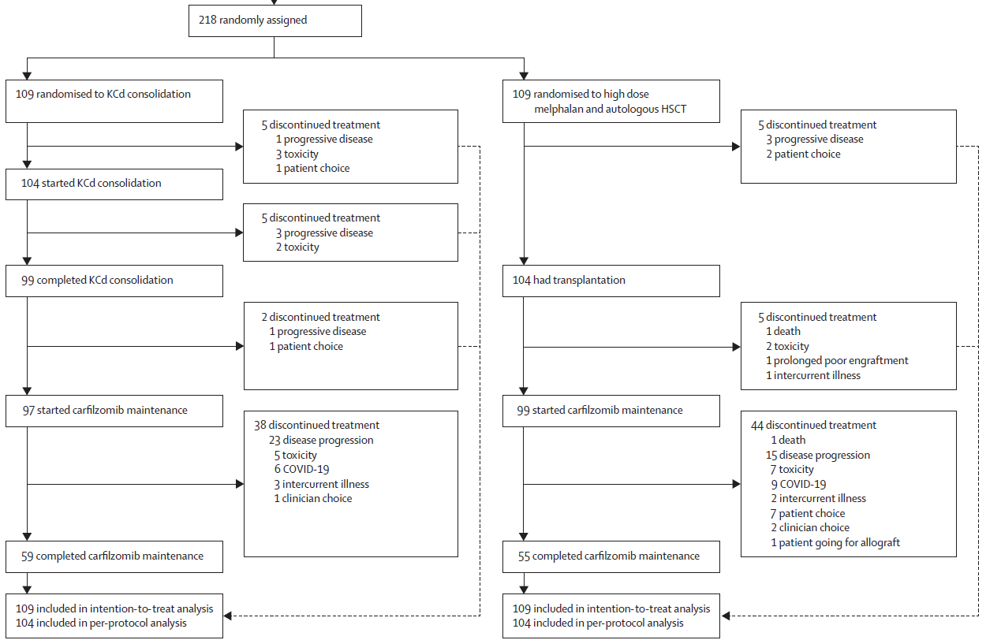

Slide 13
FOLLOW UP
Disease response assessment as per modified International Myeloma Working Group criteria
Bone marrow examination:
After PBSC harvesting
End of KCd consolidation or 100 days after HSCT
6 months after maintenance
End of maintenance
MRD was assessed in all the above
Adverse events graded as per CTCAE(Common Terminology Criteria for Adverse Events version 4.03

Slide 14
FOLLOW UP
Treatment delay upto 4 weeks during normal period and upto 14 weeks during covid pandemic permitted
After 12 months of maintenance treatment could stop at the discretion of investigator
Dose modifications : Step up doses if >4weeks break and wrt adverse events.
Those withdrawing from trial also followed up for collection of outcome data

Slide 15
PRIMARY OUTCOME
Proportion of patients with atleast a very good partial response after induction
Difference in progression free survival rate at 2yrs from randomisation

Slide 16
SECONDARY OUTCOMES
Disease response and MRD at each timepoint
Time until second progression or death
Overall survival (from registration & randomisation until death from any cause)
Toxicity & Quality of life

Slide 17
STATISTICAL ANALYSIS

Slide 18
STATISTICAL ANALYSIS
SAMPLE SIZE: Hern Single Phase 2 Design
281
Efficacy outcomes analysed: Intention to treat analysis method
Progression free & overall survival : Kaplan & Meier Method

Slide 19
STATISTICAL ANALYSIS
P-values for comparision between treatment group: Cox regression analyses for survival outcomes
Response rates: Chi-square test
Sensitivity analysis excluding patients whose maintenance was delayed due to covid performed on the primary progression free survival outcome

Slide 20
STATISTICAL ANALYSIS
Safety data – all those received atleast one dose of any study drug
Analyses performed with Stata Version 16.1
Registered with ClinicalTrials.gov(NCT02315716)

Slide 21
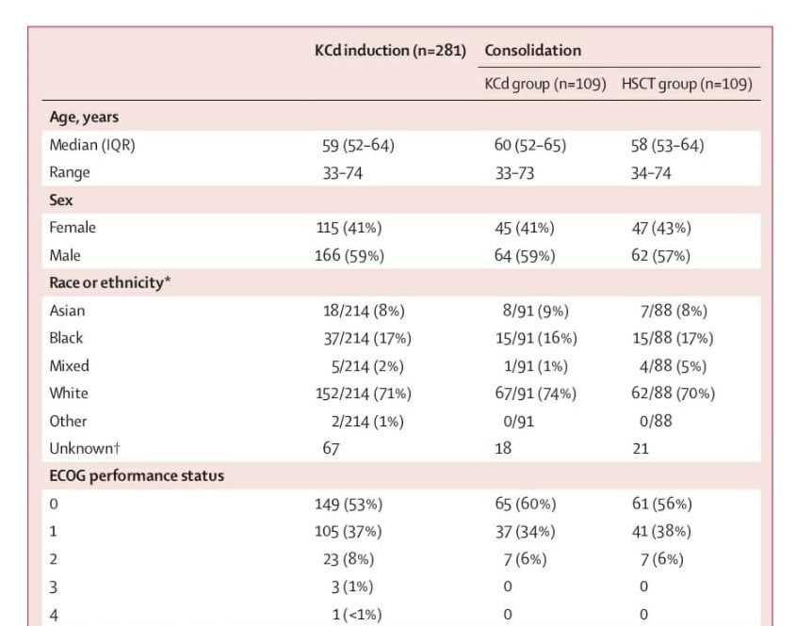
RESULTS: DEMOGRAPHIC DATA

Slide 22
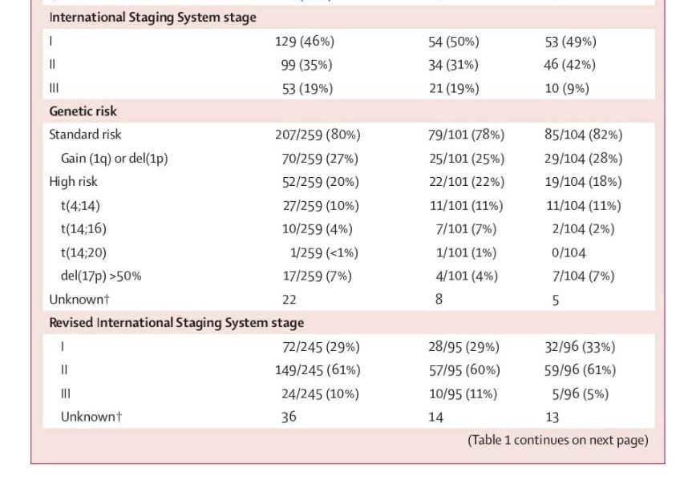
DEMOGRAPHIC DATA

Slide 23
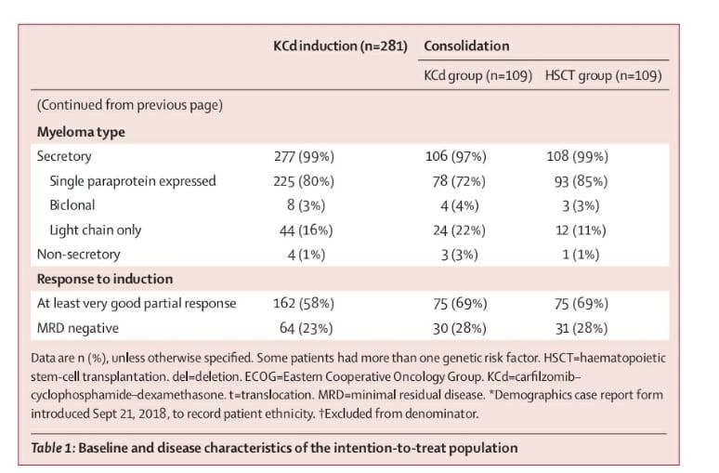
RESULTS

Slide 24
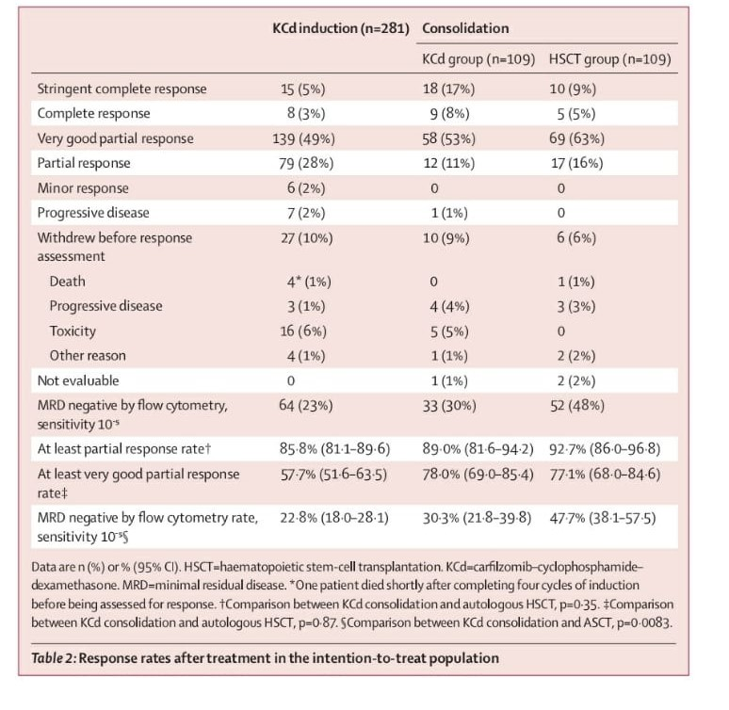
RESULTS

Slide 25
RESULTS
Median time from starting induction therapy to randomisation was 5.6months
Median follow up from registration 45.5months
Median follow up from randomisation was 40.2months
Post randomisation, more patients in HSCT group (52 out of 109- 48%) had MRD negativity than patient in KCd group (33 of 109- 33%).p= 0.0083

Slide 26
RESULTS
18 out of 63 patients (29%) with disease progression after KCd consolidation were reported to have received subsequent transplantation

Slide 27
RESULTS
Median progression free survival :
from registration to end point: 38.1 months
from randomisation : 42.4 months for HSCT & 33.8 months for KCd
Criteria for non inferiority of KCd consolidation is not met
Excluding patients who had delayed maintenance due to Covid did not alter the conclusion

Slide 28
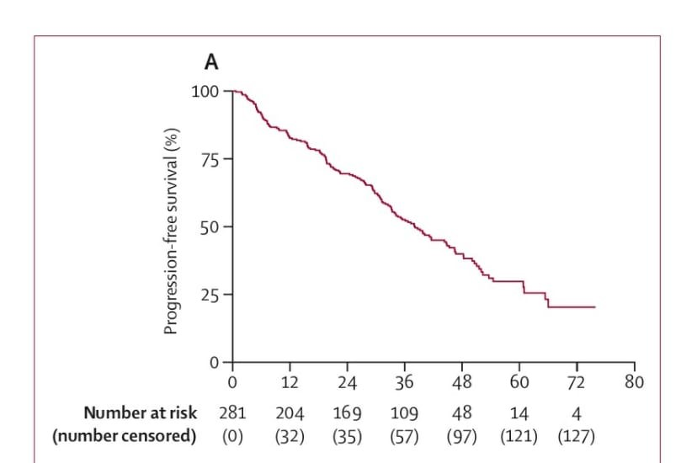
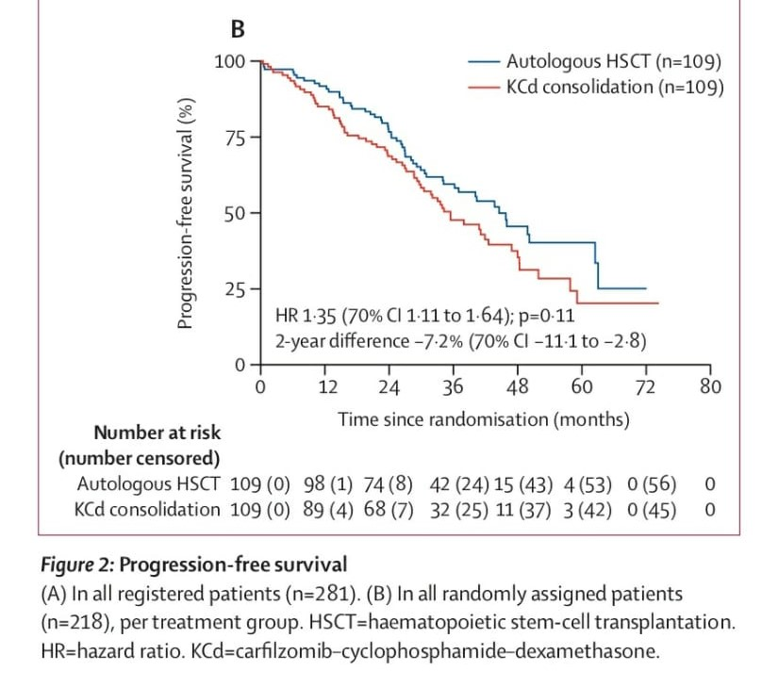
RESULTS

Slide 29
ADVERSE EVENTS
Most common during induction: Infections
M/C Grade 3 adverse event during induction: Lymphocytopenia
Hypertension
Neutropenia
Anemia
Consolidation: Hypertension(KCd)
Maintenance: lung infection & cytopenia in HSCT group

Slide 30
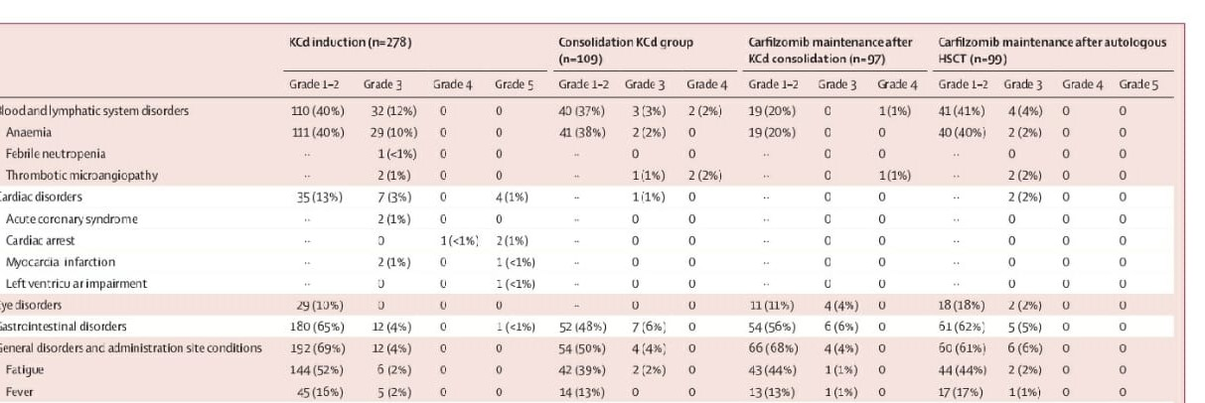
RESULTS: ADVERSE EVENTS

Slide 31
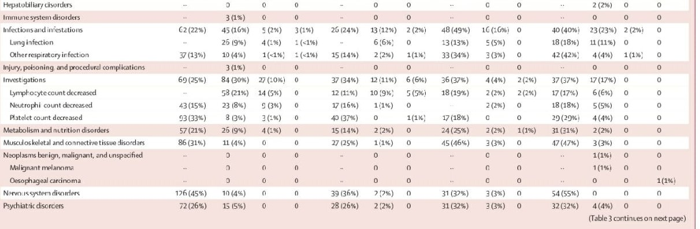
RESULTS: ADVERSE EVENTS

Slide 32
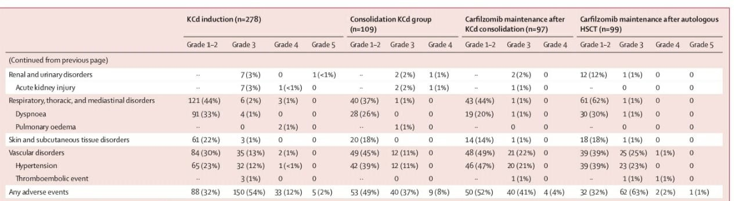
RESULTS: ADVERSE EVENTS

Slide 33
CONCLUSION
Upfront autologous HSCT should remain the treatment of newly detected multiple myeloma
Deferred autologous HSCT in some patient subgroups should be investigated in large prospective trials.

Slide 34
CRITICAL APPRAISAL

Slide 35
CRITICAL APPRAISAL
TITLE
  Is it interesting? YES
ABSTRACT
  Will the conclusions (if valid), likely to be useful to you, in your area of clinical practice or research? YES
  Whether the settings in the material methods are similar to our own settings? YES

Slide 36
REFERENCE QUESTION
Is there a clear cut / specific research question? YES
Was it feasible for the authors to study this question given there technical expertise and available facilities? YES
Does the research question has some element of novelty? YES

Slide 37
VALIDITY
Have the authors made a mention of Actual / Study Population ? YES
Is the method of sampling been described? YES
Whether a mention of all the potential confounding factors been made? YES
Any selection or information bias could have occurred? NO

Slide 38


GATE Framework Assessment : PECOT
P=281
Outcome: MRD-
I=109 C=109
KCd HSCT
30.3% 47.7%

Slide 39
ASSESSING VALIDITY

Slide 40
The RAMMbo acronym : Assessing study bias
P
Recruitment
E
Allocation
C
Maintenance
O
Measurement of outcome
T
Blind or objective
P
E/I C
T
O

Slide 41
RAMMbo : Recruitment
Study setting & eligibility criteria well described ? YES
Participants representative of eligible ? YES
Prognostic/risk profile appropriate to study question? YES
Randomization process described adequately? YES

Slide 42
RAMMbo: A is for Allocation
P=281
Randomisation (1:1)
KCd 109 HSCT 109

Slide 43
RAMMbo: MAINTENANCE
Did most participants
remain in allocated groups ? YES
Participants &/or investigators
blind to exposure (and comparison
exposure)? NO
Compliance high & similar in
EG &CG? MODERATE & SIMILAR
Completeness of follow-up high
& similar in EG &CG? MODERATE & SIMILAR

Slide 44
RAMMbo
Measurement of outcomes
blind or objective?
Outcome measurements were
BLIND
Authors reviewed all results YES

Slide 45
Recruitment
Bias: No bias
Allocation : Adequate
Maintenance: Moderate Retention
Measurement : Right Statistical tools (of outcomes)

Slide 46
STRENGTHS
Intention to treat analysis helped to asses the real world scenario of this protocol
No bias in randomisation
Funding agency did not interfere during any of the stages of the study

Slide 47
LIMITATIONS
Superiority of the autologous HSCT could not be commented
Was not powered to analyse non-inferiority in subgroup analyses
Transplant related events were not reported
Reported rate of patients who received a deffered transplant after disease progression might be a underestimation
Covid pandemic led to withdrawal during maintenance

