Slide 1



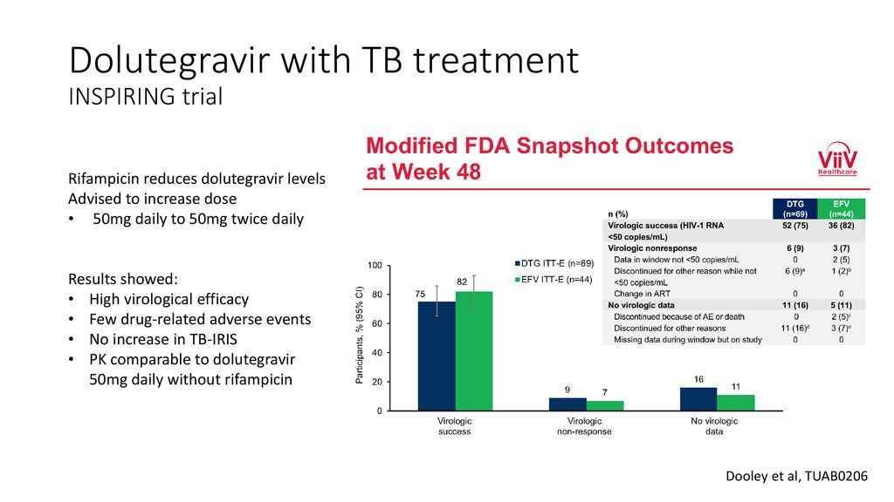
Various Trials
INSPIRING Trial
Botswanan Study

Slide 2
AIM- RADIANT-Tb Trial
Study aimed to determine whether virological outcomes with standard dose dolutegravir- based ART would be acceptable in people with HIV on Rifampicin based anti-tubercular therapy

Slide 3
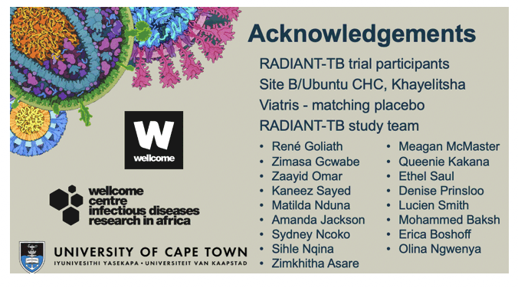
Study Design
Phase 2b
Randomized
Double-blind
Non-comparative
Placebo controlled

Slide 4
Inclusion and Exclusion Criteria
Inclusion Criteria
Age > 18 yr
Seropositivity for HIV-1, plasma HIV-RNA > 1000/ml
CD4 count > 200 cell/µl (subsequently changed to > 100 cells/ µl)
ART naivety or first line ART interruption (ART duration < 6 months or HIV-RNA <50 copies/ml, less than six months before interruption)
On Rifampicin based ATT for less than 3 months
Exclusion Criteria
Pregnant Female
ALT > 3 time above normal
Allergy or intolerance to any drug in the regimen
Active psychiatric condition

Slide 5
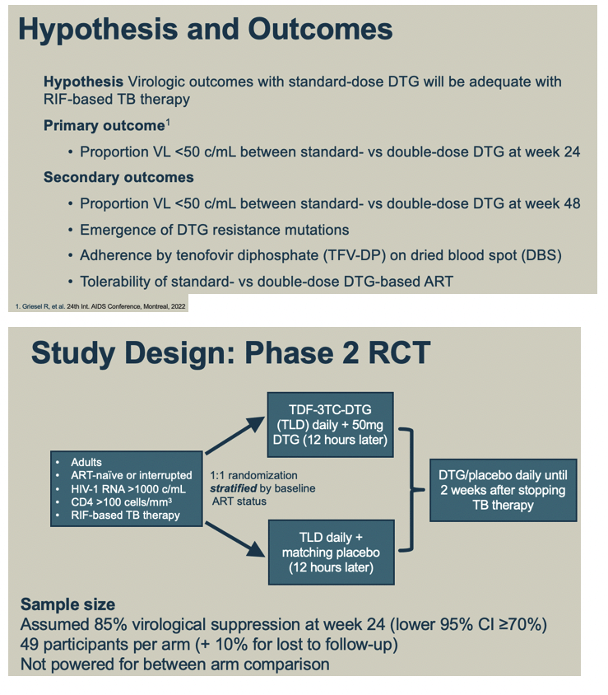
Method
Recruitment and Randomization
Duration of study : 48 weeks
Follow up Visit: 4,8,12, 16, 20, 24 and 48 weeks

Slide 6
Procedure
Tb diagnosis – Microbiological or Histological
Tb classification- pulmonary, extra-pulmonary or disseminated
Screening – HIV-RNA testing, CD4 count
If CD4 count between 50-99 cell/µl, test was repeated
Study Defined Virological failure : HIV-RNA > 1000 copies/ml at week 24 or if HIV-RNA was less than <50 copies/ml and then rebound to >1000 copies/ml at any time point

Slide 7
Outcomes
Primary Outcome
  Proportion of participants with virological suppression
  Defined as HIV-1 RNA less than 50 copies per mL at week 24

Slide 8
Outcomes
Secondary Outcome
  Proportion of participants with HIV-1 RNA of less than 50 copies per mL at weeks 12 and 48
  Change in baseline CD4 count at 24 and 48 weeks
  Proportion of participants with dolutegravir trough concentrations above the PA-IC₉₀ at weeks 4, 24, and 48
  ART adherence assessment determined by tenofovir diphosphate in dried blood spots at weeks 12, 24, and 48
  Occurrence of grade 3 and 4 and serious adverse events
  Change in Modified Mini Screen and Insomnia Severity Index questionnaires from baseline
  The emergence of integrase strand transfer inhibitor resistance mutations in participants with study-defined virological failure

Slide 9
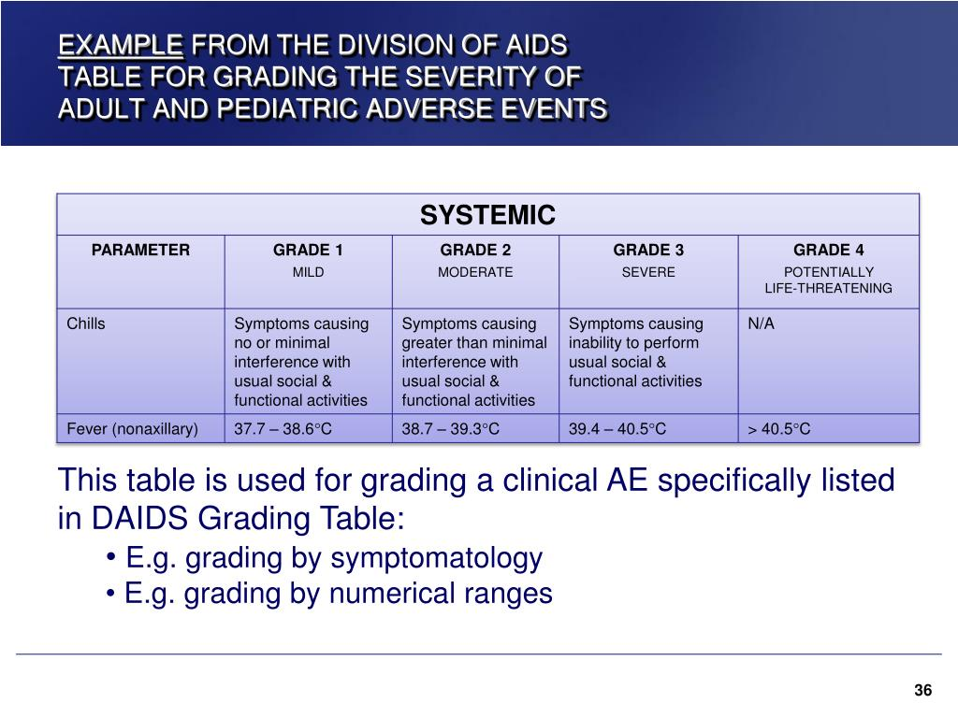
Adverse Events
As per DAIDs severity grading
Immune reconstitution inflammatory syndrome
Neuropsychiatric Symptoms - MMS and ISI questionaries

Slide 10

Statistical Analysis

Slide 11
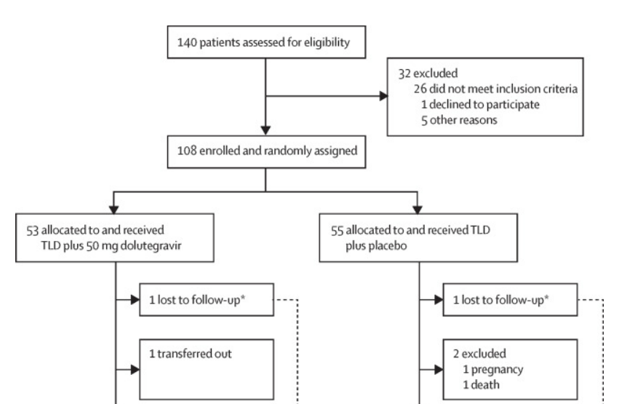
Study Profile

Slide 12
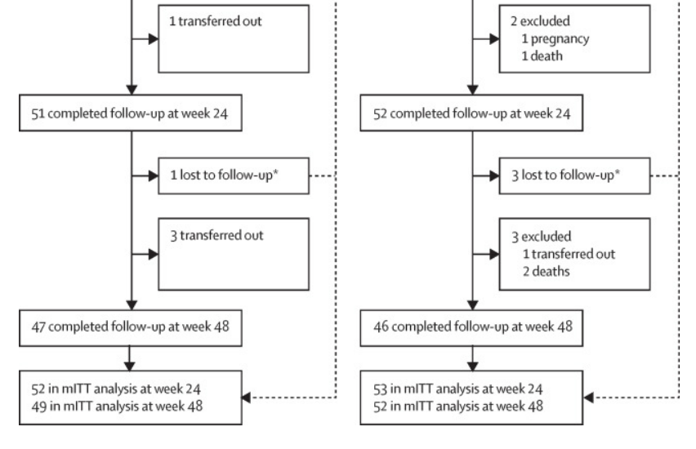
Study Profile

Slide 13
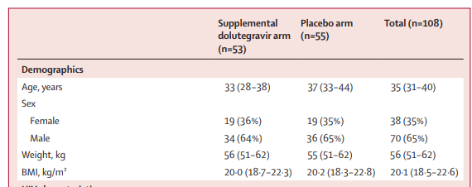
Demographic Profile

Slide 14
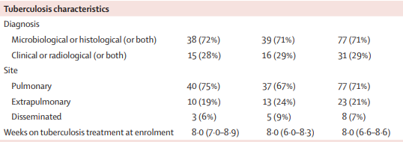
Demographic Profile

Slide 15
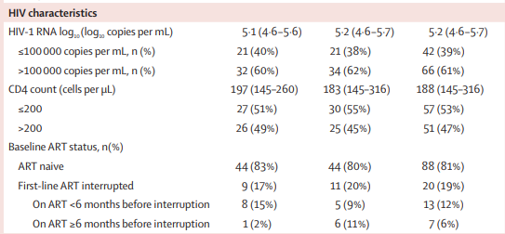
Demographic Profile

Slide 16
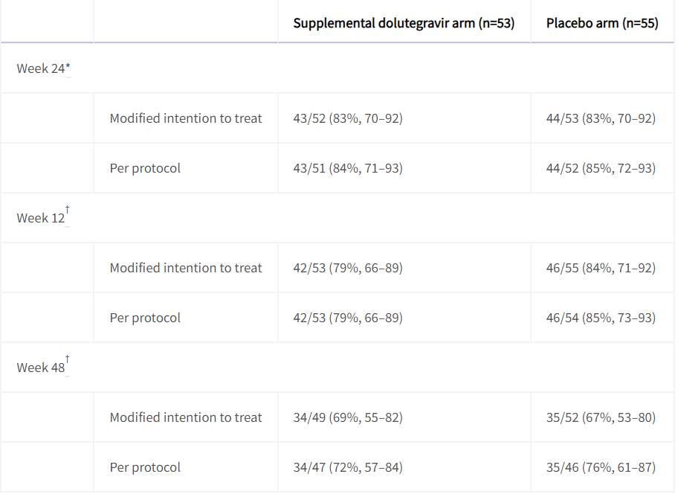

Result- virological Suppression

Slide 17
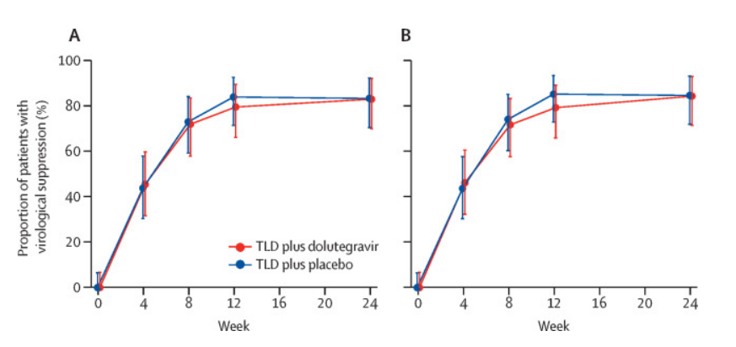
Virological Suppression- graph

Slide 18
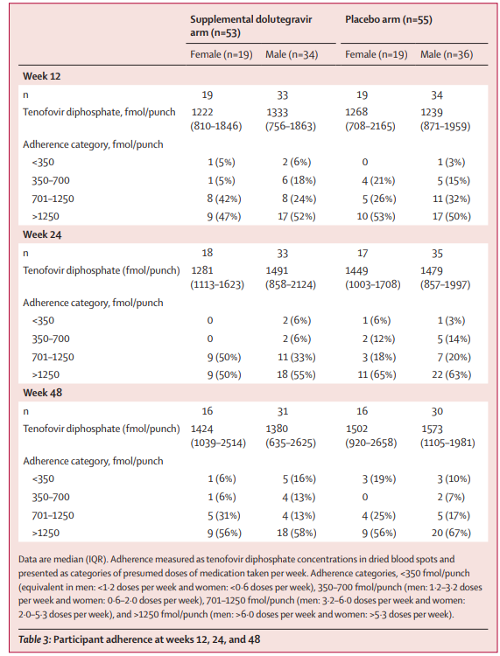
Adherence

Slide 19
Adherence

Slide 20
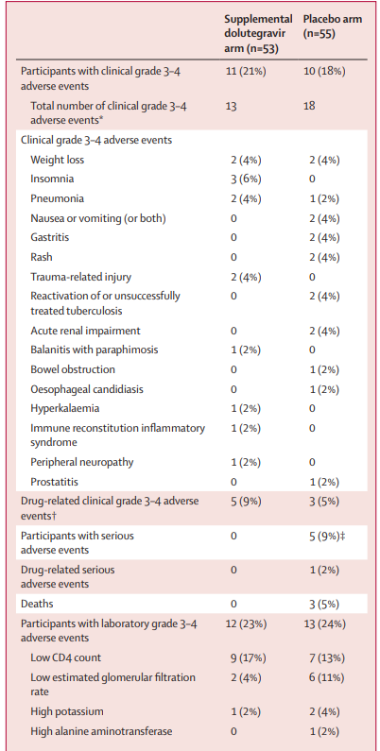
Adverse reaction

Slide 21
Adverse reaction

Slide 22

Critical Appraisal

Slide 23
Critical Appraisal
TITLE
  Is it interesting? YES
ABSTRACT
  Will the conclusions (if valid), likely to be useful to you, in your area of clinical
  practice or research? YES
  Whether the settings in the material methods are like our own settings? YES
Is there a clear cut / specific research question? YES
Was it feasible for the authors to study this question given their technical expertise and available facilities? YES

Slide 24
Critical Appraisal
Does the research question have some element of novelty? YES
Have the authors made a mention of Actual / Study Population ? YES
Is the method of sampling been described? YES
Whether a mention of all the potential confounding factors been made? NO
Any selection or information bias could have occurred? NO

Slide 25


Gate Framework of Assessment
PARTICIPANTS:
140
EXPOSURE GROUP: 53
Placebo GROUP: 55
OUTCOME :
At 24 weeks : 43 out of 52 of exposure group and 44 out of 53 of placebo group had virological suppression
At 48 weeks no dolutegravir resistant in 19 virological failure cases
Duration :
48 weeks
T

Slide 26
RAMMBO : Recruitment
Study setting & eligibility criteria well described ? Yes
Participants representative of eligible population ? Yes
Randomization process described adequately ? Yes

Slide 27
RAMMBO : Allocation
140
Randomization
E-53 P- 55
1:1 ratio for baseline randomization
T

Slide 28
RAMMBO : Maintenance
P
Good Maintenance ? yes
Did most participants remain in allocated groups ? Yes
Participants &/or investigators blind to exposure
(and comparison exposure)? Yes
Compliance high & similar in both group? Yes
Completeness of follow-up high & similar in both group?
Yes
O

Slide 29
RAMMBO : Measurement
Measurement of outcomes blind or objective?
EG CG
Outcome measurements were Objective
Authors reviewed all results
O

Slide 30
RAMMBO : Bias
Recruitment
Bias: No bias
P
Allocation : Adequate
E C
Maintenance: High Retention
Measurement : Right Statistical tools
(of outcomes)
O
T

Slide 31
Limitations
The study was not powered to make comparisons between arms
Findings might not be generalizable to people on dolutegravir-based second-line ART or to people with CD4 counts below 100 cells/μL
Study only enrolled participants who were ART-naive or had interrupted first-line ART without virological failure
It not detect treatment-emergent dolutegravir resistance in the placebo arm

Slide 32
Conclusion
The similar rates of virological suppression in the supplemental dolutegravir and placebo arms
There were no treatment-emergent integrase strand transfer inhibitor resistance mutations among participants with study-defined virological failure
Twice-daily dolutegravir dosing might be unnecessary in people with HIV-associated tuberculosis

