Slide 1


JOURNAL CLUB (Date: 17 Jul 2023)
Moderator | Presenter
Lt Col SK Singh Professor Dept of Internal Medicine AFMC, Pune | Sqn Ldr Yashas Saipangallu Resident (JR-2) Dept of Internal Medicine AFMC, Pune

Slide 2
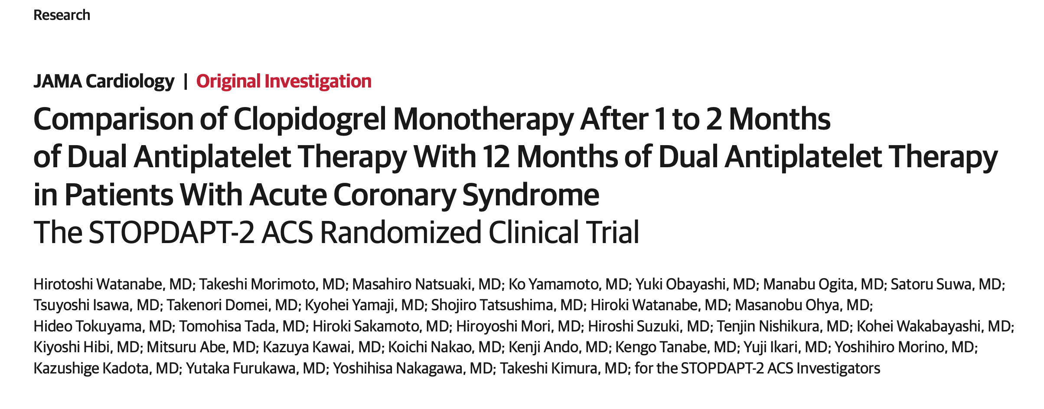

Slide 3
PURPOSE OF THE STUDY:
OBESRVATION FROM PREVIOUS STUDIES
ACS patients → Higher risk of cardiovascular events after PCI (compared to CCS)
In ACS → recommended to take DAPT for a longer duration after PCI
(~12 months).
  Rationale?→ trials in 1990
Concerns → Increased bleeding events with prolonged DAPT.
GLOBAL LEADERS trial, ticagrelor monotherapy even after 1 month of DAPT compared with 12 months of DAPT with aspirin and ticagrelor was associated with a significant reduction in major bleeding events without an increase in cardiovascular events.

Slide 4
OBESRVATION FROM PREVIOUS STUDIES
Recent studies→ Very short DAPT (1 to 3 months) followed by a single antiplatelet medication may be just as effective in reducing bleeding events without increasing cardiovascular events.
  Ticagrelor was used as monotherapy after stopping DAPT
    Superiority of Ticagrelor and Prasugrel
  Study on Clopidogrel??

Slide 5
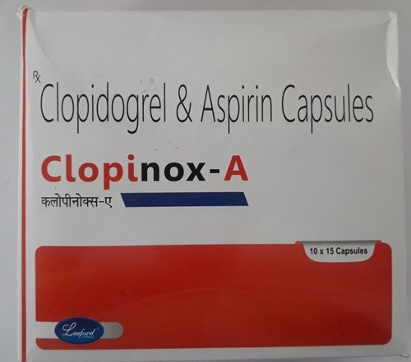
RESEARCH QUESTION…..
Is 1 to 2 months of dual antiplatelet therapy (DAPT) followed by clopidogrel monotherapy noninferior to 12 months of DAPT with aspirin and clopidogrel for patients with acute coronary syndromes?

Slide 6


STUDY DESIGN
Multicenter: 74 centers in Japan
Open label
Randomized controlled study
The study-group assignments were blinded
  Statistician
  Members of the independent clinical event committee
  Steering committee
  Sponsor (Abbott medical ®)

Slide 7
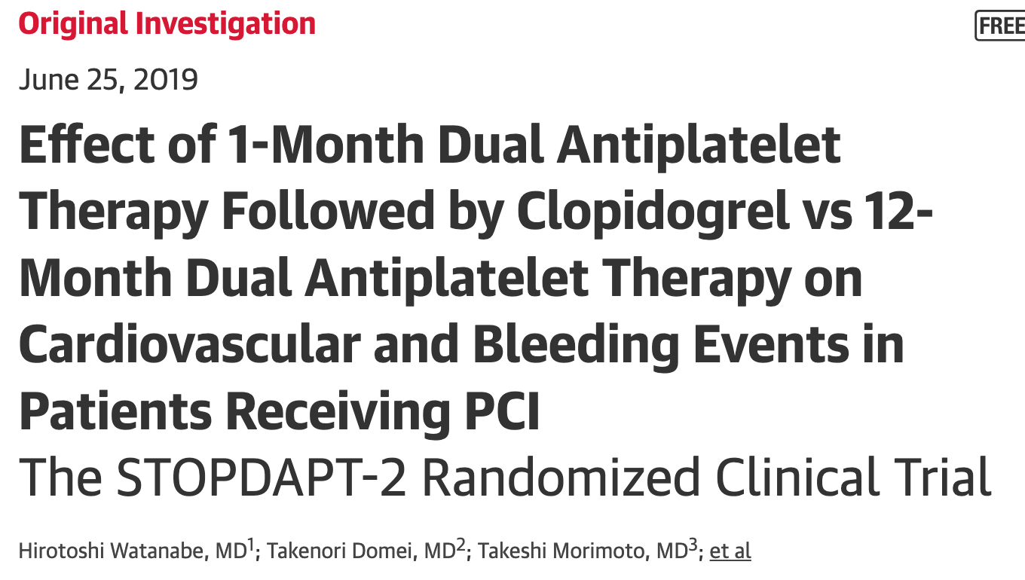

STOPDAPT-2 TRIAL (OR) STOPDAPT-ACS TRIAL
Short and Optimal Duration of Dual Antiplatelet Therapy After Everolimus- Eluting Cobalt-Chromium Stent-2

Slide 8
STOPDAPT-2 TRIAL….
(25-DEC-15 → 08 DEC 2017)
3009 PATIENTS
CCS: 1861
ACS: 1148
1 MONTH DAPT
12 MONTH DAPT
STEERING COMMITTEE DECISION
BEFORE THE END……..
STOPDAPT-2 ACS TRIAL
(30 MAR 18 → 08-JUN-2020)
After final PCI→
1-2 months of DAPT→ Randomisation
1-2 MONTH DAPT
12 MONTH DAPT

Slide 9
ANTIPLATELET REGIMEN
SOON AFTER PCI…………….
TAB CLOPIDOGREL ONLY
TAB CLOPIDOGREL ONLY
1-2 MONTHS
DAPT
TO STOP ASPIRIN
UPTO 5 YRS
DAPT
DAPT
ASPIRIN (DOSE ?)
CLOPIDOGREL 75MG/DAY
(OR) PRASUGREL 3.75MG/DAY
TAB ASPIRIN + CLOPIDOGREL
DAPT
ASPIRIN 75-100 MG OD
12 MONTH
DAPT
UPTO 5 YRS
1 MONTH
2 MONTHS
12 MONTHS

Slide 10

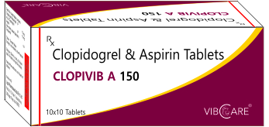
INCLUSION CRITERIA
PCI with the Everolimus-eluting cobalt-chromium stent (CoCr-EES, XienceTM ®) in the setting of ACS (STEMI/ NSTEMI/ UA).
No major complications (death, MI, stroke, or major bleeding) during hospital stay for treatment.
Capable of oral DAPT

Slide 11
EXCLUSION CRITERIA
Patients with,
  Oral anticoagulants
  Medical history of ICH
  Serious complications (MI, stroke, and major bleeding) during hospital stay post-PCI
  DES other than Xience ® implanted in PCI performed at the time of enrolment.
  Coronary bioabsorbable vascular scaffolds (BVS) implanted prior to or at the time of enrolment (including implantation cases in clinical trial)
  Intolerability to clopidogrel before enrolment

Slide 12
END POINTS
PRIMARY
SECONDARY END POINTS:
Death:
  Cardiac death: MI
  Vascular death : CVA
  Non cardiac death: Infections
MI
Need for revascularization
Stent thrombosis
Requiring surgeries: CABG, Vascular complications
Bleeding complications
CVA
Angina
TLF: Target Lesion Failure
Cardiac death, myocardial infarction (MI) of target vessels, Clinically-indicated TLR
TVF: Target Vessel Failure
Cardiac death (or) MI
MACE: Major Adverse Cardiac Events Cardiac death (or) MI
Note: Evaluation method of the primary endpoint:
Non-inferiority of the Clopidogrel monotherapy after 1-month DAPT over the 12-month DAPT was verified with regard to the primary endpoint at 12 months (primary analysis)

Slide 13
RESULTS AND DISCUSSION
1 YEAR FOLLOW UP completed → Jun 2021
  4107/4136 (99.3%)

Slide 14
 | STOPDAPT-2 TRIAL (25-DEC-15 → 08 DEC 2017) |  |  | STOPDAPT-2 ACS TRIAL (30 MAR 18 → 08-JUN-2020)
 | 1161 |  |  | 3008
ASSIGNED POPULATION | 1-2 M DAPT 572 | 12 M DAPT 589 |  | 1-2 M DAPT 1506 | 12 M DAPT 1502
WITHDRAW CONSENT | 7 | 6 |  | 13 | 7
 | 565 | 583 |  | 1493 | 1495
 | ANALYTICAL POPULATION 4136
 | 1-2 M DAPT 2058 |  | 12 M DAPT 2078
LOST TO FOLLOW UP | 15 |  | 14
 | 2043 |  | 2064

Slide 15
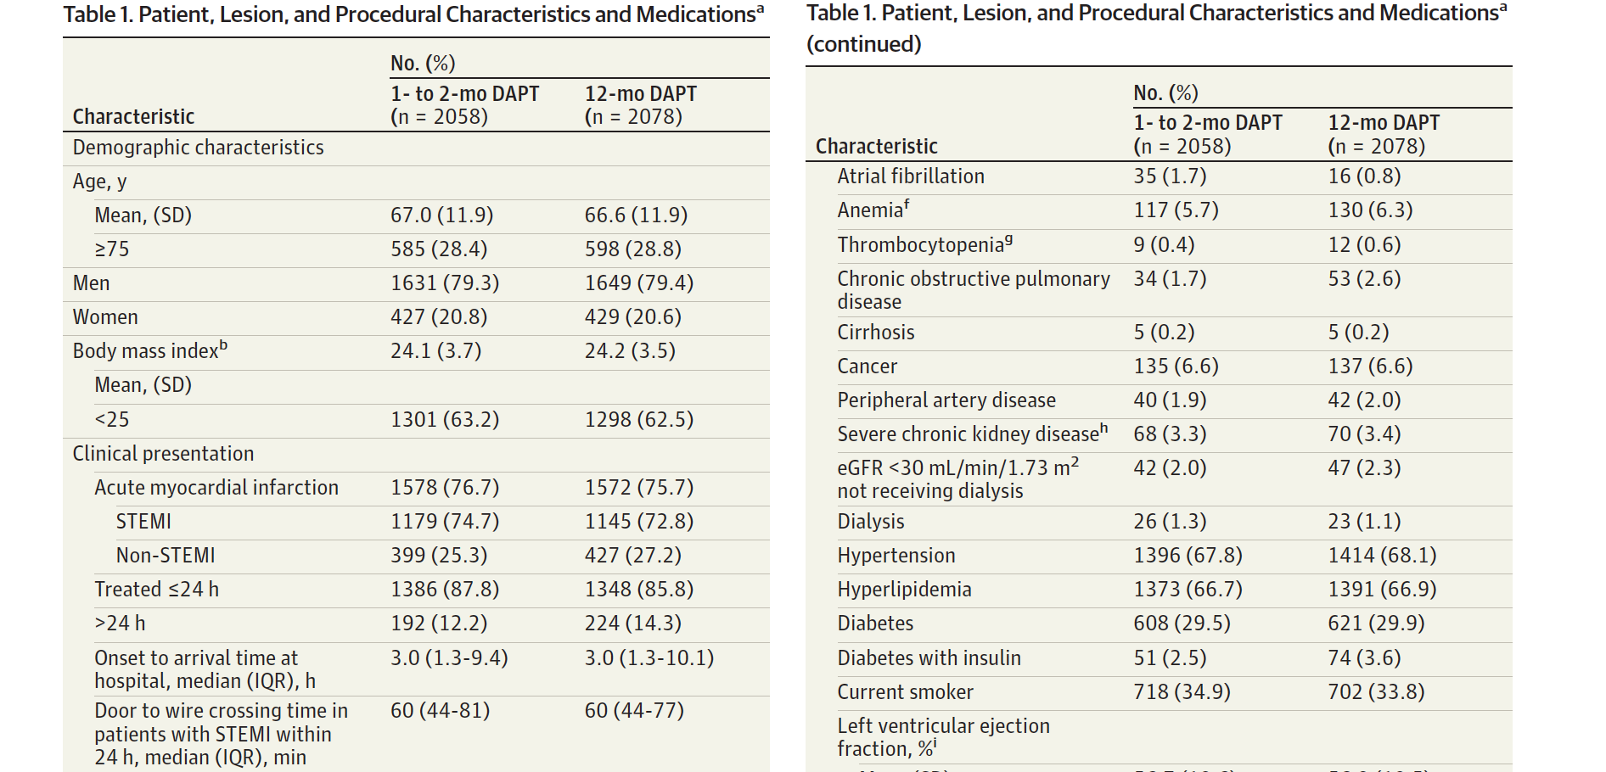

Slide 16
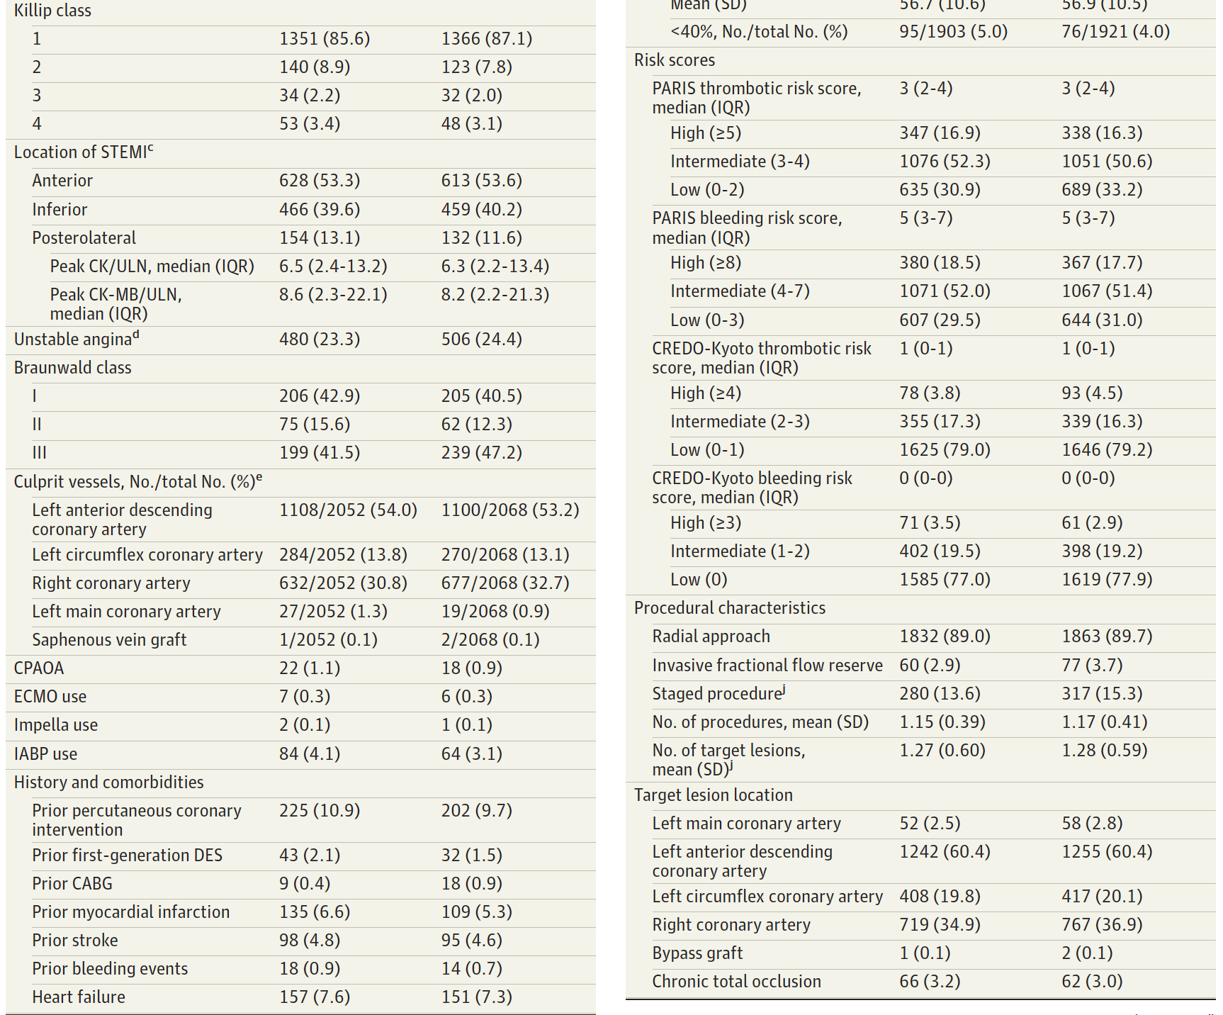

Slide 17
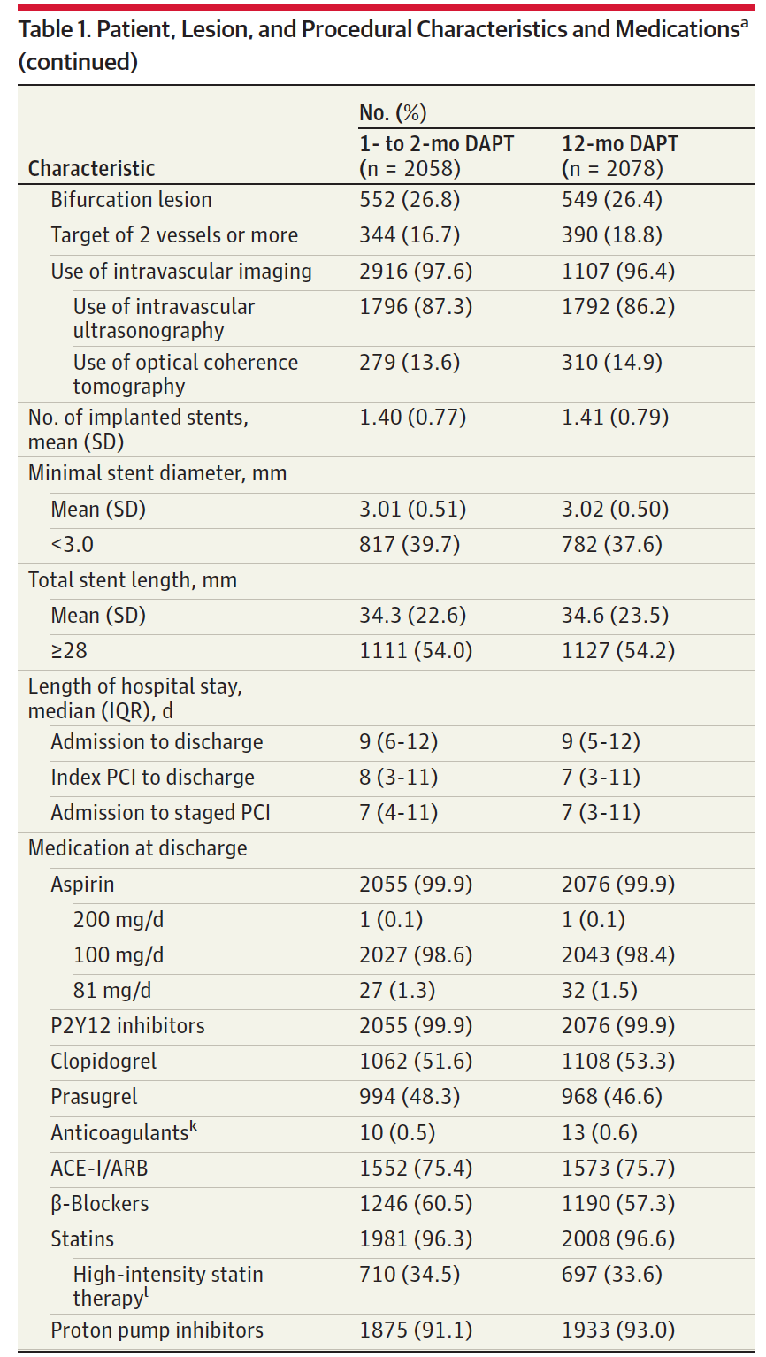

Slide 18
The baseline characteristics and medications were well balanced between the 1-2 month and 12 month DAPT groups

Slide 19
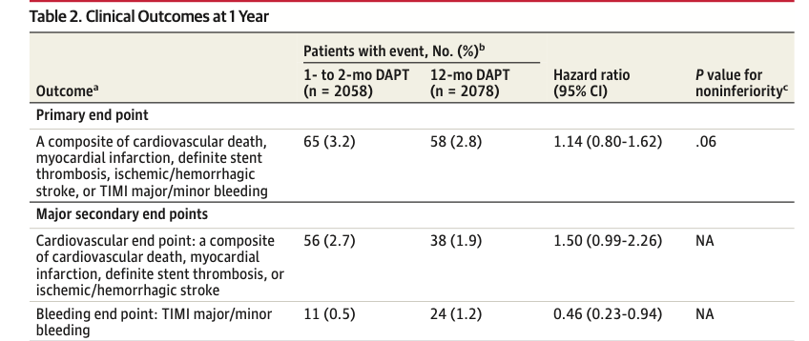
INTERPRETATION:
1-2 months of DAPT group did not meet criteria for non-inferiority compared with 12 months of DAPT for the primary end point.
Clopidogrel monotherapy after 1 to 2 months of DAPT → Associated with a reduction in major bleeding events and numerical increase in cardiovascular events

Slide 20
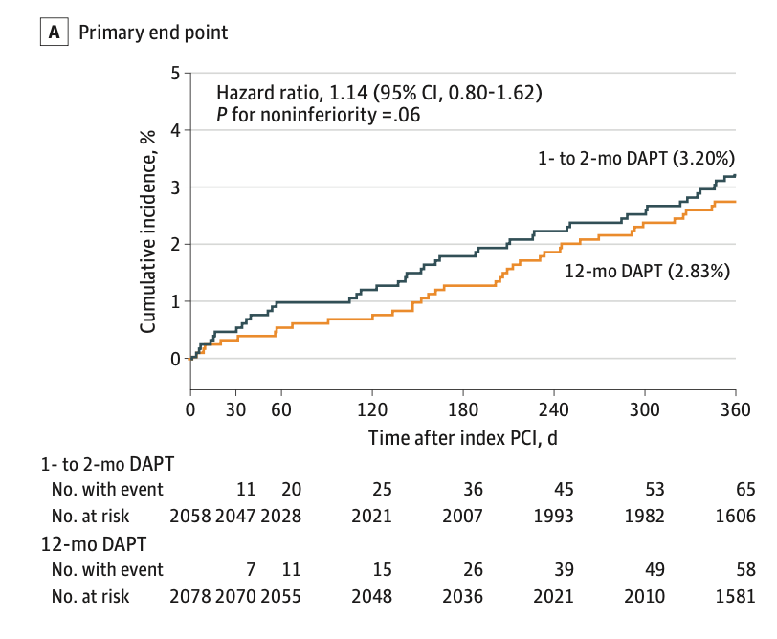
1-2 months of DAPT group did not meet criteria for noninferiority compared with 12 months of DAPT for the primary end point.
The present study would be inconclusive, given the failure of non-inferiority testing for the primary end point.

Slide 21
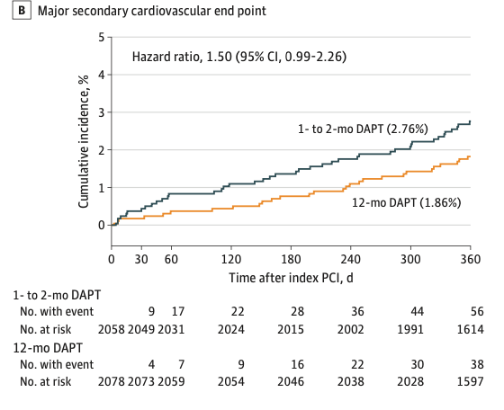
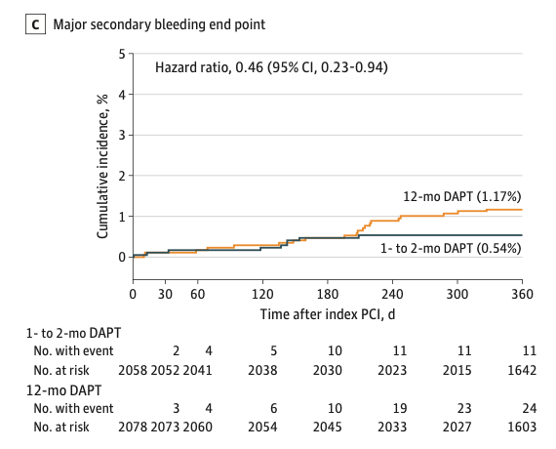
Clopidogrel monotherapy after 1 to 2 months of DAPT → Associated with a reduction in major bleeding events
Numerical increase in cardiovascular events

Slide 22
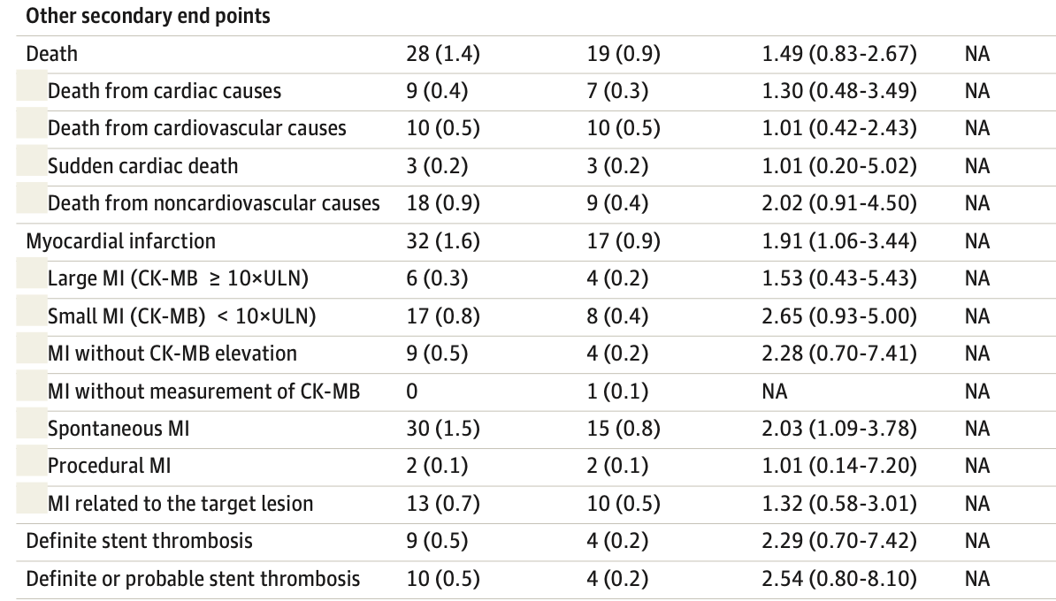

Slide 23
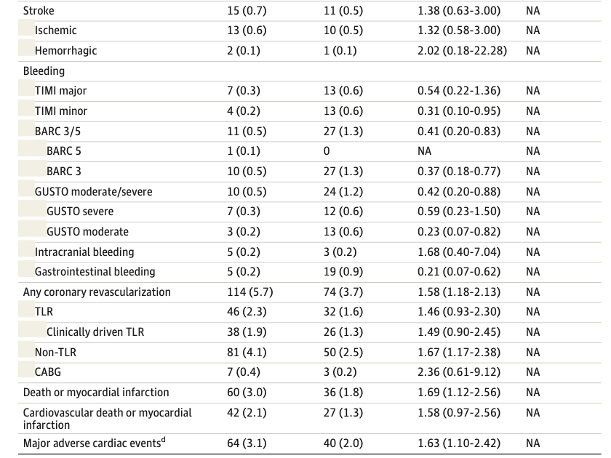

Slide 24
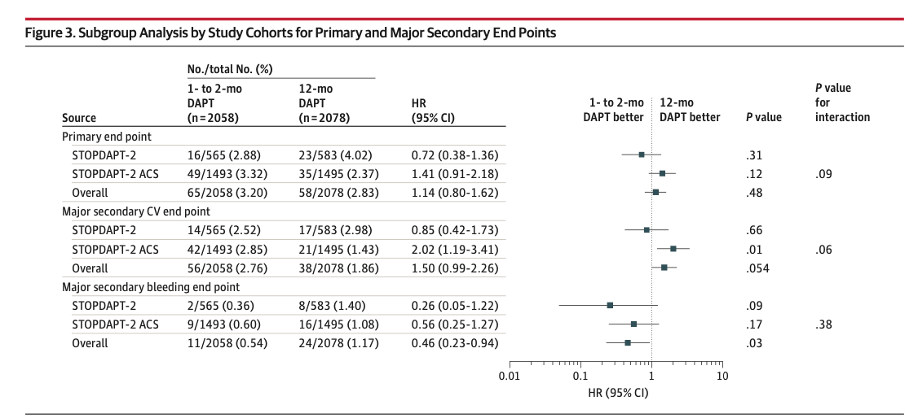

Slide 25
KEY POINTS
The standard regimen after PCI in patients with ACS →12 months of DAPT → Aspirin + Newer P2Y12 inhibitor (Ticagrelor or Prasugrel).
Thrombotic risk of patients with ACS is known to attenuate over time.
Prevalence of patients with high bleeding risk is much higher in real clinical practice than in clinical trials.
De-escalation of antithrombotic therapy + time-dependent attenuation of thrombotic risk → “might be” a reasonable approach in patients with ACS.

Slide 26
ARGUMENT:
  “We should be cautious in adopting clopidogrel monotherapy after 1 to 2 months of DAPT in patients with ACS, because → Its Associated with a numerical increase in cardiovascular events compared with 12 months of DAPT with aspirin and clopidogrel”.
  “Clopidogrel monotherapy after 1 to 2 months of DAPT remains a viable option even in patients with ACS, because → It was associated with significant reduction in major bleeding without meaningful difference in cardiovascular death, large myocardial infarction, and stroke compared with 12 months of DAPT with aspirin and clopidogrel”.

Slide 27
DISCUSSION: WHICH IS BETTER?
Clopidogrel monotherapy → might NOT be the optimal antithrombotic regimen after very short DAPT in patients with ACS who underwent successful PCI.
Several previous studies suggested that Aspirin monotherapy as safe and effective after a 3-month course of DAPT in patients with ACS or CCS.
Which anti-platelet agent is optimal for monotherapy after very short DAPT?
  NOT KNOWN
Further studies are warranted to define the optimal antithrombotic regimen after PCI in patients with ACS.

Slide 28
CONCLUSION
In patients with ACS who underwent successful PCI using CoCr-EES (Cobalt-Chromium Everolimus - Eluting Stent), clopidogrel monotherapy after 1 to 2 months of DAPT failed to attest noninferiority to 12 months of DAPT with aspirin and clopidogrel for the net clinical benefit with a numerical increase in cardiovascular events despite reduction in major bleeding events.
The directionally different efficacy and safety outcomes indicate the need for further clinical trials.

Slide 29
STRENGTH
RCT
Trial was performed at 74 centres across Japan
Follow up rate was 99.3%→ high follow up rate
Study-group assignments were blinded, ( Statistician, Members of the independent clinical event committee, Steering committee, Sponsor (Abbott medical ®)
Net clinical benefit might be a clinically relevant measure for comparing a given antithrombotic regimen with another.
Scope for further research

Slide 30
LIMITATIONS
Pooled the study patients from the 2 different trials (STOPDAPT-2 and STOPDAPT-2 ACS)→ might have confound the interpretation of data.
Validity of evaluating net clinical benefit has not yet been established→ Given intervention affects the components of the primary end point in opposite directions.
Incidence of the primary end point in the 12-month DAPT group was remarkably lower than anticipated → Underpowered study.

Slide 31
LIMITATIONS
Open-label trial design might have resulted in the differences in the ascertainment of outcomes.
Randomization was not performed at initial1 to 2 months
1- to 2-month DAPT group, aspirin was discontinued not exactly at 1 month, but at 30 to 59 days after index PCI.
Influence of clopidogrel resistance owing to CYP2C19 variations on clinical outcomes→ prevalence of clopidogrel resistance is high in Japanese patients

Slide 32
CRITICAL APPRAISAL
TITLE
  Is it interesting?: YES
ABSTRACT
  Will the conclusions likely to be useful to you, in your area of clinical practice or research? YES
  Whether the settings in the material methods are similar to your own settings? YES

Slide 33
REFERENCE QUESTION
Is there a clear cut / specific research question? YES
Was it feasible for the authors to study this question given there with the technical expertise and available facilities? YES
Does the research question has some element of novelty? YES

Slide 34
VALIDITY
Have the authors made a mention of actual / study population? YES
Is the method of sampling been described? YES
Whether a mention of all the potential confounding factors been made? YES
Any selection or information bias could have been occurred? UNLIKELY

Slide 35


GATE Framework Assessment: PECOT
PARTICIPANTS : 4136
P
1-2 month DAPT : 2058
12 MONTH DAPT: 2078
E
C
CARDIOVASCULAR OUTCOMES
BLEEDING OUT COMES
DURATION : 25 DEC 15 TO 08 JUN 2020
O
T

Slide 36
ASSESSING VALIDITY

Slide 37
THE RAMMBO ACRONYM : ASSESSING STUDY BIAS
P
E
C
O
T
P
Recruitment
Allocation
Maintenance
Measurement of outcome
Blind or Objective
E
C
O
T

Slide 38
RAMMBO : RECRUITMENT
Study setting & eligibility criteria well described ? YES
Participants representative of eligible ? YES
Prognostic/risk profile appropriate to study question? YES
Randomization process described adequately? YES

Slide 39
RAMMbo: “A”: ALLOCATION
4136
1:1 ratio for baseline randomization
Randomization
1-2 month DAPT : 2058
12 MONTH DAPT: 2078
O

Slide 40
RAMMBO- MAINTENANCE
Good Maintenance ? YES
Did most participants remain in allocated groups ? YES
Participants &/or investigators blind to exposure (and comparison exposure)? NO
Compliance high & similar in EG &CG? YES
Completeness of follow-up high & similar in EG &CG? YES
O

Slide 41
RAMMbo
P
Measurement of outcomes
blind or objective? BLIND (Adjudicators)
EG CG
Authors reviewed all results: YES
O
T

Slide 42
Recruitment
Bias: NO
P
Allocation : Adequate
E C
Maintenance: High Retention
O
Measurement : Right Statistical tools (of outcomes)
T

