Slide 1
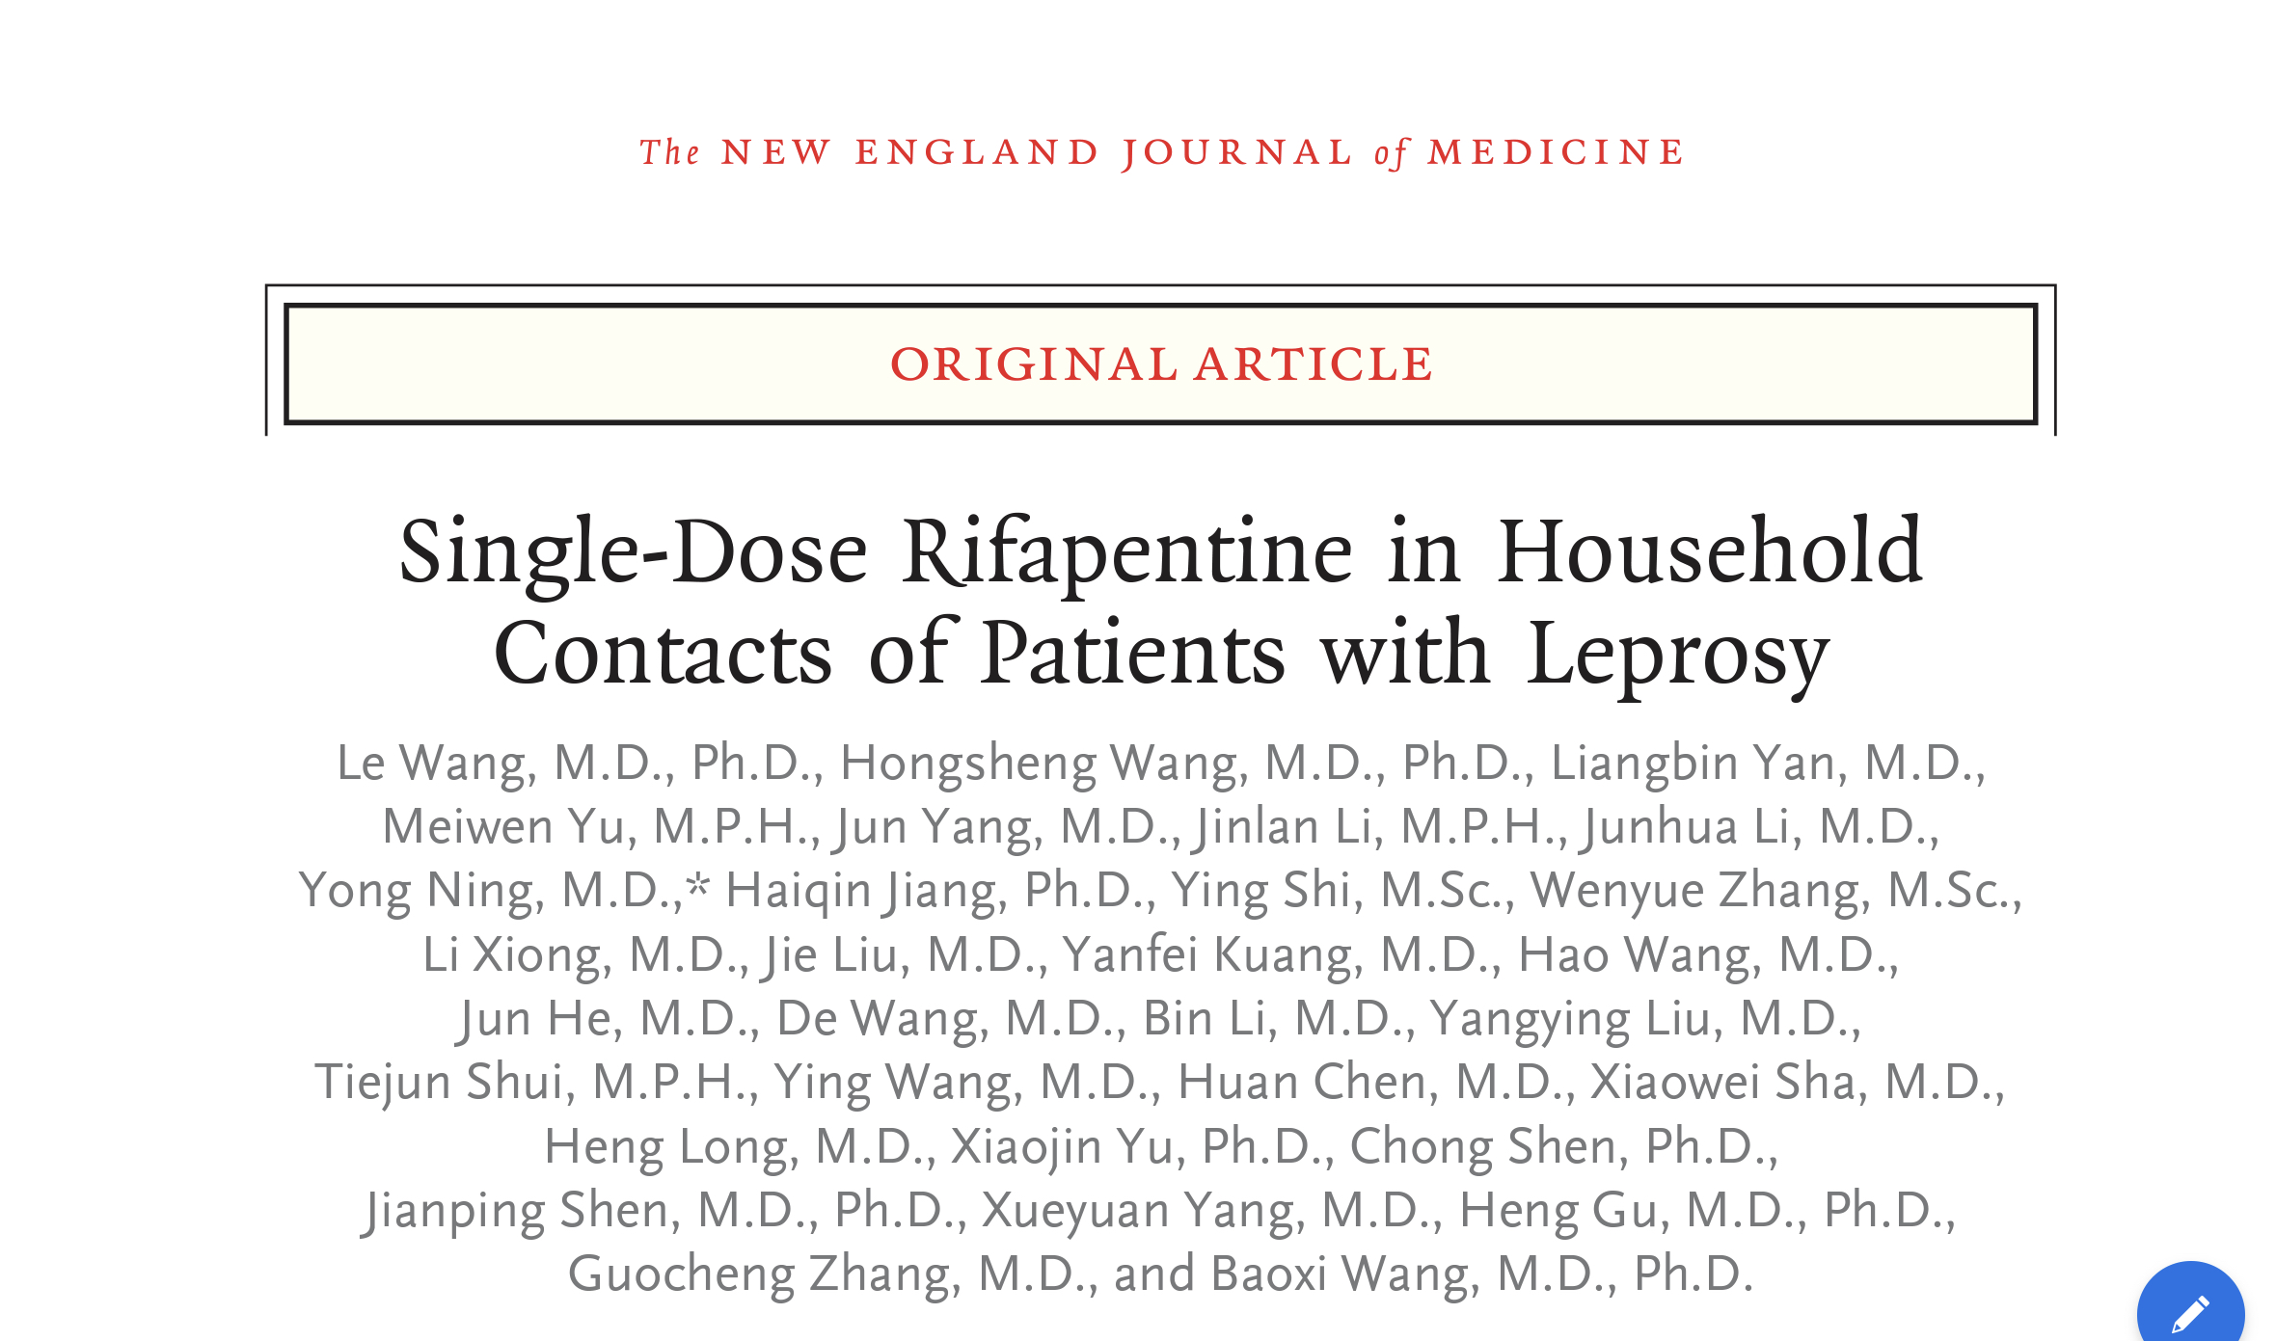
JOURNAL CLUB
PRESENTER:
SQN LDR K RAJESH KUMAR
MODERATOR:
WG CDR ROHIT VASHISHT

Slide 2
AIM
To investigate whether single-dose Rifapentine is effective in preventing leprosy in household contacts of patients with leprosy.

Slide 3
METHODOLOGY
Cluster-Randomized, Controlled trial
Clusters from 4 provinces of China - Yunnan, Guizhou, Sichuan and Hunan)
Written Informed Consent
Sep 2015
July 2018
July 2022

Slide 4
INTERVENTION AND FOLLOW UP
A household contact –
Person living in the same house
cumulative total of at least 6 months
within the period from 6 years before diagnosis
1 month after initiation of MDT
The single oral dose of rifapentine or rifampin - 600 mg (> 15 yrs)
-450 mg (10 to 14 yrs)
Visit 2 - 2 weeks after visit 1
- Safety evaluation

Slide 5
INTERVENTION AND FOLLOW UP
Follow-up was - annually
-visit 3 after the first year
- visit 4 after the second year
- visit 5 after the third year
-visit 6 after the fourth year
Skin examination - Performed at every visit

Slide 6
OUTCOMES
Primary Outcome :
Cumulative incidence of leprosy among household contacts over the 4-year follow-up period

Slide 7
OUTCOMES
Secondary Outcomes :
Cumulative incidence of leprosy among household contacts over the 2-year follow-up period
Safety measures at visit 2
Cumulative incidence of leprosy among household contacts over the 4-year follow-up period in a subgroup analysis.

Slide 8
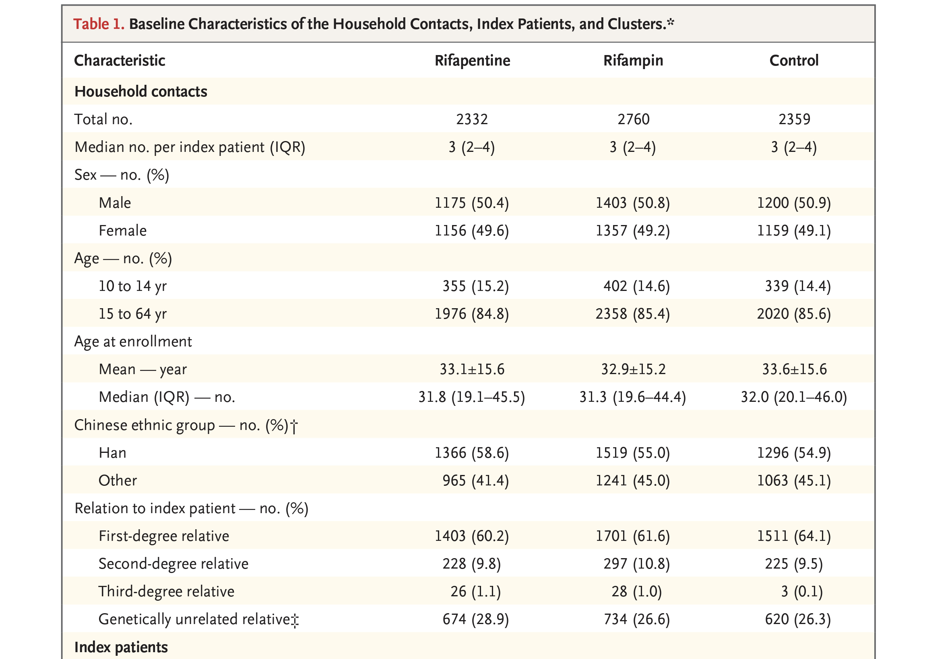
PATIENT CHARACTERSTICS

Slide 9
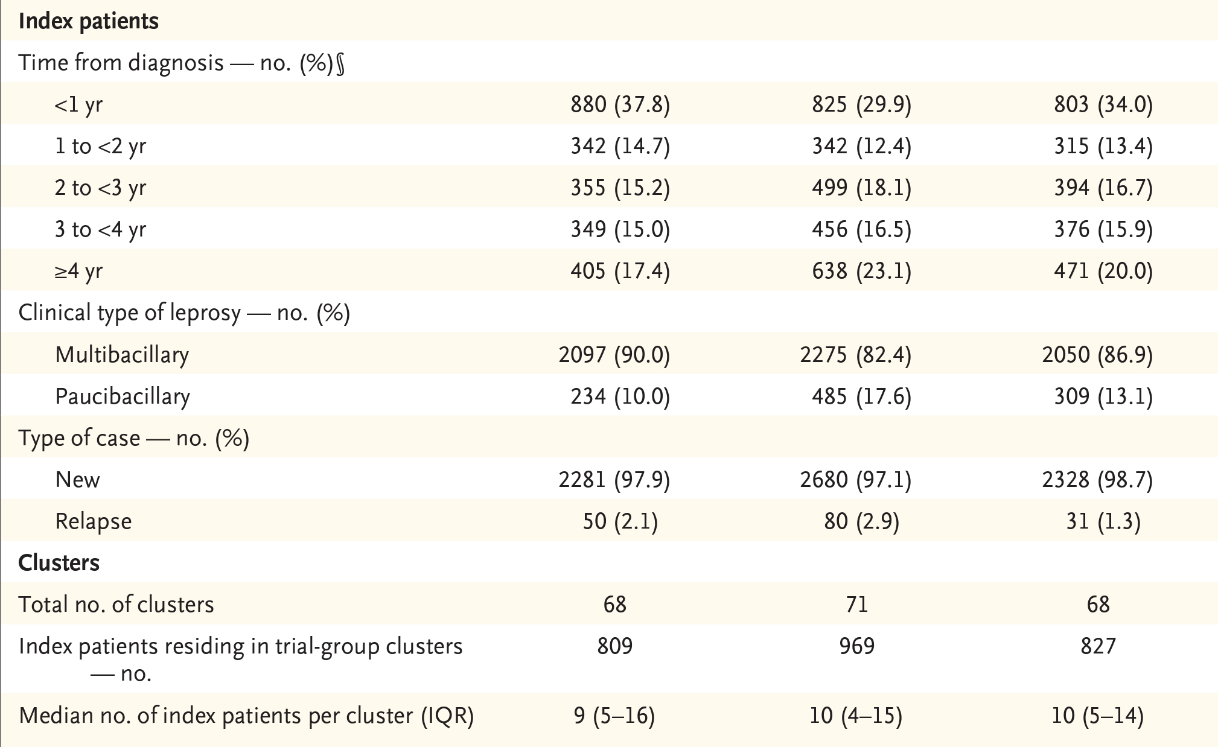
PATIENT CHARACTERSTICS

Slide 10
TRIAL CONDUCT

Slide 11
TRIAL CONDUCT

Slide 12
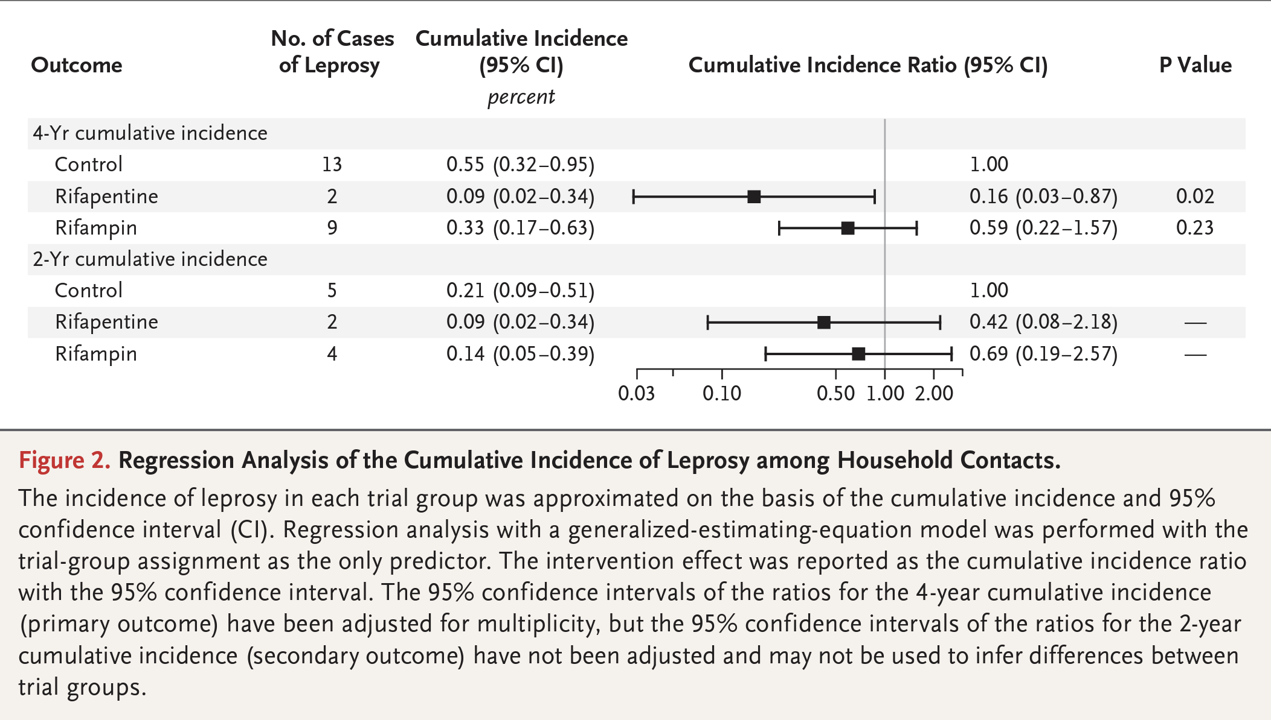
OUTCOME

Slide 13
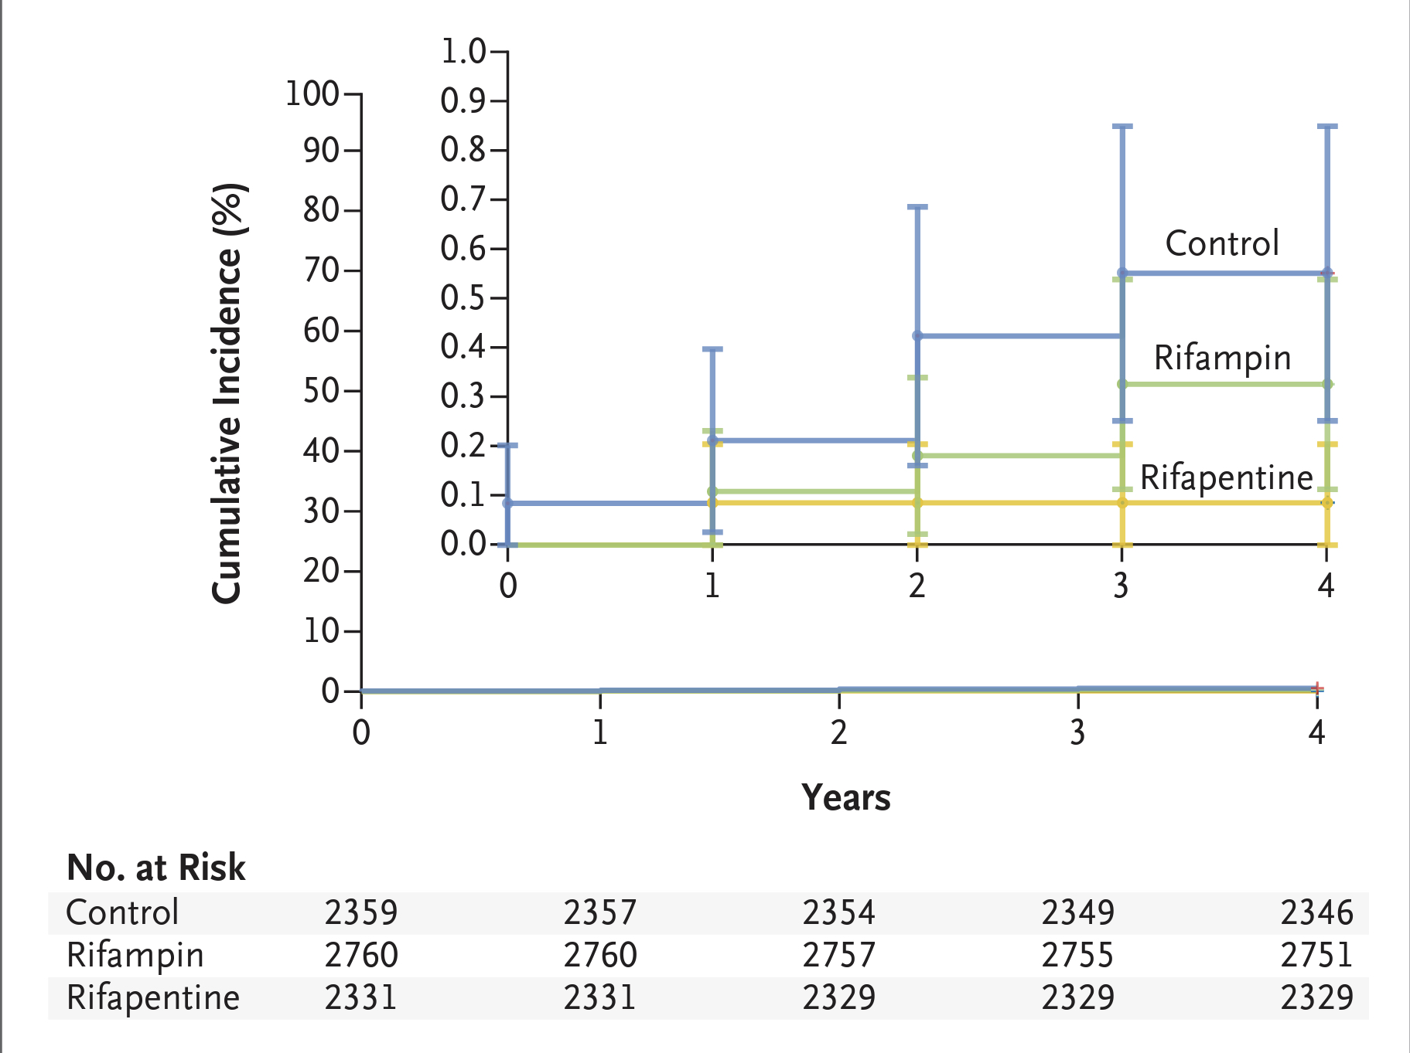
OUTCOME

Slide 14
CRITICAL APPRAISAL
TITLE
Is it interesting? YES
ABSTRACT
Will the conclusions (if valid), likely to be useful to you, in your area of clinical practice or research? YES
Whether the settings in the material methods are similar to our own settings? YES

Slide 15
REFERENCE QUESTION
Is there a clear cut / specific research question? YES
Was it feasible for the authors to study this question given there technical expertise and available facilities? YES
Does the research question has some element of novelty? YES

Slide 16
VALIDITY
Have the authors made a mention of Actual / Study Population ? YES
Is the method of sampling been described? YES
Whether a mention of all the potential confounding factors been made? YES
Any selection or information bias could have occurred? YES

Slide 17
GATE Framework Assessment : PECOT
PARTICIPANTS: 7450
P
Rifapentine group: 2331
Rifampin group : 2760
Control group : 2359
OUTCOME:
Incidence of leprosy
DURATION : 4 years
O
T

Slide 18
RAMMbo : Recruitment
Study setting & eligibility criteria well described ? YES
Participants representative of eligible ? YES
Prognostic/risk profile appropriate to study question? YES
Randomization process described adequately? YES

Slide 19
RAMMbo: Allocation
7450
1:1:1 ratio randomization
Randomization
Rifapentine group: 2331
Rifampin group : 2760
Control group : 2359
OUTCOME:
Incidence of leprosy
DURATION : 4 years
O

Slide 20
RAMMbo: Maintenance
Good Maintenance ?
Did most participants remain in allocated groups ? YES
Compliance high & similar in EG &CG? SIMILAR
Completeness of follow-up high & similar in EG &CG? SIMILAR
O

Slide 21
RAMMbo: Measurement
P
Measurement of outcomes
blind or objective?
EG CG
Outcome assessments were OBJECTIVE
Authors reviewed all results YES
O
T

Slide 22
CONCLUSION
The incidence of leprosy among household contacts over 4 years was lower with single-dose Rifapentine than with no intervention.

