Slide 1
JOURNAL CLUB
PRESENTED BY MODERATOR
DR LAKSHMI MOHAN WG CDR ROHIT VASHISHT

Slide 2
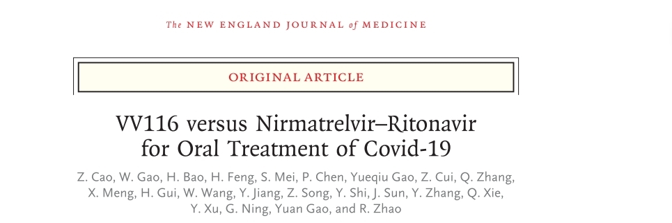

Slide 3
INTRODUCTION
VV116
Dueterated remdesivir analogue
Acts as viral RNA dependent RNA polymerase inhibitor
Nirmatrelvir/Ritonavir
Inhibitor of SARS-CoV-2 main protease
Ritonavir slows nirmatrelvir metabolism by inhibition of CYP3A4
Combination provides higher systemic exposure.

Slide 4
BACKGROUND
Nirmatrelvir-ritonavir – authorised for emergency use by WHO for the treatment of covid-19 infection
Supply fell short of the global demand – need for more options → VV116 was introduced

Slide 5
METHODS
Multicenter, phase 3, non inferiority, observer blinded, randomized trial during omicron outbreak
STUDY POPULATION
Participants from seven hospitals in Shanghai, China
STUDY PERIOD
April 4, 2022 – May 2, 2022

Slide 6
Inclusion Criteria
-->Age > 18
-->Positive SARS CoV 2 RTPCR with symptom score > 2
-->One risk factor for progression to severe covid 19

Slide 7
Exclusion Criteria
-->Confirmed or suspected severe or critical covid 19
-->Anticipated need for mechanical ventilation before randomization
-->AST,ALT level more than 1.5 times the upper limit
-->eGFR less than 60ml

Slide 8
OBJECTIVES AND ENDPOINTS
PRIMARY OBJECTIVE
Evaluate the effect of VV116 compared to Nirmatrelvir-ritonavir on sustained clinical recovery
PRIMARY ENDPOINT
Time to sustained clinical recovery

Slide 9
SECONDARY OBJECTIVES | SECONDARY ENDPOINTS
Overall clinical status | Percentage of the participants who experience progress to severe/critical covid 19 or death from any cause through day 28
Changes of Covid 19 clinical status through Day 28 | Time to clinical symptom resolution Percentage of participants with clinical recovery with symptom absent Change of covid 19 symptom score from baseline Change of WHO clinical progress scale from baseline Percentage of participants who reduced at least one level of WHO CPS compared with baseline
Changes in SARS-CoV 2 through Day 14 | Percentage of participants with SARS CoV 2 clearance Changes in SARS – CoV 2 CT value
Changes in chest CT scan through Day 10 (optional) | Changes in Chest CT scan from baseline to Day 7 or 10
Safety | Safety assessments such as Aes and SAEs through Day 28

Slide 10
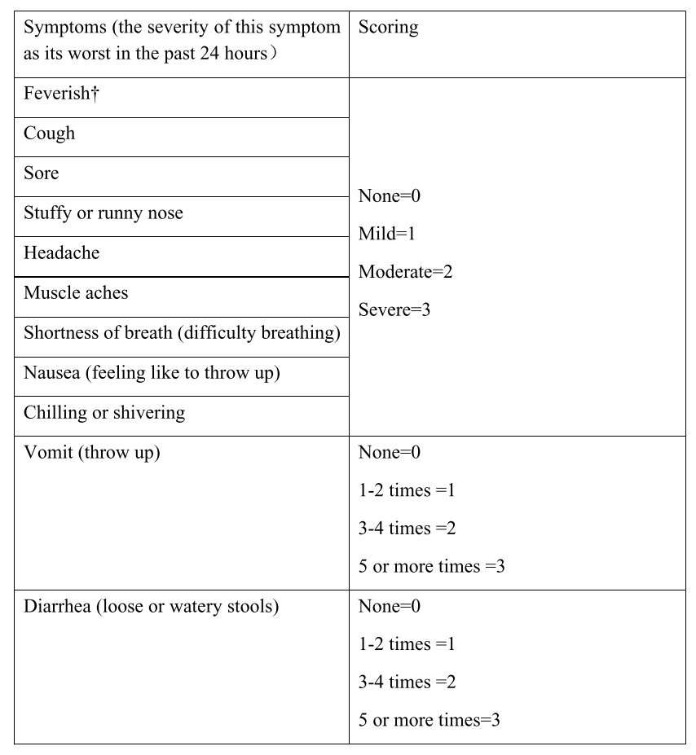


Slide 11
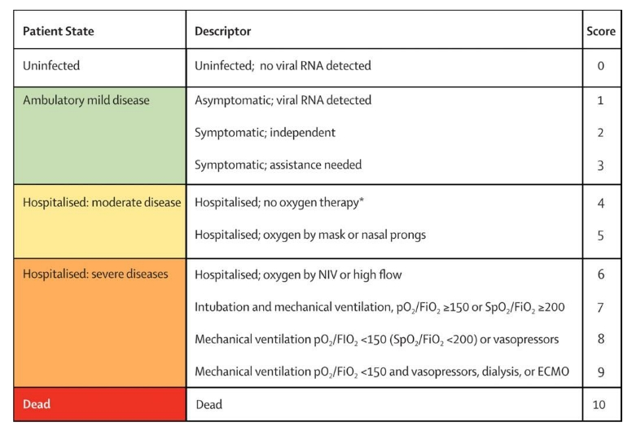
WHO CLINICAL PROGRESSION SCALE

Slide 12
SUSTAINED CLINICAL RECOVERY
Defined as the score of covid 19 related target symptoms ≤ 1 for 2 consecutive days
TIME TO SUSTAINED CLINICAL RECOVERY
Number of days from the first dose after randomisation to the first day when the score of all covid 19 related target symptoms ≤ 1 for 2 consecutive days

Slide 13
SUSTAINED SYMPTOM RESOLUTION
Defined as the score of covid 19 related target symptoms =0 for 2 consecutive days
TIME TO SUSTAINED SYMPTOM RESOLUTION
Number of days from the first dose after randomisation to the first day when the score of all covid 19 related target symptoms =0 for 2 consecutive days

Slide 14
STATISTICAL ANALYSIS

Slide 15
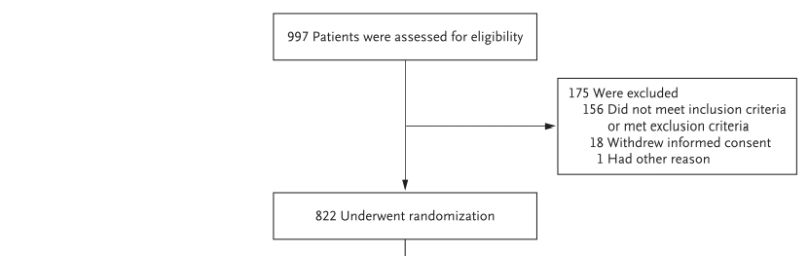
RANDOMIZATION

Slide 16
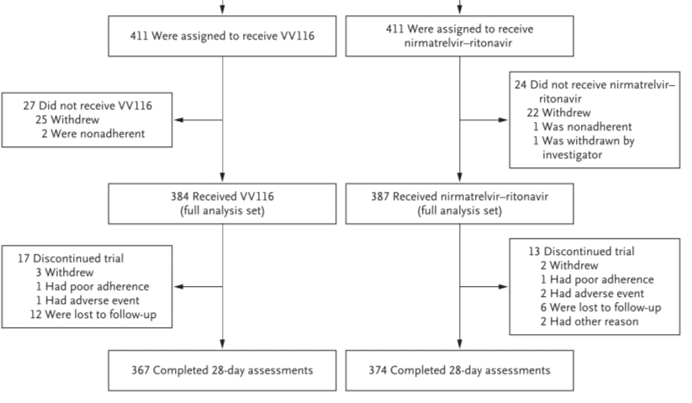

Slide 17
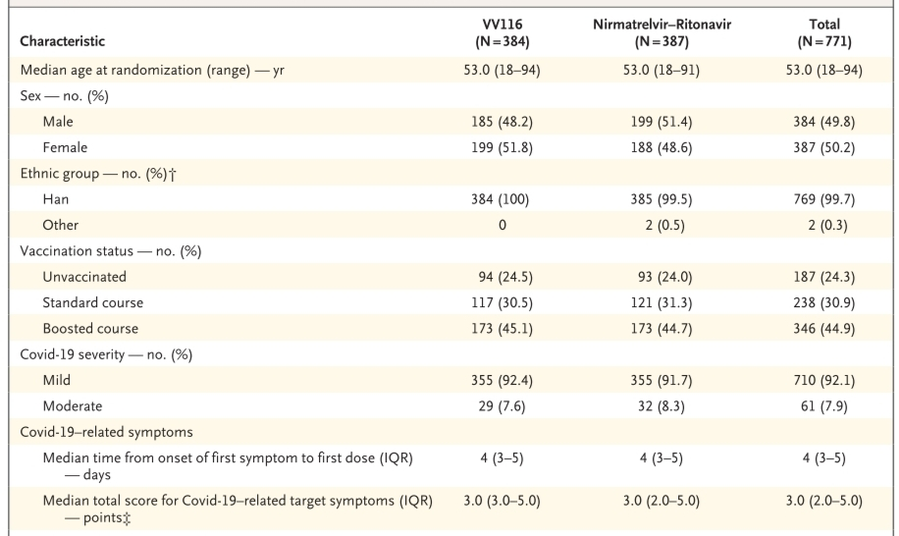
DEMOGRAPHIC AND CLINICAL CHARACTERISTICS

Slide 18
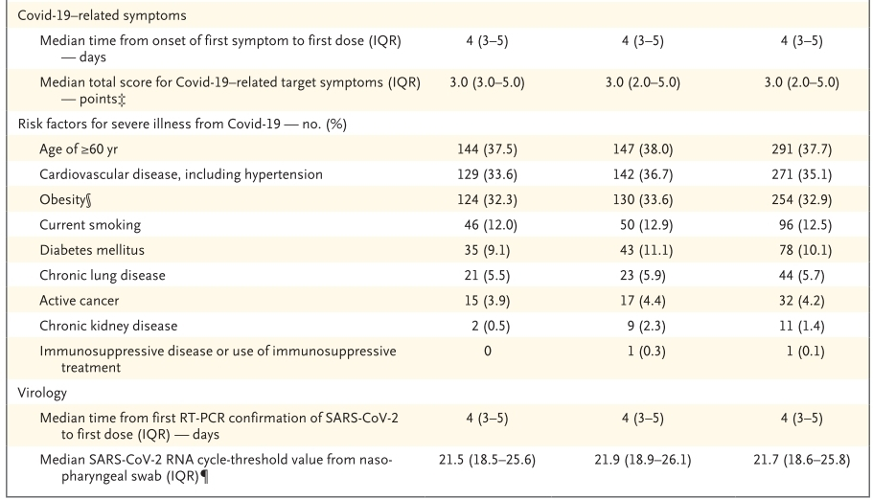

Slide 19
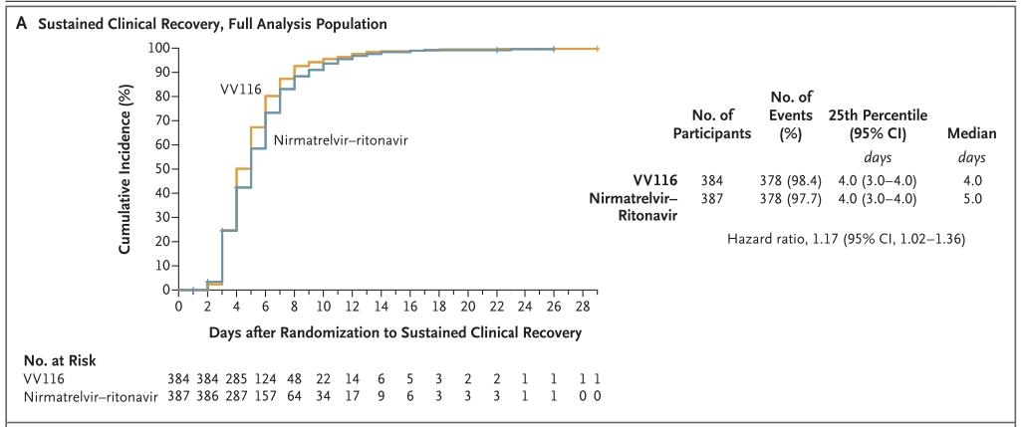

Slide 20
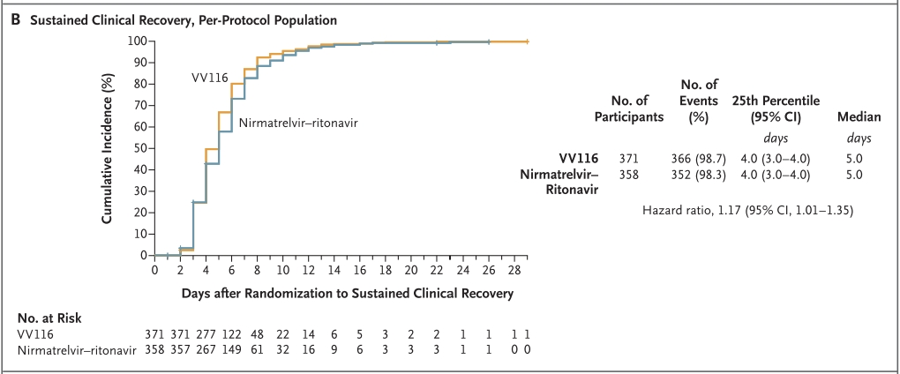

Slide 21
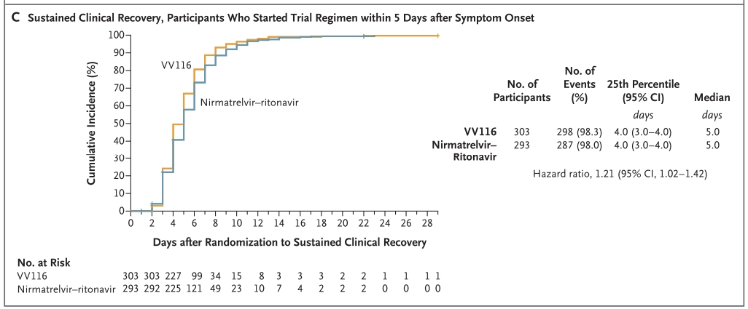

Slide 22
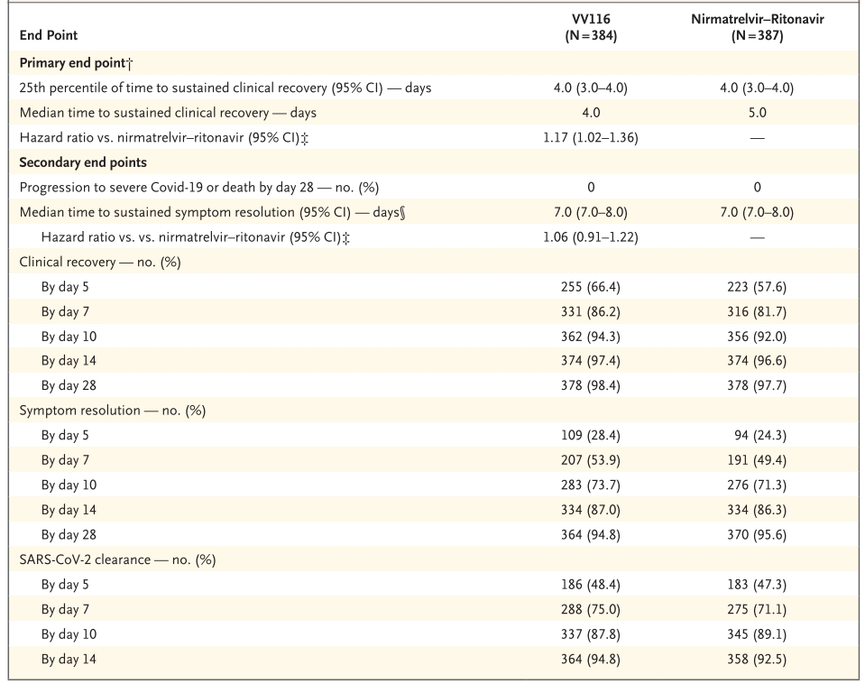
DISCUSSION

Slide 23
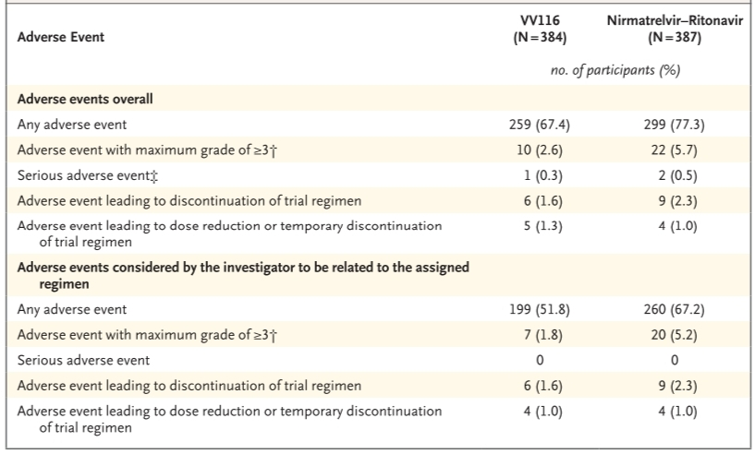
ADVERSE EVENTS

Slide 24
CRITICAL APPRAISAL
TITLE
Is it interesting? YES
ABSTRACT
Will the conclusions likely to be useful to you, in your area of clinical practice or research? YES
Whether the settings in the material methods are similar to your own settings? YES

Slide 25
REFERENCE QUESTION
Is there a clear cut / specific research question? YES
Was it feasible for the authors to study this question given there with the technical expertise and available facilities? YES
Does the research question has some element of novelty? YES

Slide 26
VALIDITY
Have the authors made a mention of actual / study population? YES
Is the method of sampling been described? YES
Whether a mention of all the potential confounding factors been made? YES
Any selection or information bias could have been occurred? Possible

Slide 27


GATE Framework Assessment: PECOT
P
PARTICIPANTS : 822
VV116 : 384
E
C
Nirmatrelvir-ritonavir : 387
SUSTAINED CLINICAL RECOVERY
O
T
DURATION : 4 APR 2022 – 2 MAY 2022

Slide 28
ASSESSING VALIDITY

Slide 29
The RAMMbo acronym : Assessing study bias
P
E
C
O
T
P
Recruitment
Allocation
Maintenance
Measurement of outcome
Blind or Objective
E
C
O
T

Slide 30
RAMMbo : Recruitment
Study setting & eligibility criteria well described ? YES
Participants representative of eligible ? YES
Prognostic/risk profile appropriate to study question? YES
Randomization process described adequately? YES

Slide 31
RAMMbo: A is for Allocation
822
1:1 ratio for baseline randomization
Randomization
VV116- 384 Nirmatrelvir- ritonavir - 387
O

Slide 32
RAMMbo
Good Maintenance ?
Did most participants remain in allocated groups ? YES
Participants &/or investigators blind to exposure (and comparison exposure)? NO
Compliance high & similar in EG &CG? YES
Completeness of follow-up high & similar in EG &CG? YES
O

Slide 33
RAMMbo
P
Measurement of outcomes
blind or objective?
EG CG
Outcome measurements were BLIND
Authors reviewed all results YES
O
T

Slide 34
Recruitment
Bias: No bias
P
Allocation : Adequate
E C
Maintenance: High Retention
O
Measurement : Right Statistical tools (of outcomes)
T

Slide 35
STRENGTH
Head to head clinical trial

Slide 36
LIMITATIONS
Not studied in heterogenous populations
Possibility of symptom recurrence after 2 consecutive days without symptoms
No conclusions can be made about the efficacy of VV116 for the prevention of progression to severe or critical covid 19 or death , because no events occurred in either group

Slide 37
CONCLUSION
Among adults with mild to moderate Covid 19 who were at risk of progression, VV116 was non inferior to nirmatrelvir-ritonavir with respect to the time to sustained clinical recovery, with fewer safety concerns

Slide 38
THANK YOU

