Slide 1
JOURNAL CLUB
Rituximab versus azathioprine for maintenance of remission for patients with ANCA- Associated vasculitis and relapsing disease: an international RCT- RITAZAREM Trial
Presenter- Maj Abhishek Aravind
Moderator- Col P S CHAUHAN

Slide 2
How this study might affect research, practice or policy?
Illustrates the need for newer therapeutic agents in AAV

Slide 3
Aim
To assess whether fixed interval dose of Rituximab was superior to azathioprine for the maintenance of remission following induction of remission with Rituximab and glucocorticoids in patients with relapsing AAV

Slide 4
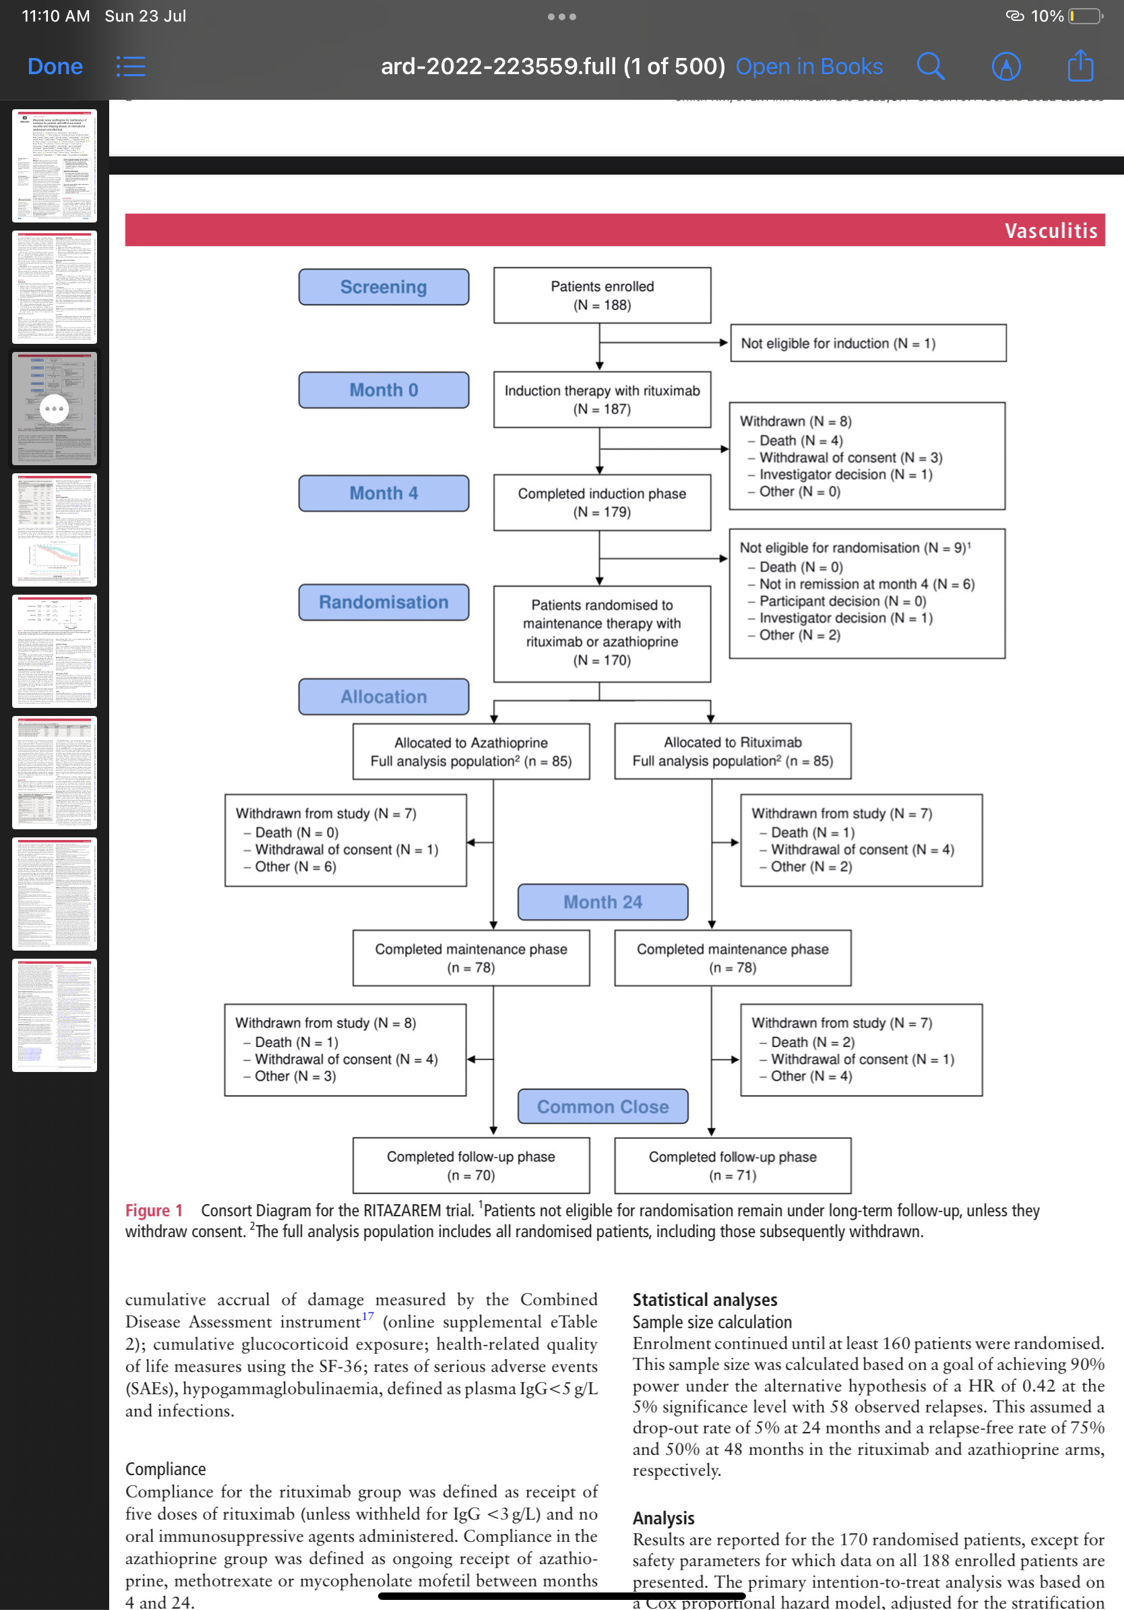
Methods

Slide 5
Methods

Slide 6
Patient eligibility criteria
  Patient age >15 years
  Diagnosis of GPA/ MPA according to Chapel Hill Consensus conference 2012 definitions
  Current or prior positive test for PR3 or MPO- ANCA
  Achieved relapse defined by 01 major or 03 minor items of disease activity on the BVAS/ WG after inducing remission with a combination of Glucocorticoids and Rituximab

Slide 7
Exclusion criteria
  Receipt of B cell depleting agents within 06 months
  Receiving IVIG, anti TNF therapy or plasma exchange within 03 months
  Patients with other auto-immune multi-system disorder
  Malignancy within 05 years prior to study

Slide 8
Study design
  Open label unblinded study
  1:1 randomization
  Stratified based upon
    ANCA type
    Relapse type- severe and non severe
    Intensity of oral glucocorticoid regimen

Slide 9
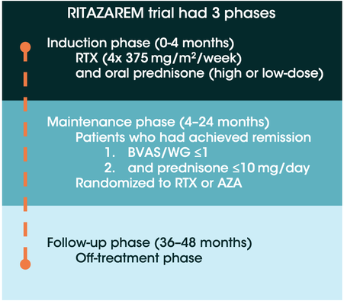
Study design

Slide 10
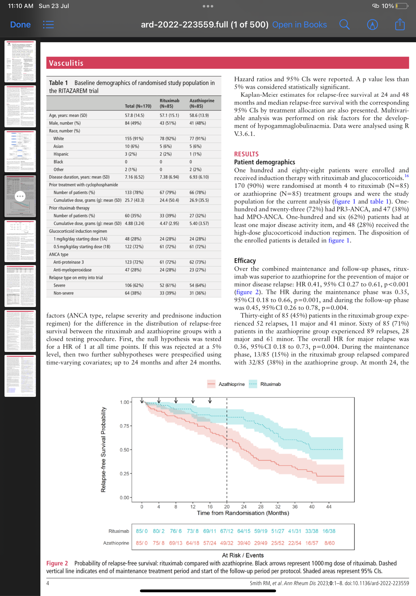
Baseline characteristics

Slide 11
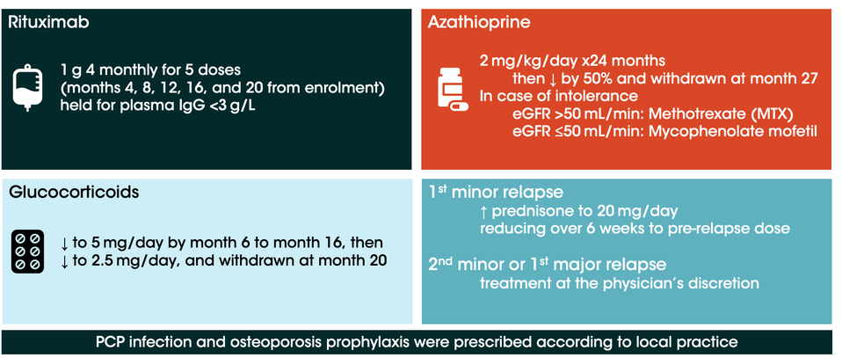
Maintenance phase and interventions

Slide 12
Maintenance phase
  Identified successful remission
    ≤1 on Birmingham Vasculitis Activity Score for Wegener’s granulomatosis (BVAS/WG)
    prednisone dose ≤10 mg/day
  Patients who achieved remission randomised to receive either rituximab or azathioprine
  Patients not in remission by month 4 were excluded.

Slide 13
Outcome measures
    Primary Outcome: Time to disease relapse (either minor or major based on BVAS/WG) reported by month 24
    Relapses were reviewed by a blinded adjudication committee
    Secondary Outcomes:
      Time to a major or second minor relapse
      Proportion of patients who maintained remission at 24 and 48 months
      Health-related quality of life, as measured using a 36-item short form health survey
      Severe adverse event rates and infections that required treatment with antibiotics

Slide 14
Funding
RITAZAREM was funded by grants from Arthritis Research UK and Roche/Genentech
The primary sponsor was Cambridge University Hospitals NHS Foundation Trust UK.

Slide 15
Result

Slide 16
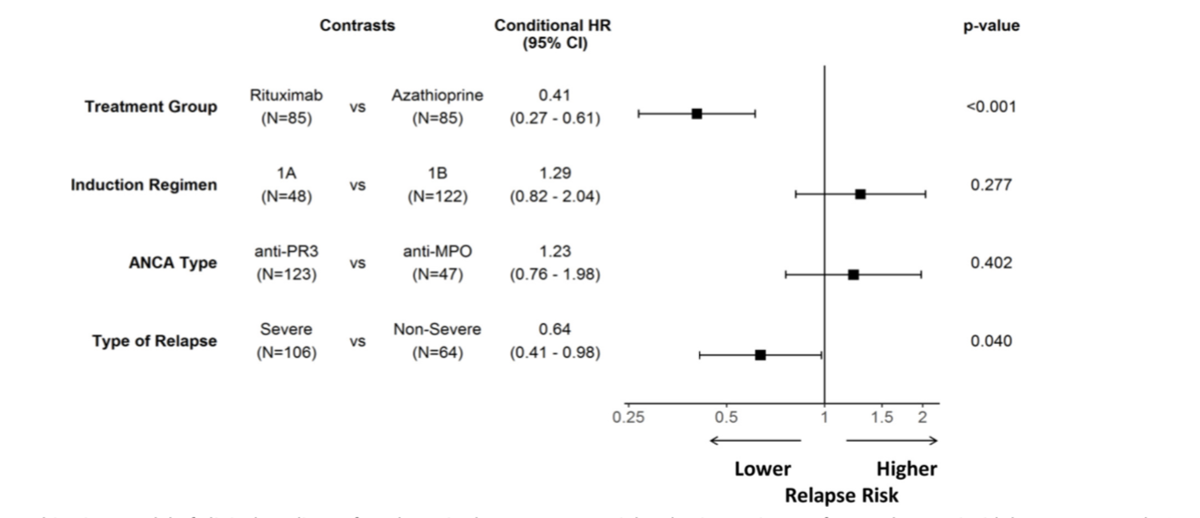
Statistical Analysis

Slide 17
CRITICAL APPRAISAL
TITLE
  Is it interesting? YES
ABSTRACT
  Will the conclusions (if valid), likely to be useful to you, in your area of clinical practice or research? YES
  Whether the settings in the material methods are similar to our own settings? YES

Slide 18
REFERENCE QUESTION
Is there a clear cut / specific research question? YES
Was it feasible for the authors to study this question given there technical expertise and available facilities? YES
Does the research question has some element of
novelty? No

Slide 19
VALIDITY
Have the authors made a mention of Actual / Study Population ? YES
Is the method of sampling been described? YES
Whether a mention of all the potential confounding factors been made? YES
Any selection or information bias could have occurred? Possible

Slide 20



GATE Framework Assessment : PECOT
PARTICIPANTS: 170
P
Azathioprine group- 85
Rituximab group- 85
OUTCOME: Development of relpase
O
DURATION : Nov 2016 to Nov 2019
T

Slide 21
The RAMMbo acronym : Assessing study bias
P
E
C
O
T
P
Recruitment
Allocation
Maintenance
Measurement of outcome
Blind or Objective
E
C
O

Slide 22
RAMMbo : Recruitment
Study setting & eligibility criteria well described ? YES
Participants representative of eligible ? YES
Prognostic/risk profile appropriate to study question? YES
Randomization process described adequately? YES

Slide 23
RAMMbo: A is for Allocation
170
E-85 C- 85
1:1 ratio for baseline randomization
O
T

Slide 24
RAMMbo: Maintenance
Good Maintenance ?
Did most participants remain in allocated groups ? Yes
Participants &/or investigators blind to exposure
(and comparison exposure)? No
Compliance high & similar in both group? Yes
Completeness of follow-up high & similar in both group?
Yes
O

Slide 25
RAMMbo: Measurement
EG CG
Outcome measurements were Objective
Authors reviewed all results
O

Slide 26
RAMMBO
Recruitment
Bias: No bias
P
Allocation : Adequate
E C
Maintenance: High Retention
Measurement : Right Statistical tools
(of outcomes)
O
T

Slide 27
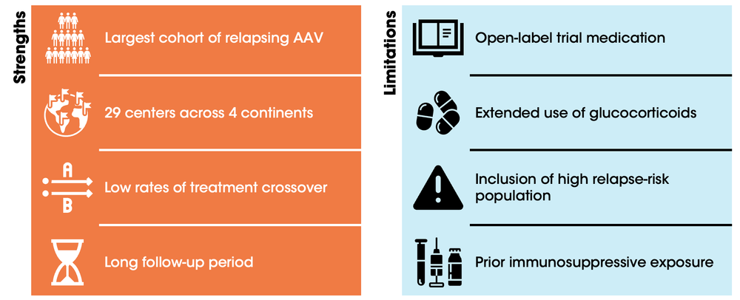
STRENGTHS v/s Limitations

Slide 28
CONCLUSION
  Rituximab is more effective than azathioprine in preventing relapse in AAV
  Lower glucocorticoid dosage to be ecncouraged as there is no change in rate of relapse
  Search for newer agents against AAV as current standard of treatment is associated with higher relapse rates

