Slide 1

JOURNAL CLUB
PRESENTER:
MAJ SHIVANK
RESIDENT
INTERNAL MEDICINE
AFMC
MODERATOR:
WG CDR ROHIT VASHISHT
ASSOS PROF & ID SPL
INTERNAL MEDICINE
AFMC

Slide 2
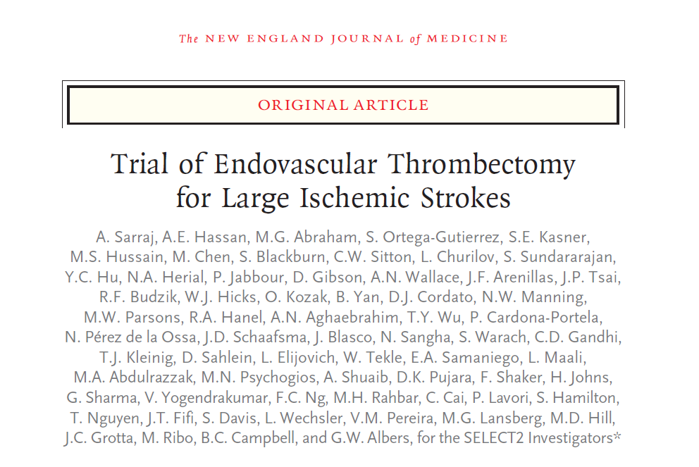

Slide 3
AIM
SELECT 2 TRIAL
Assess Endovascular Thrombectomy within first 24 hours
after onset involving patients with stroke due to
occlusion of ICA or M1 segment of MCA with large ischemic core

Slide 4
METHODOLOGY
Phase 3, Randomized, Open label clinical trial
31 sites across the United States, Canada, Europe, Australia, and New Zealand
Written Informed Consent
Data and Safety Monitoring Board
Sep 2019
Sep 2022
Funded by a grant from Stryker Neurovascular

Slide 5
METHODOLOGY
Inclusion Criteria:
Adults 18-85 years
CT-angiogram or MR-angiogram proven large artery occlusion in the distal ICA or MCA M1 locations
Large ischemic core on non-contrast CT (defined as an ASPECTS value of 3 to 5) or an estimated ischemic-core volume of 50 ml or greater on CT perfusion imaging
NIHSS ≥ 6
Last known well to groin puncture or medical management between 0 to 24 hours
Baseline modified Rankin Scale score of 0-1
Eligible for thrombectomy with stent retriever or medical management

Slide 6
METHODOLOGY
Exclusion Criteria:
Inability to undergo CT-Angiography and/or CT/MR Perfusion imaging
ASPECTS ≤ 2
Evidence of intracranial tumour (except small meningioma) acute intracranial haemorrhage, neoplasm, or arteriovenous malformation
Significant mass effect with midline shift
Evidence of internal carotid artery dissection that is flow limiting or aortic dissection
Intracranial stent implanted in the same vascular territory precludes the safe deployment/removal of the neuro thrombectomy device
Co-morbid psychiatric or medical illnesses that would confound the neurological assessments

Slide 7
INTERVENTION
Randomization in a 1:1 ratio to undergo endovascular thrombectomy and standard medical care or standard medical care alone
Endovascular thrombectomy was performed with stent retrievers, aspiration devices or both

Slide 8
OUTCOMES
Primary Outcome
Ordinal Score on the modified Rankin scale at 90 days

Slide 9
OUTCOMES
Secondary Outcomes
  Functional independence (a score on the modified Rankin scale of 0 to 2) at 90 days after randomization
  Independent ambulation (a score on the modified Rankin scale of 0 to 3) at 90 days after randomization
  Procedural complications
  Successful reperfusion (grade 2b to 3 on the modified Treatment in Cerebral Ischemia Scale)
  Early neurologic improvement (reduction of ≥8 points in the NIHSS score from baseline to 24 hours after presentation or a score of 0 to 1)
  Quality of life as assessed with the use of domain-specific Neuro-QoL measures

Slide 10
TRIAL DESIGN
Initial trial design: Intended sample of 560 patients
Two prespecified interim analysis at 200 and 380
However, prespecified efficacy boundary crossed in favor of endovascular thrombectomy
Enrollment stopped prematurely

Slide 11
TRIAL CONDUCT
Clinical assessment: Baseline, 24 hrs, 5-7 days, 30 days and 90 days → by trained certified assessors
mRS: in-person visits or telephonic interviews
Automated processing of imaging with RAPID software→ reviewed by Central Imaging Core laboratory

Slide 12
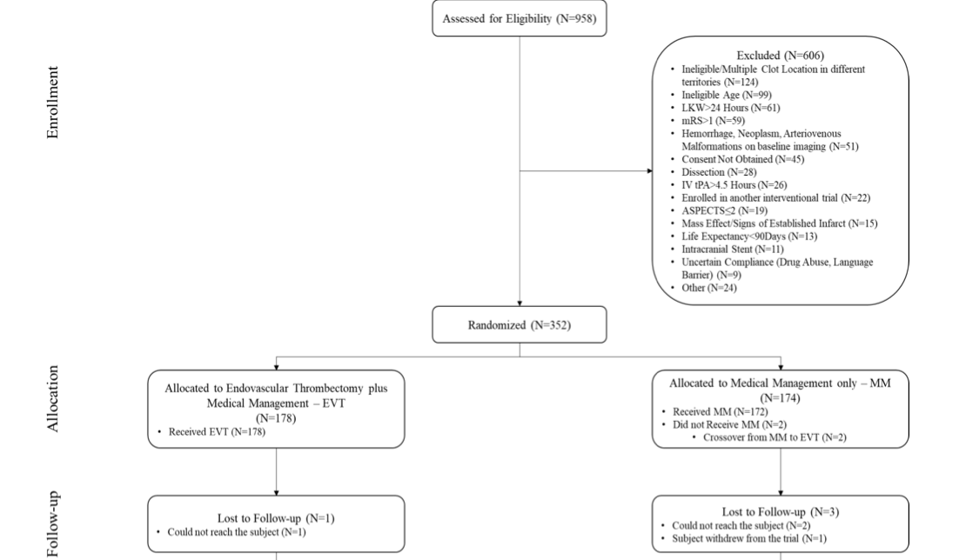
STATISTICAL ANALYSIS

Slide 13
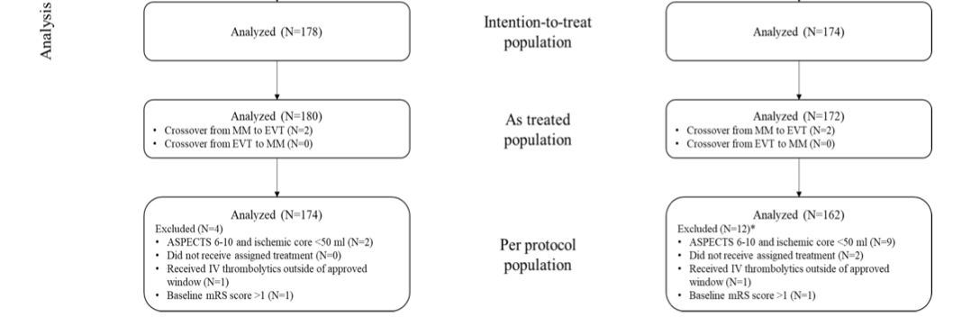
STATISTICAL ANALYSIS

Slide 14
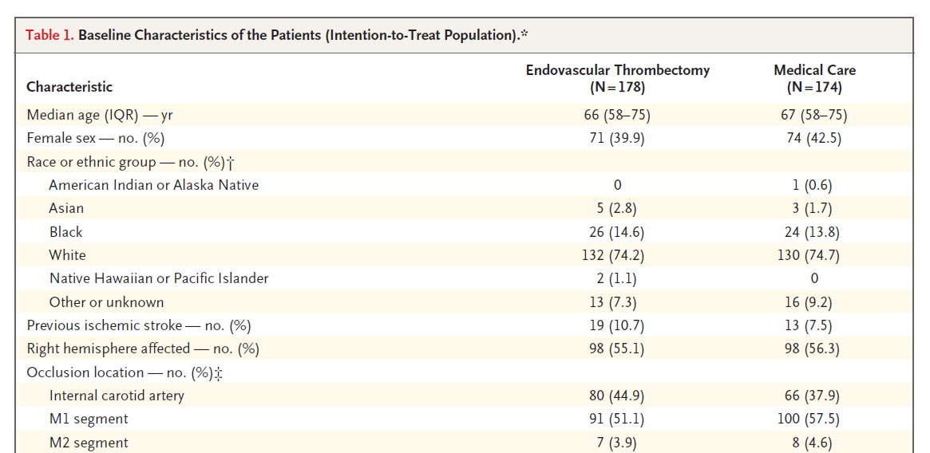
PATIENT CHARACTERSTICS

Slide 15
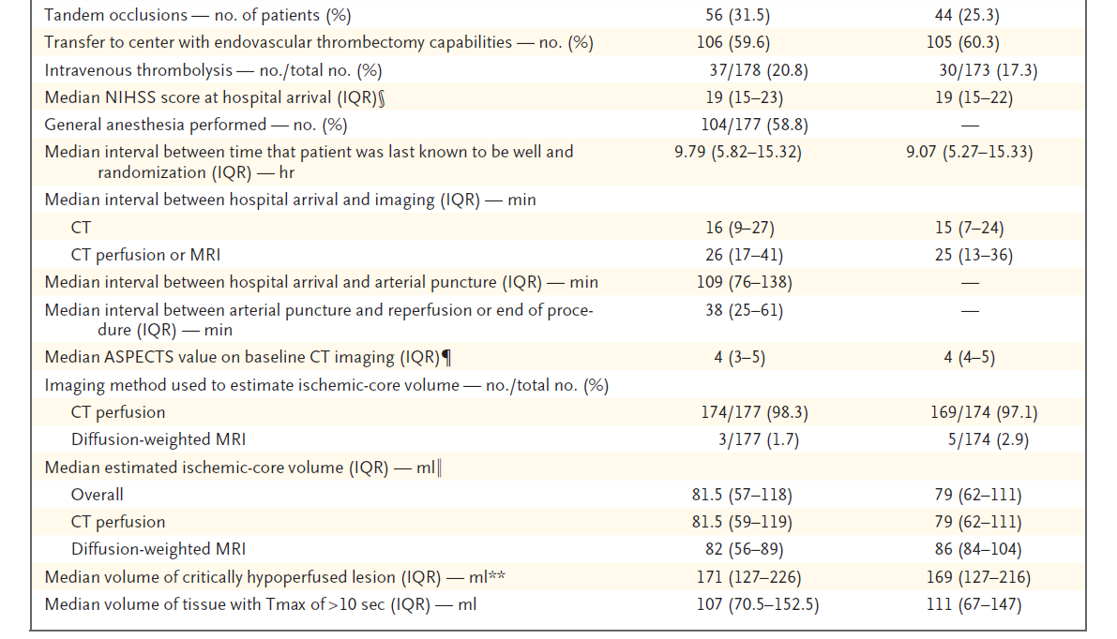
PATIENT CHARACTERSTICS

Slide 16
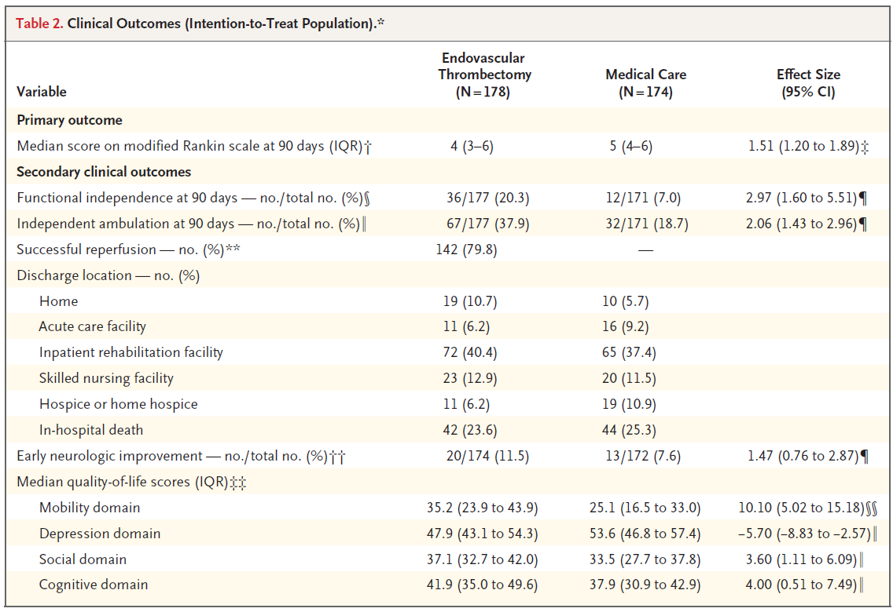
OUTCOME

Slide 17
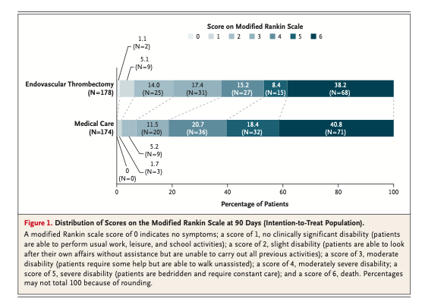
OUTCOME

Slide 18
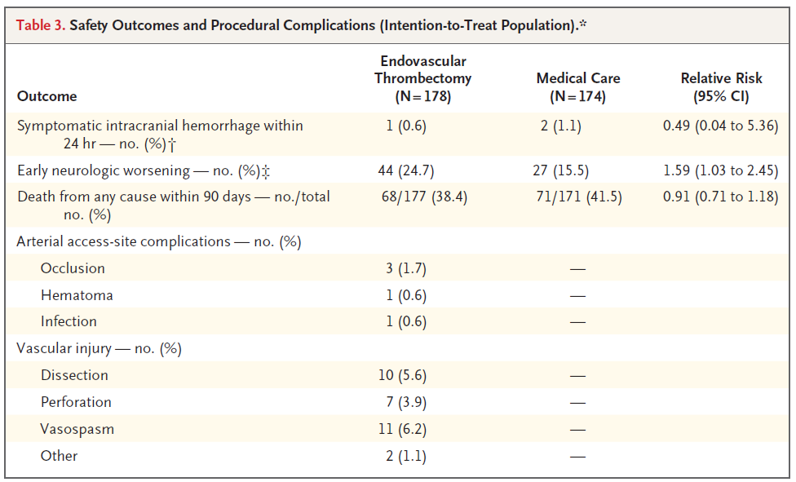
SAFETY

Slide 19
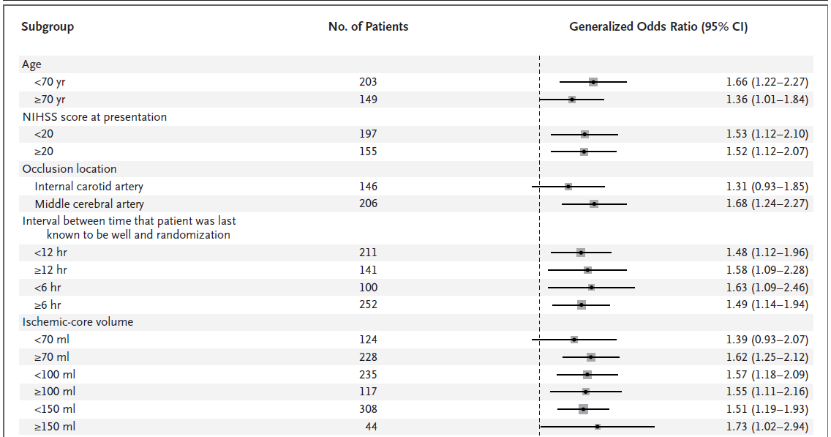
SUBGROUP ANALYSIS

Slide 20
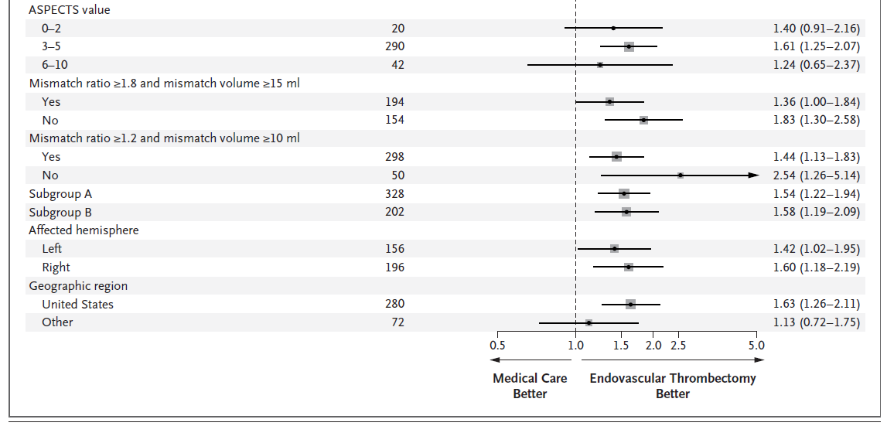
SUBGROUP ANALYSIS

Slide 21
CRITICAL APPRAISAL
TITLE
  Is it interesting? YES
ABSTRACT
  Will the conclusions (if valid), likely to be useful to you, in your area of clinical practice or research? YES
  Whether the settings in the material methods are similar to our own settings? NO

Slide 22
REFERENCE QUESTION
Is there a clear cut / specific research question? YES
Was it feasible for the authors to study this question given there technical expertise and available facilities? YES
Does the research question has some element of novelty? NO

Slide 23
VALIDITY
Have the authors made a mention of Actual / Study Population ? YES
Is the method of sampling been described? YES
Whether a mention of all the potential confounding factors been made? YES
Any selection or information bias could have occurred? YES

Slide 24



GATE Framework Assessment : PECOT
PARTICIPANTS: 352
P
Endovascular Thrombectomy:178
Medical Care:174
OUTCOME:
mRS at 90 days
DURATION : 3 years
O
T

Slide 25
RAMMbo : Recruitment
Study setting & eligibility criteria well described ? YES
Participants representative of eligible ? YES
Prognostic/risk profile appropriate to study question? YES
Randomization process described adequately? YES

Slide 26
RAMMbo: Allocation
352
1:1 ratio randomization
Randomization
Endovascular Thrombectomy:178
Medical Care:174
O

Slide 27
RAMMbo: Maintenance
Good Maintenance ?
Did most participants remain in allocated groups ? YES
Compliance high & similar in EG &CG? SIMILAR
Completeness of follow-up high & similar in EG &CG? SIMILAR
O

Slide 28
RAMMbo: Measurement
P
Measurement of outcomes
blind or objective?
EG CG
Outcome assessments were BLIND
Authors reviewed all results YES
O
T

Slide 29
STRENGTHS
International
Multicentre
Included all ethnic groups
Use of standardized Imaging modalities and assessment

Slide 30
LIMITATIONS
Early termination could have caused the treatment effect to be overestimated
The sample size was underpowered for subgroup analyses
Some patients who were enrolled on the basis of low ASPECTS values had lower ischemic-core volumes than intended for enrollment
Only approximately 20% of the patients in the trial received intravenous thrombolytic agents before randomization

Slide 31
CONCLUSION
Among patients with acute ischemic stroke due to a proximal large-vessel occlusion and with a large ischemic core endovascular thrombectomy in addition to standard medical care resulted in better functional outcomes than medical care alone

