Slide 1
JOURNAL CLUB
PRESENTER:
Maj Dwarakanadh
MODERATOR:
COL P S Chauhan

Slide 2
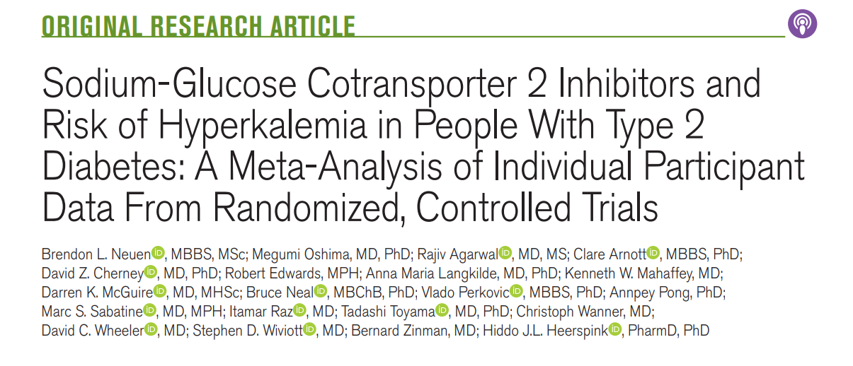
AHA JOURNALS
MAY 10 2022

Slide 3
BACKGROUND
Small studies of relatively short duration collectively suggest that SGLT2 inhibitors may reduce the risk of hyperkalemia in people with type 2 diabetes.
However, the long-term effect of these agents in preventing hyperkalemia in large clinical trials that recruited heterogeneous patient cohorts with varying background therapies has not been systematically evaluated.

Slide 4
STUDY DESIGN
Meta-analysis of randomized, double-blind, placebo-controlled, clinical outcome trials, comprising of 06 trials
Sample size : 49875

Slide 5
METHOD
Inclusion Criteria :
People with type 2 diabetes at high cardiovascular risk or with CKD in whom serum potassium levels were routinely measured

Slide 6
METHOD
A literature search of PubMed and MedLine from 1ST Jan 2000 to
1st Jul 2021, identified the following trials:
  EMPA-REG OUTCOME
  CANVAS Program
  DECLARE-TIMI 58
  VERTIS-CV
  CREDENCE
  DAPA - CKD

Slide 7
METHOD
Exclusion Criteria :
Patients without Type 2 DM in DAPA – CKD
Patients in DAPA- HF and EMPEROR- reduced were also excluded
Data from Sotagliflozin trials

Slide 8
PRIMARY OUTCOME
Time to first Lab determined Serious hyperkalemia- Sr. potassium ≥6.0 mmol/L.
Time to first investigator-reported hyperkalemia was also assessed.
Mild hyperkalemia- Sr. potassium ≥5.5 mmol/L, was assessed as a sensitivity analysis.
Hypokalemia, defined as a serum potassium ≤3.5 mmol/L,
Mean change in serum potassium from baseline over time were assessed.

Slide 9
PRIMARY OUTCOME
Outcomes were analysed based on following baseline characteristics
  HbA1c- ≤8% and >8%
  eGFR; <60 and ≥60 mL∙min−1∙1.73 m−2
  UACR; <30 and ≥30 mg/g
  History of heart failure,
  Use of RAAS inhibitors, diuretics, and MRAs.

Slide 10
STATISTICAL ANALYSIS
The effects were assessed for potassium outcomes using the intention-to-treat population
Treatment effects from each study, expressed as hazard ratios (HRs)
Corresponding 95% CIs, were pooled with the random-effects model and the Mantel-Haenszel method.

Slide 11
STATISTICAL ANALYSIS
Heterogeneity in treatment effect estimates across baseline participant subgroups was also assessed with Pheterogeneity values.
Mean change in serum potassium levels assessed from baseline to weeks 52, 104, 156, and 208

Slide 12
STATISTICAL ANALYSIS
Sensitivity analysis for the primary outcome
Data from DAPA-HF and EMPEROR-Reduced included regardless of diabetes status to assess the robustness of our findings in a broader patient population.

Slide 13
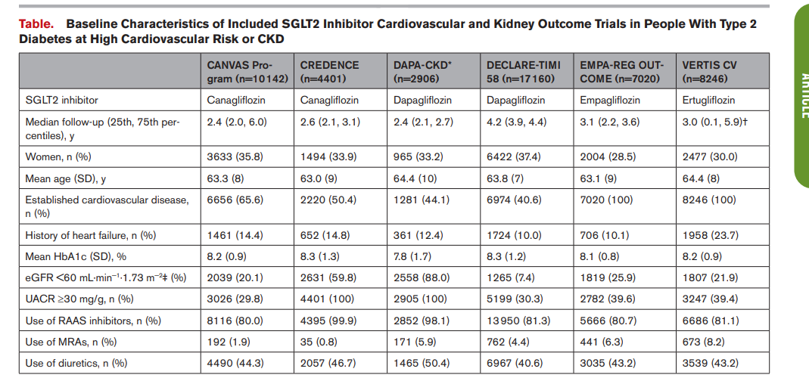
BASELINE CHARACTERISTICS

Slide 14
RESULTS
Across all included trials
1754 participants developed serious hyperkalemia,
1119 investigator-reported hyperkalemia events were recorded.
The incidence of serious hyperkalemia was substantially higher in the kidney outcome trials

Slide 15
RESULTS
Risk of serious hyperkalemia reduced by 16% (HR, 0.84 [95% CI, 0.76–0.93]; an effect consistent across trials
This effect was unchanged in a sensitivity analysis that included data from DAPA-HF and EMPEROR-Reduced (HR, 0.82 [95% CI, 0.75–0.90];
Incidence of mild hyperkalemia was also modestly low (HR, 0.92 [95% CI, 0.86–0.98];

Slide 16
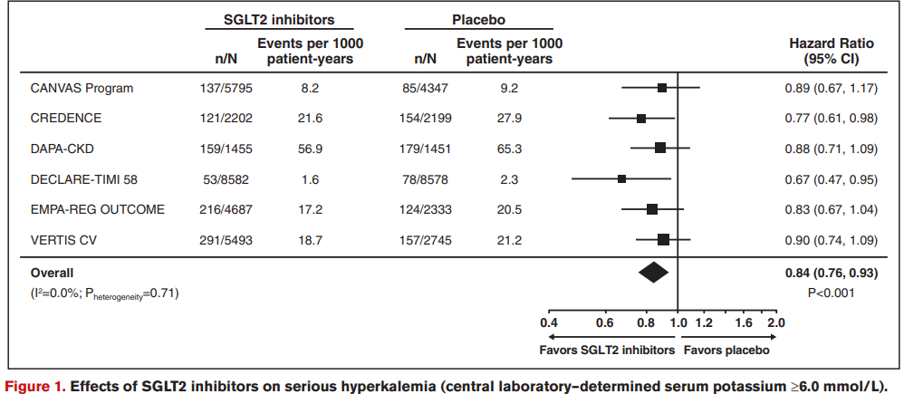
RESULTS
  Median progression free survival
    59.1 month in KRd arm ( 95% CI 54.8-not estimable)
    41.4 months in Lenalidomide arm (95 % CI 33.2-65.4)
    HR 0.51 (95% CI 0.31-0.86) [P= 0.012]
    Rate of MRD negativity higher in KRd arm 53% vs 31% in lenalidomide arm [p=0.0035]

Slide 17
RESULTS
Risk of investigator-reported hyperkalemia events by 20%, an effect consistent across trials (HR, 0.80 [95% CI, 0.68–0.93]
The incidence of serious hyperkalemia was higher in participants with eGFR <60 mL∙min−1∙1.73 m−2, a history of heart failure, and those using MRAs at baseline
The beneficial effect on serious hyperkalemia appeared larger in participants not receiving RAAS inhibitors at baseline

Slide 18
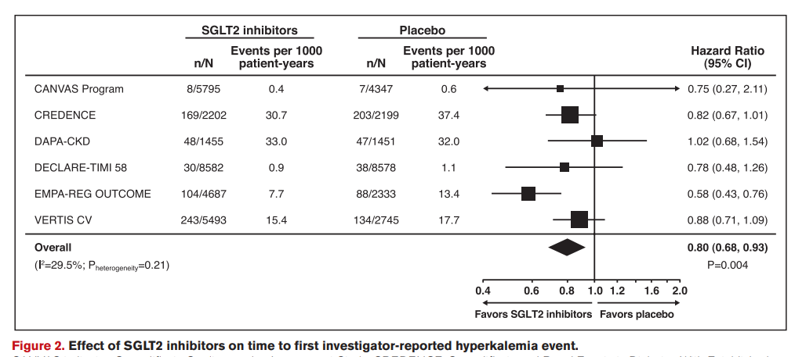
RESULTS

Slide 19
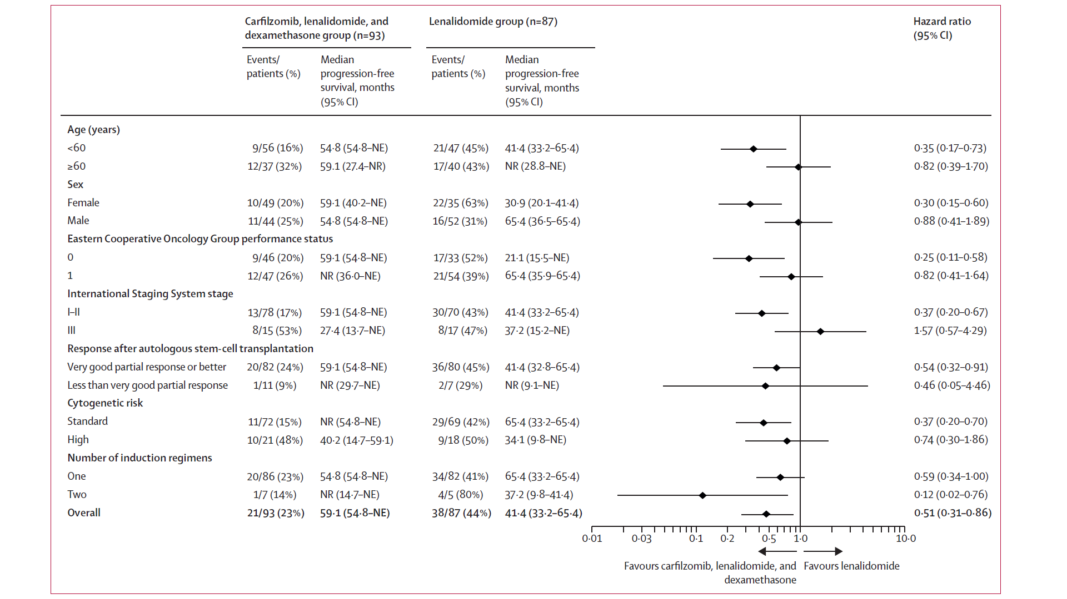
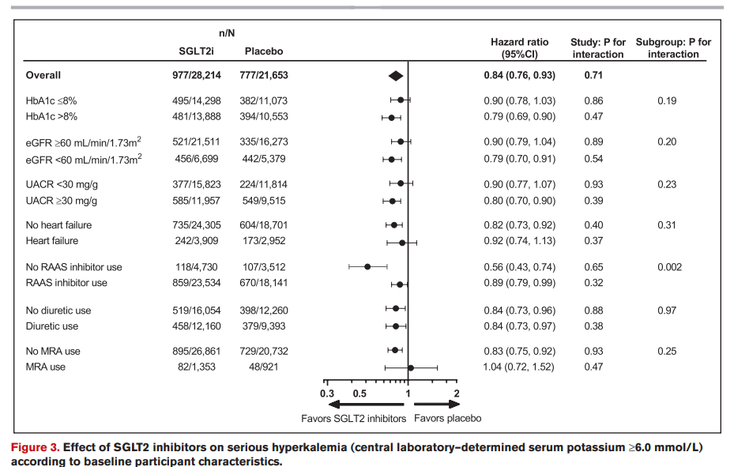
RESULTS

Slide 20
RESULTS
Addl analysis of CREDENCE and DAPA-CKD, with the use of more granular eGFR categories demonstrated consistent relative risk reductions with SGLT2 inhibitors across all eGFR categories.

Slide 21
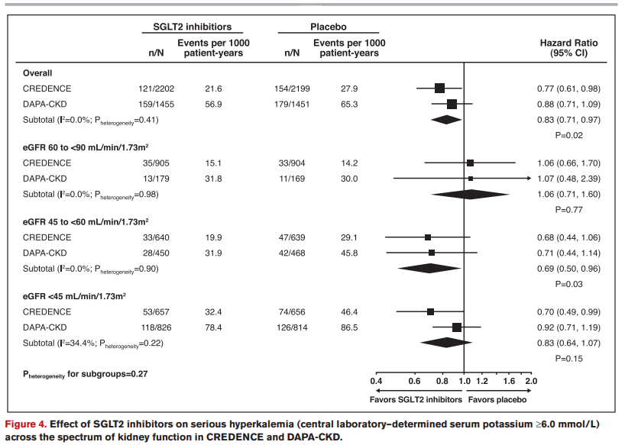
RESULTS

Slide 22
RESULTS
SGLT2 inhibitors did not affect the hypokalemia which is consistent across trials
The neutral effect on hypokalemia was consistent across a range of participant characteristics, including those receiving diuretics.

Slide 23
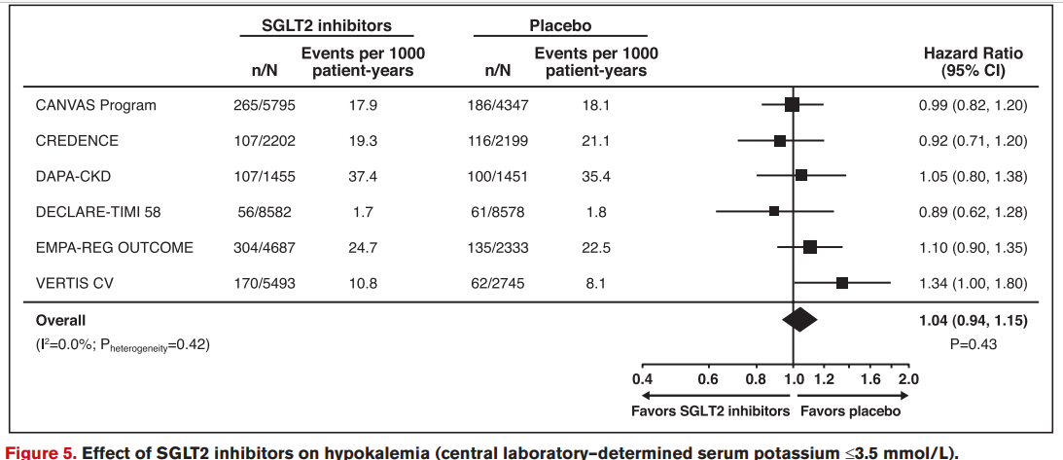
RESULTS

Slide 24
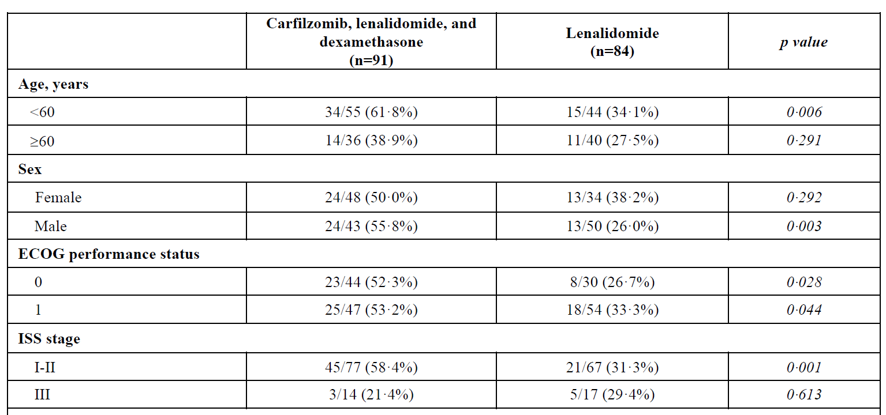
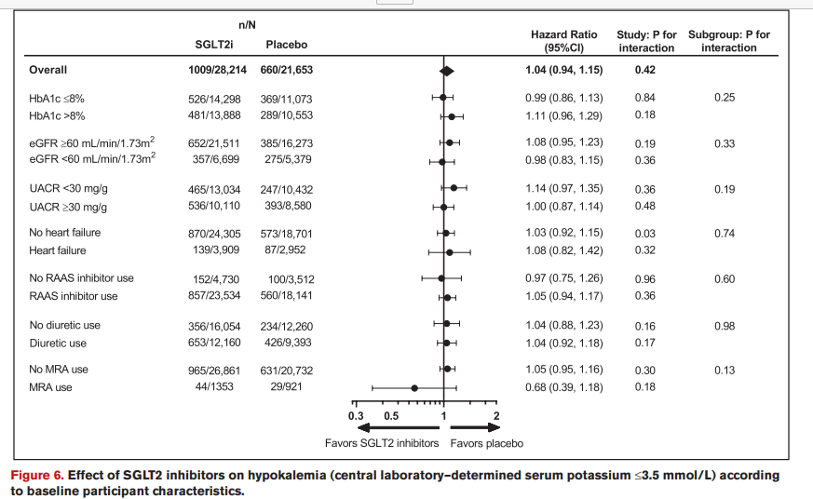
RESULTS
MRD NEGATIVITY RATE

Slide 25
RESULTS
The mean difference in serum potassium from baseline was modestly lower in participants randomized to SGLT2 inhibition compared with placebo at annual visits up to 4 years after randomization

Slide 26
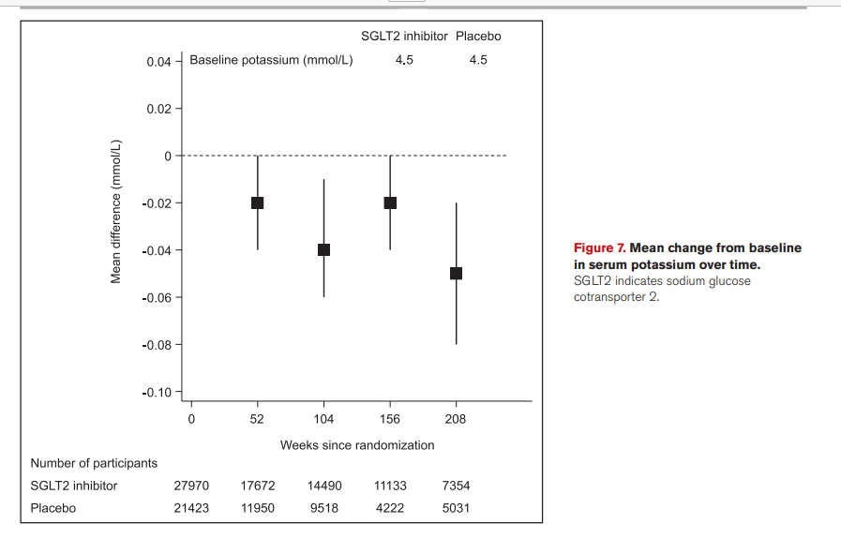
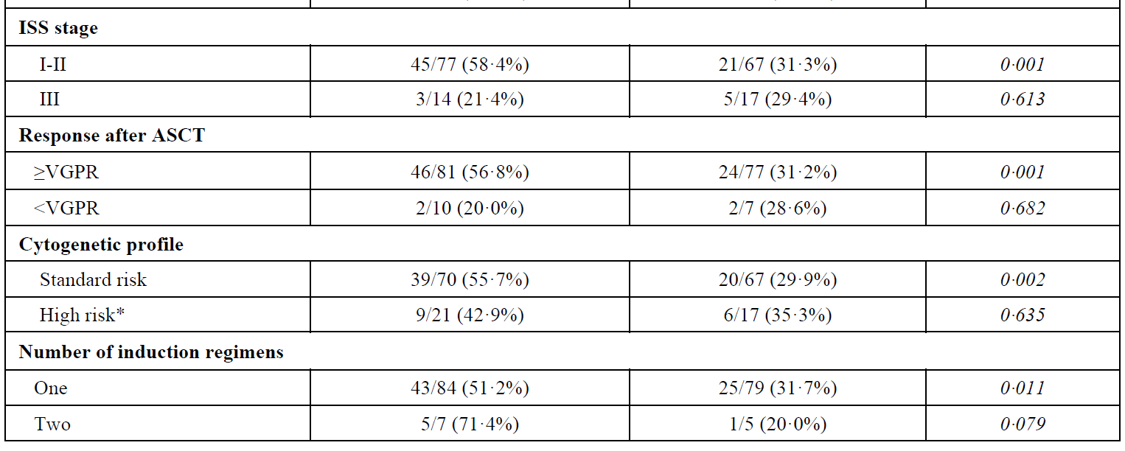
RESULTS
MRD NEGATIVITY RATE

Slide 27
CRITICAL APPRAISAL

Slide 28
CRITICAL APPRAISAL
TITLE
  Is it interesting? YES
ABSTRACT
  Will the conclusions (if valid), likely to be useful to you, in your area of clinical practice or research? YES
  Whether the settings in the material methods are similar to our own settings? YES

Slide 29
REFERENCE QUESTION
Is there a clear cut / specific research question? YES
Was it feasible for the authors to study this question given there technical expertise and available facilities? YES
Does the research question has some element of novelty? YES

Slide 30
VALIDITY
Have the authors made a mention of Actual / Study Population ? YES
Is the method of sampling been described? YES
Whether a mention of all the potential confounding factors been made? YES
Any selection or information bias could have occurred? YES

Slide 31



GATE Framework Assessment : PECOT
PARTICIPANTS:49875
P
SGLT2 Inh: 28214
Placebo:21653
OUTCOME: SGLT2 inhibitors consistently reduced the risk of serious hyperkalemia
O
DURATION : 208 weeks
T

Slide 32
ASSESSING VALIDITY

Slide 33
The RAMMbo acronym : Assessing study bias
P
E
C
O
T
P
Recruitment
Allocation
Maintenance
Measurement of outcome
Blind or Objective
E
C
O
T

Slide 34
RAMMbo : Recruitment
Study setting & eligibility criteria well described ? YES
Participants representative of eligible ? YES
Prognostic/risk profile appropriate to study question? YES
Randomization process described adequately? YES

Slide 35
RAMMbo: A is for Allocation
Randomization
1.3: 1 ratio
SGLT2 inhibitors:
28214
Placebo : 21653
O

Slide 36
RAMMbo
Good Maintenance ?
Did most participants remain in allocated groups ? YES
Participants &/or investigators blind to exposure (and comparison exposure)? YES
Compliance high & similar in EG &CG? SIMILAR
Completeness of follow-up high & similar in EG &CG? SIMILAR
O

Slide 37
RAMMbo
P
Measurement of outcomes
blind or objective?
EG CG
Outcome measurements were
Objective
Authors reviewed all results YES
O
T

Slide 38
Recruitment
Bias: No bias
P
Allocation : Adequate
E C
Maintenance: High Retention
Measurement : Right Statistical tools (of outcomes)
O
T

Slide 39
STRENGTHS
Study has large population data and long follow up
Use of indl participant data, which ensured consistency in methodology and outcome definitions and allowing time-to-event analyses.
Inclusion of largest number of individuals with CKD of any SGLT2 inhibitor study till date.

Slide 40
LIMITATIONS
Few participants receiving MRAs in CREDENCE trial were excluded due to concerns of Hyperkalemia with Canagliflozin
The exact time at which people developed hyperkalemia was not identify due to differences in trial- follow up procedures.

Slide 41
POSSIBLE MECHANISM
SGLT2 inhibitors might increase the rate of sodium and water delivery to the distal nephron
There is some evidence that SGLT2 inhibitors may modestly increase aldosterone,
Preservation of kidney function rather than any direct effects on tubular function per se.
As-yet unrecognized mechanism outside of the kidney

Slide 42
CONCLUSION
SGLT 2 inhibitors reduce the risk of serious hyperkalemia in people with type 2 DM at high cardiovascular risk or with CKD without increasing the risk of hypokalemia.

