Slide 1
JOURNAL CLUB
MODERATOR
PRESENTER
WG CDR ROHIT VASHIST
INFECTIOUS DISEASE SPECIALIST
SQN LDR DK THAKUR
RESIDENT
INTERNAL MEDICINE

Slide 2
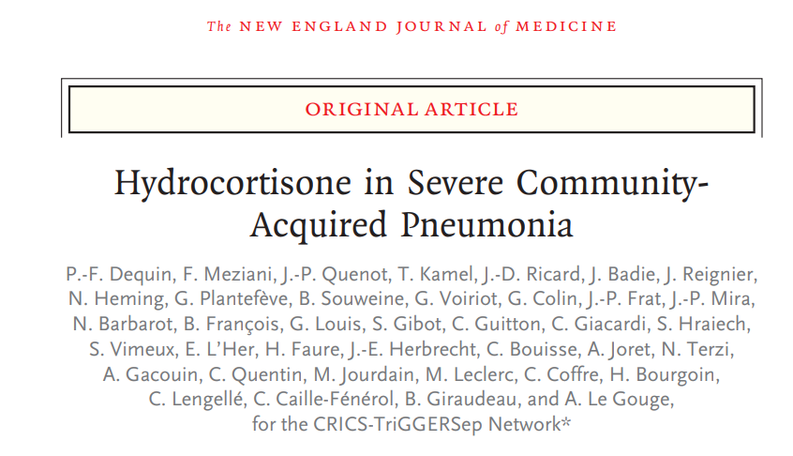
PUBLISHED ON 21 MAR 2023

Slide 3
AIM
CAPE-COD TRIAL
Assessed death at 28 day in patients with CAP received intravenous hydrocortisone for at least 4 days , tapered off for 8-14 days

Slide 4
METHODOLOGY
Phase 3, Multicentric, Double blind, RCT
31 sites across France
CRICS-TriGGERSep Network
Written informed consent
Data and Safety Monitoring Board
28 Oct 2015
5984
11 Mar 2020
Funded By French ministry of health
Notes:
CLINICAL RESEARCH IN INTENSIVE CARE AND SEPSIS –TRIAL GROUP FOR GLOBAL EVALUATION AND RESEARCH IN SEPSIS

Slide 5
METHODOLOGY
Inclusion Criteria:
Adults > 18 years
At least one ICU Admission for severe CAP
Clinical and Radiological criteria for Pneumonia
Severity: ( 1 OUT OF 4)
Initiation of mechanical ventilation- Invasive or non invasive-PEEP at least 5cm H₂O
HFNC with PaO2: FiO2 <300, FiO2 > 50%
On NRBM PaO2: FiO2 < 300
PSI> 130
Exclusion
Do not intubate
Pneumonia by influenza
Septic shock

Slide 6
INTERVENTION
18 Years and above with severe non-influenze CAP admitted in ICU receive intravenous hydrocortisone 200mg daily either for 4 or 8 days as determined by clinical improvement, followed by tapering for 8-14 days
Vs
Placebo

Slide 7
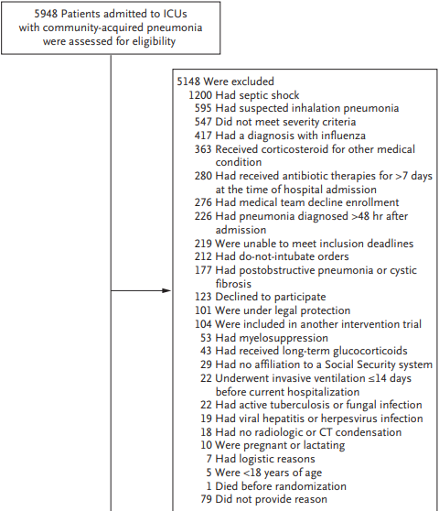
PATIENT CHARACTERISTICS

Slide 8
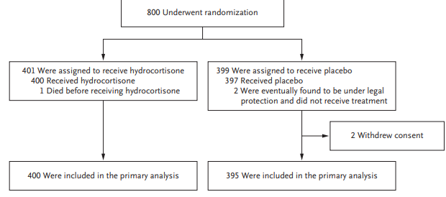
STATISTICAL ANALYSIS
PATIENT CHARACTERISTICS

Slide 9
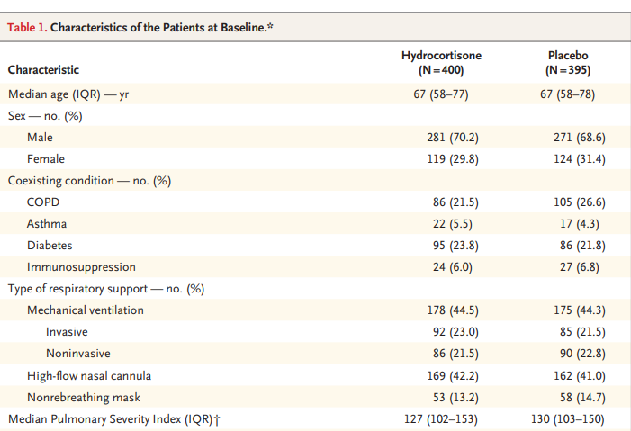
PATIENT CHARACTERSTICS
PATIENT CHARACTERISTICS

Slide 10
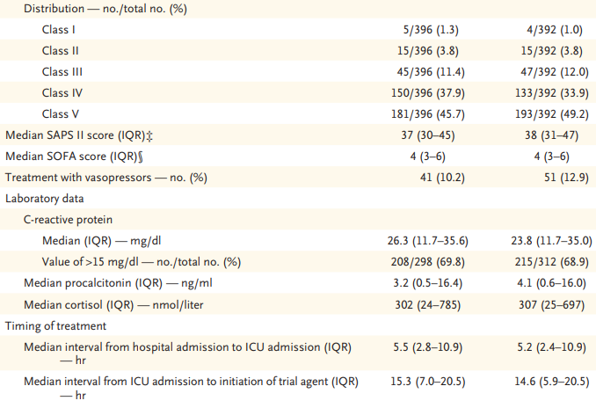
PATIENT CHARACTERSTICS
PATIENT CHARACTERISTICS

Slide 11
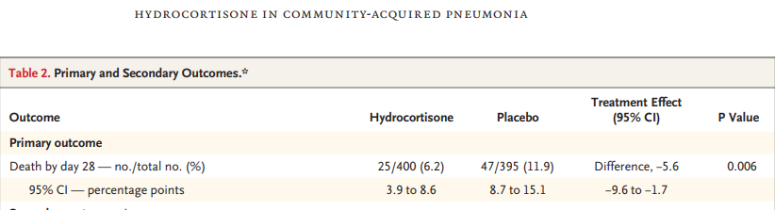


OUTCOMES
Primary Outcome
By day 28 death had occurred in 25/400 in hydrocortisone group- 6.2% whereas 47/395 in placebo group – 11.9%

Slide 12
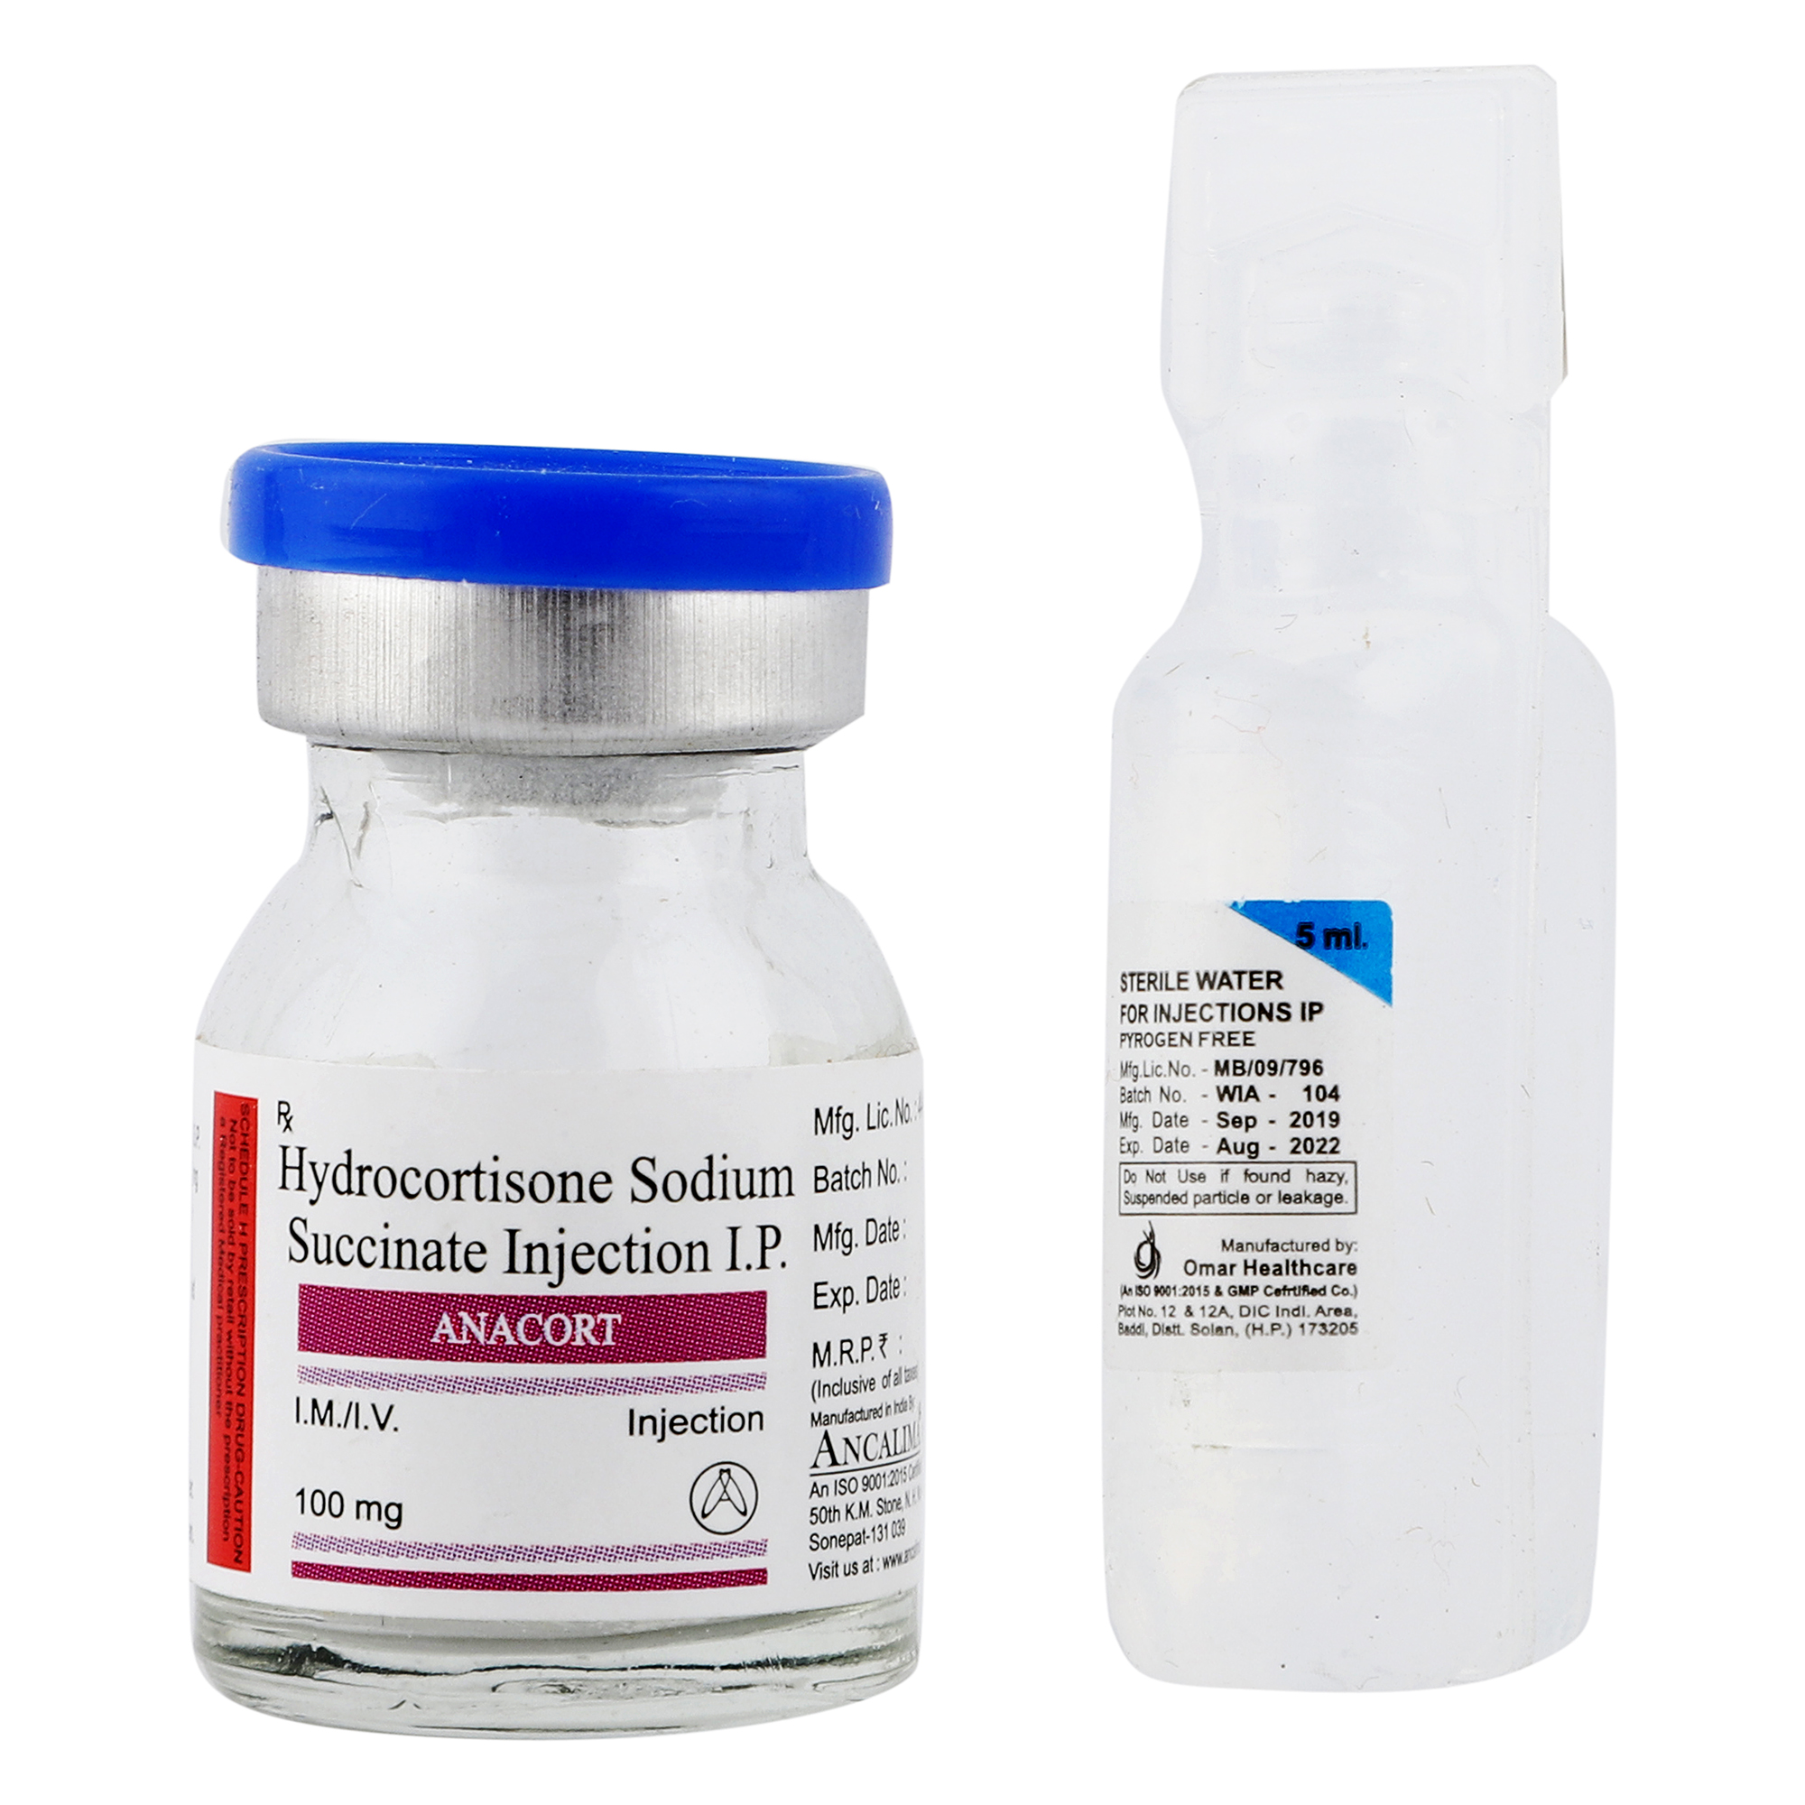
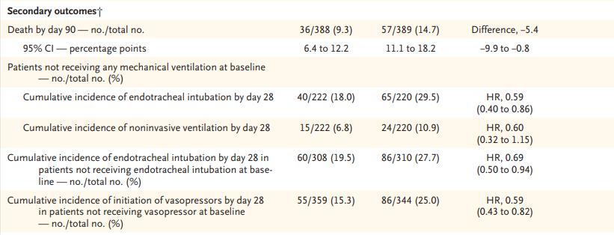

OUTCOMES
Secondary Outcomes
Death by day 90- 9.3% in Hydrocortisone group & 14.7% in placebo group

Slide 13
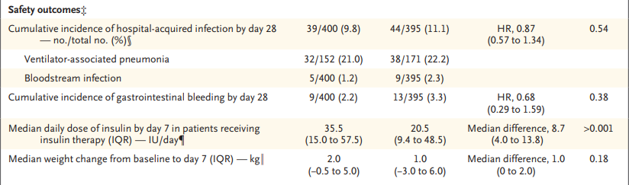
OUTCOMES
Safety Outcome

Slide 14
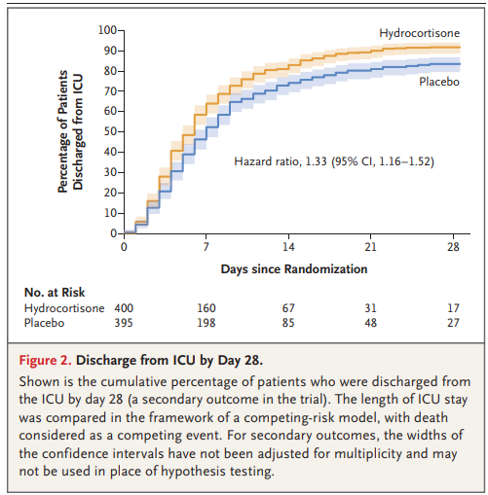
OUTCOME
DISCHARGE

Slide 15
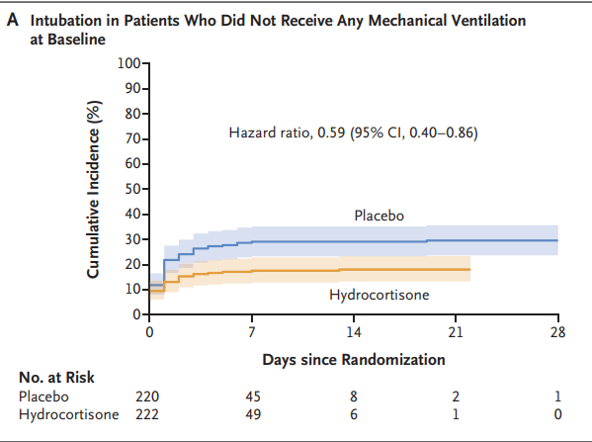
OUTCOME
INTUBATION

Slide 16
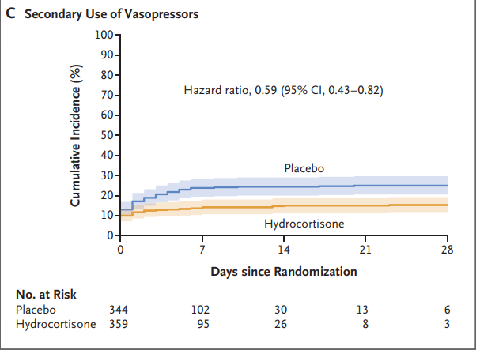
OUTCOME
VASOPRESSOR

Slide 17
CRITICAL APPRAISAL
TITLE
  Is it interesting? YES
ABSTRACT
  Will the conclusions (if valid), likely to be useful to you, in your area of clinical practice or research? YES
  Whether the settings in the material methods are similar to our own settings? NO

Slide 18
REFERENCE QUESTION
Is there a clear cut / specific research question? YES
Was it feasible for the authors to study this question given there technical expertise and available facilities? YES
Does the research question has some element of novelty? NO

Slide 19
VALIDITY
Have the authors made a mention of Actual / Study Population ? YES
Is the method of sampling been described? YES
Whether a mention of all the potential confounding factors been made? YES
Any selection or information bias could have occurred? YES

Slide 20



GATE Framework Assessment : PECOT
PARTICIPANTS: 795
P
HYDROCORTISONE:400
Placebo:397
OUTCOME:
Death at 28 & 90 days
O
DURATION : 4 years & 5 months
T
Notes:
P-POPULATION, E-EXPOSURE, C- COMPARISON, O- OUTCOME, T- STUDY TIME

Slide 21
RAMMbo : Recruitment
Study setting & eligibility criteria well described ? YES
Participants representative of eligible ? YES
Prognostic/risk profile appropriate to study question? YES
Randomization process described adequately? YES
Notes:
RAMMbo: RELIABILITY, AVAILBILITY, MAINTAINABILITY, BUILDABILITY, OPERABILITY

Slide 22
RAMMbo: Allocation
795
1:1 ratio randomization
Randomization
HYDROCORTISONE:400
Placebo: 397
O

Slide 23
RAMMbo: Maintenance
Good Maintenance ? Yes
Did most participants remain in allocated groups ? YES
Compliance high & similar in EG &CG? SIMILAR
Completeness of follow-up high & similar in EG &CG? SIMILAR
O

Slide 24
RAMMbo: Measurement
P
Measurement of outcomes
blind or objective?
Outcome assessments were BLIND
Authors reviewed all results YES
EG CG
O
T

Slide 25
STRENGTHS
International
Multicenter
Included all ethnic groups
Use of standardized severity scale
Government sponsored

Slide 26
LIMITATIONS
Observed mortality ( 11.9%) was lower than anticipated ( 27%) in control group
Standardized microbiologic investigation not done, no pathogen was isolated
Inclusion of immunocompromised patients affected mortality
No evaluation of reversibility of glucocorticoid induced hyperglycemia

Slide 27
CONCLUSION
Early treatment with hydrocortisone reduced 28-day mortality among patients who had been admitted to the ICU with severe community-acquired pneumonia

