Slide 1
JOURNAL CLUB
PRESENTER:
MAJ SREEJITH P V
MODERATOR:
COL P S CHAUHAN

Slide 2
JAMA Cardiology
November 9, 2022

Slide 3
BACKGROUND
Symplicity HTN-1
  Un-blinded, observational study
  Five centers in Europe and Australia
  50 patients
  Shown that significantly lowered BP at 1, 3, 6, 9 and 12 months post treatment
Symplicity HTN-2
  Un-blinded, randomized, sham- controlled (2010)
  In resistant hypertensive patients
  106 patients
  Substantial drop in office BP at 6 and 12 months

Slide 4
BACKGROUND
The Renal Denervation for Hypertension (DENERHTN) Trial
  Randomized, single blinded and sham controlled (2011-2013, USA & Europe)
  106 patients
  Initially patients were stabilized for 4-6 weeks on a fixed dose, triple combination
  Predefined antihypertensive medication escalation protocol
  Demonstrated that decrease in daytime systolic ABP was statistically greater in renal denervation plus standardized therapy arm versus standardized therapy alone
  Only blinded, sham-controlled, evidence demonstrating significant effect of renal denervation in resistant hypertension

Slide 5
BACKGROUND
Symplicity HTN-3 (2016-2020, Published in Lancet, Oct 2022)
  Randomized, single blinded and sham controlled, USA
  535 patients, baseline office systolic BP was ≥160 mmHg despite maximum tolerated doses of at least 3 antihypertensive drugs
  Demonstrated office systolic BP drop at 6 months in both treatment arm and control arm, such that the difference between arms was not statistically significant.
  ABP data: difference in systolic BP drop between arms was < 2mmHg

Slide 6
AIM
To report the persistence of the BP effects and safety of uRDN vs sham at 6 months in conjunction with escalating antihypertensive medications.

Slide 7
METHODS
International, Multicenter, Randomized, Sham-controlled, Double blinded
RADIANCE-HTN TRIO trial
28 centres in US & 25 centres in Europe
Duration of Study: 6 months
Inclusion Criteria:
Age 18 to 75 years
Seated office SBP and DBP of 140/90 mm Hg or higher despite 3 or more antihypertensive medications including a diuretic
eGFR of 40 mL/min/ 1.73 m2 or greater.
Exclusion Criteria:
    Renal artery anatomy on either side, ineligible
    eGFR of <40 mL/min/1.73 m2
    Pregnant or planning to become pregnant

Slide 8
METHODS
Enrollment:
  At enrollment, participants were switched to a single pill, fixed-dose, daily combination of valsartan 160 mg (or Olmesartan 40mg), amlodipine 10mg (or 5mg in the event of severe leg edema) and hydrochlorothiazide, 25mg for 4 weeks.
Recruitment & Randomisation:
  136 participants recruited.
  1:1 randomisation
u RDN: 69
Sham : 67

Slide 9
PROCEDURE
After randomization patients were to remain in the initial antihypertensive treatment until 2 months.
2nd to 5th month: SSAHT (Standard stepped care antihypertensive treatment) in both groups if the mean home BP was 135/85 mm Hg or higher
SSAHT
aldosterone antagonist (spironolactone,25 mg/day)
β1-blocker (bisoprolol,10mg/day)
α2-receptor agonist (clonidine,0.1-0.2mg/day; rilmenidine, 1-2mg/day; or moxonidine, 0.2-0.4mg/day)
α1-receptor blocker (prazosin, 5-10 mg/day or doxazosin, 4-8mg/day).

Slide 10
FOLLOW UP
Monthly visits before ingestion of morning antihypertensive treatment
  undergo seated office BP & heart rate
  Laboratory assessments as well as urine chemical adherence testing
  Assess their 7-day home BP measurement before each onsite visit
  Record adverse events
Ambulatory BP measurements following witnessed pill intake at baseline, 2, and 6 months
CT or MR imaging angiogram of the kidney, if needed, to detect for renal artery stenosis

Slide 11
OUTCOMES
Prespecified Endpoints:
  Number of antihypertensive medications prescribed
  Proportion of patients taking different classes of added antihypertensive medications, especially aldosterone antagonists
  Baseline and covariate-adjusted changes in ambulatory, home, and office SBP.
Other Efficacy Endponts:
  Change in DBP parameters and heart rate
  Proportion of the patients with controlled out-of-office BP (<135/85mmHg for both home and daytime ambulatory SBP/DBP)

Slide 12
ADVERSE EVENTS
All-cause mortality
Hypertensive emergency resulting in hospitalization
Hypotensive emergency resulting in hospitalization
Hospitalization for heart failure
Stroke, transient ischemic attack, cerebrovascular accident
Acute myocardial infarction (STEMI/non-STEMI)
Any coronary revascularization
End stage renal disease
Any renal artery complication
Significant embolic events resulting in end organ damage
Acute renal injury
Renal artery stenosis

Slide 13
STATISTICAL ANALYSIS

Slide 14
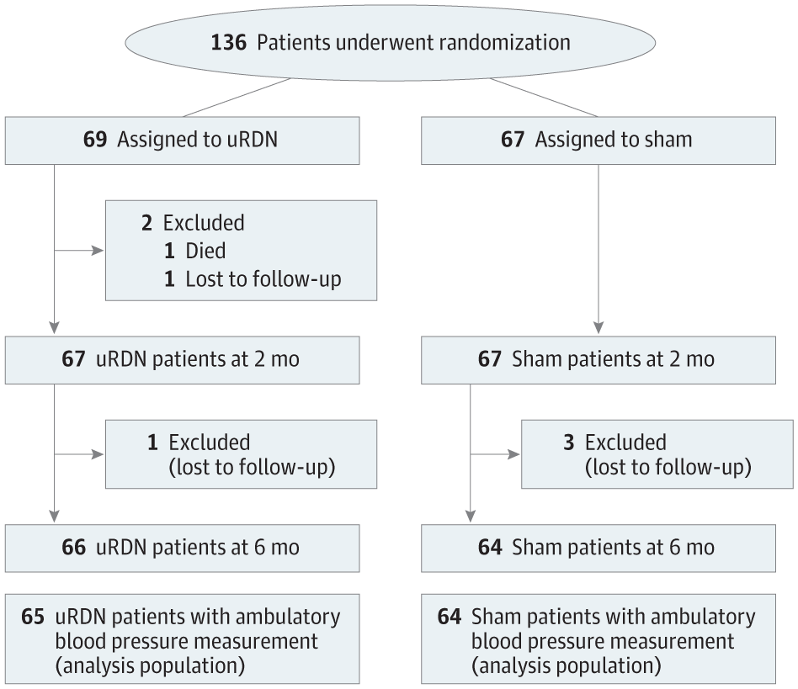
STUDY PROFILE

Slide 15
DEMOGRAPHIC DATA

Slide 16
CLINICAL DATA

Slide 17
RESULTS

Slide 19
RESULTS

Slide 20
RESULTS

Slide 21
ADVERSE EVENTS

Slide 22
CRITICAL APPRAISAL

Slide 23
CRITICAL APPRAISAL
TITLE
  Is it interesting? YES
ABSTRACT
  Will the conclusions (if valid), likely to be useful to you, in your area of clinical practice or research? YES
  Whether the settings in the material methods are similar to our own settings? NO

Slide 24
REFERENCE QUESTION
Is there a clear cut / specific research question? YES
Was it feasible for the authors to study this question given there technical expertise and available facilities? YES
Does the research question has some element of novelty? YES

Slide 25
VALIDITY
Have the authors made a mention of Actual / Study Population ? YES
Is the method of sampling been described? YES
Whether a mention of all the potential confounding factors been made? YES
Any selection or information bias could have occurred? NO

Slide 26



GATE Framework Assessment : PECOT
PARTICIPANTS: 136
P
uRDN: 69
Sham: 67
OUTCOME: No of antihypertensives prescribed, changes in ambulatory, home and office SBP
O
DURATION : 6 Months
T

Slide 27
ASSESSING VALIDITY

Slide 28
The RAMMbo acronym : Assessing study bias
P
E
C
O
T
P
Recruitment
Allocation
Maintenance
Measurement of outcome
Blind or Objective
E
C
O
T

Slide 29
RAMMbo : Recruitment
Study setting & eligibility criteria well described ? YES
Participants representative of eligible ? YES
Prognostic/risk profile appropriate to study question? YES
Randomization process described adequately? YES

Slide 30
RAMMbo: A is for Allocation
136
1:1 ratio randomization
Randomization
u RDN- 69 Sham- 67
O

Slide 31
RAMMbo
Good Maintenance ?
Did most participants remain in allocated groups ? YES
Participants &/or investigators blind to exposure (and comparison exposure)? YES
Compliance high & similar in EG &CG? SIMILAR
Completeness of follow-up high & similar in EG &CG? SIMILAR
O

Slide 32
RAMMbo
P
Measurement of outcomes
blind or objective?
EG CG
Outcome measurements were BLIND
Authors reviewed all results YES
O
T

Slide 33
Recruitment
Bias: No bias
P
Allocation : Adequate
E C
Maintenance: High Retention
Measurement : Right Statistical tools (of outcomes)
O
T

Slide 34
STRENGTHS
Use of single pill
Included all ethnic groups
Standardized policy for escalation of medications
Double blinded

Slide 35
LIMITATIONS
Short duration of follow-up
Large between-patient variation in the BP response to uRDN plus SSAHT as well as to the SSAHT alone :- variable renal nerve ablation, medication adherence, prevailing state of sympathetic hyperactivity or other factors
No reliable peri procedural marker of successful uRDN
Included only patients with RHTN and eGFR greater than 40mLper minute

Slide 36
CONCLUSION
In patients with RHTN initially randomly assigned to uRDN or sham procedure and who had persistent elevation of BP at 2 months after the procedure, protocolized escalation of antihypertensive medications resulted in similar BP reduction at 6 months in both groups, with fewer additional medications, especially aldosterone antagonists, required in the uRDN group.
Persistence of maintenance of a BP-lowering effect of uRDN at 6 months

