Slide 1
JOURNAL CLUB
MODERATOR
COL VISHESH VERMA
PRESENTED BY
DR LAKSHMI MOHAN
JR2 MEDICINE

Slide 2
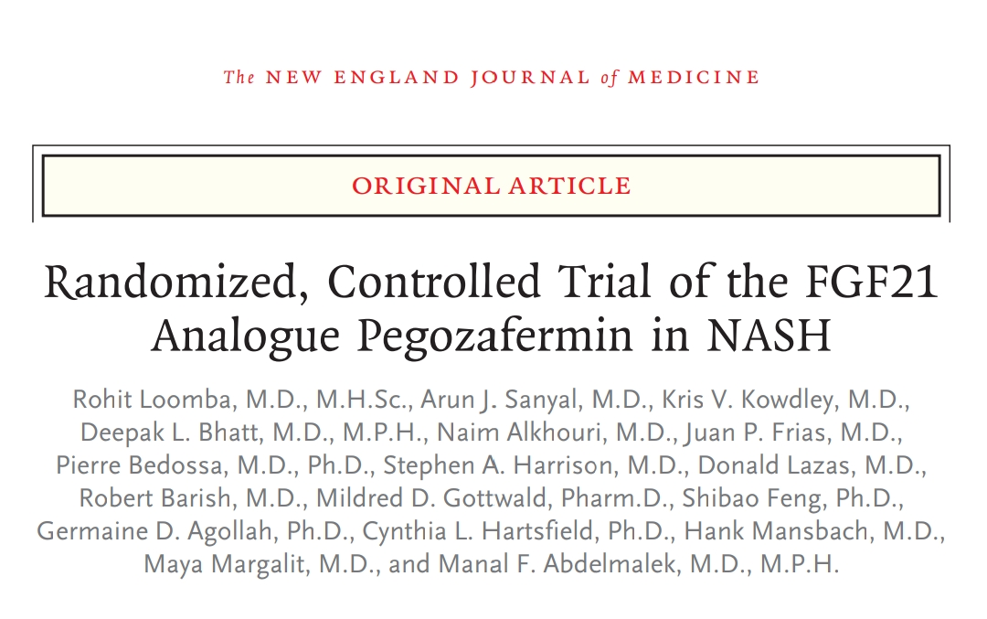
Published in NEJM on June 24, 2023

Slide 3
NON ALCOHOLIC STEATOHEPATITIS
A spectrum in Nonalcoholic Fatty Liver Disease
25% of patients with NAFLD are presumed to have NASH
NASH – heterogenous condition
Can improve to steatosis or normal histology
Can remain stable for years
Can progress to cirrhosis

Slide 4
Macrovesicular fat accumulation in more than 5% of hepatocytes is the defining feature of NAFLD
Hepatocyte ballooning, degeneration and lobular inflammation of a mixed inflammatory cell infiltrate – NASH
Fibrosis – perisinusoidal and pericellular (chicken – wire)
Alcohol associated steatosis and steatohepatitis are histologically indistinguishable
Fibro occlusive venous lesions and bile stasis – more in alcohol associated steatohepatitis

Slide 5
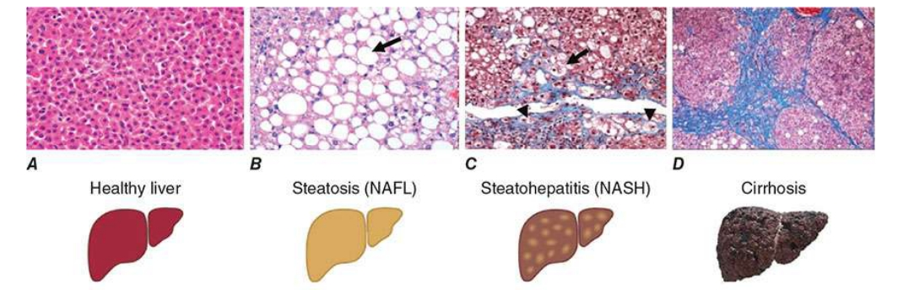

Slide 6
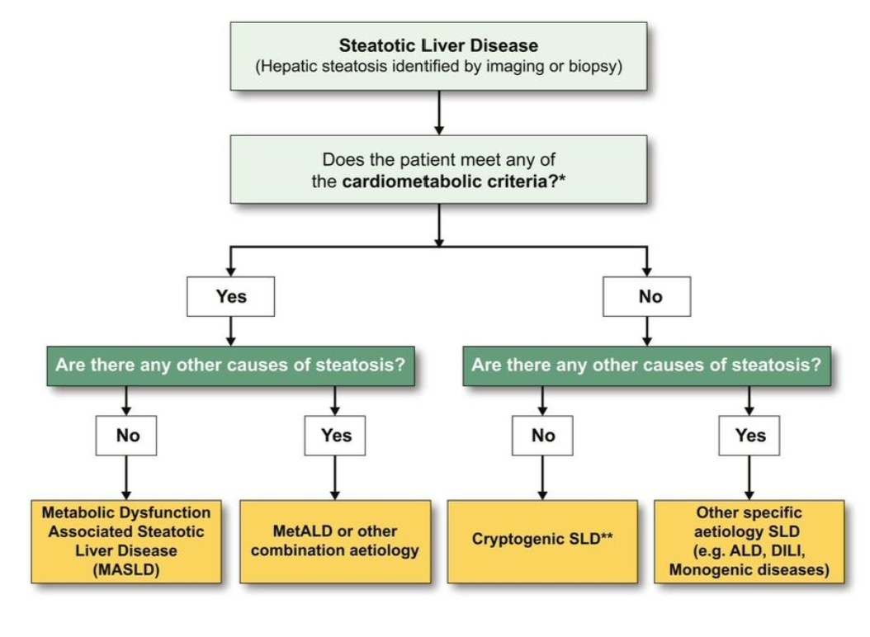

Slide 7
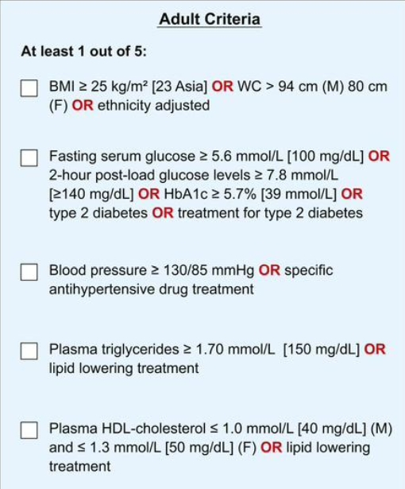

Slide 8
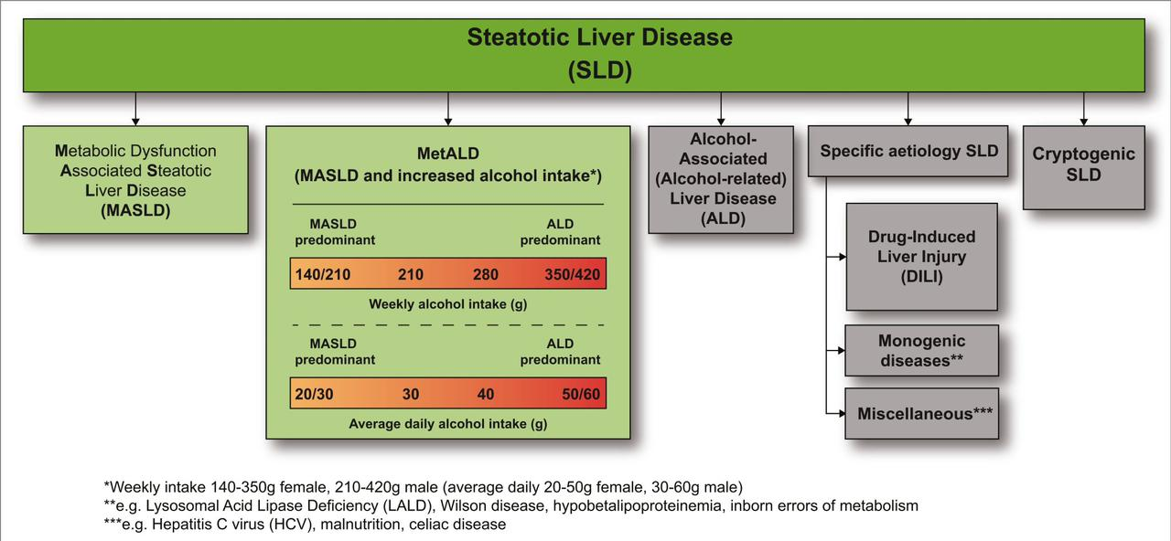

Slide 9
Causes of Fatty Liver Disease
ACQUIRED METABOLIC DISORDERS
Diabetes Mellitus
Dyslipidemia
Obesity
CYTOTOXIC DRUGS
L- Asparaginase
Azacytidine
Bleomycin

Slide 10
METALS SURGICAL PROCEDURES
1.Antimony 1.Biliopancreatic diversion
2.Barium salts 2.Jejunoileal bypass
3.Mercury 3.Extensive small bowel resection
INBORN ERRORS OF METABOLISM MISCELLANEOUS CONDITIONS
1.Abetalipoproteinemia 1.IBD
2.Familial hepatosteatosis 2.Jejunal diverticulosis with SIBO
3.Glycogen storage diseases 3.TPN

Slide 11
PATHOGENESIS
2 - hit hypothesis (proposed by Day and collegue in 1988)
Dysregulation of fatty acid metabolism leads to steatosis
Associated with several cellular adaptations and altered signalling pathway
Render hepatocytes vulnerable to a second hit

Slide 12
Second hit – environmental or genetic
Hepatocyte necrosis and inflammation
No single mechanism has been identified

Slide 13
Increased accumulation of FFA in hepatocyte
Hepatic steatosis
Lipotoxicity occurs
Promote oxidative and ER stress
Hepatocyte apoptosis and stellate cell activation
Fibrosis

Slide 14
NAFLD ACTIVITY SCORE (NAS)
1. Steatosis (%) 3. Lobular Inflammation
5% – 1 mild - 1
5-33% – 2 moderate - 2
33-66 %– 3 severe - 3
2. Ballooning
None - 0
Few - 1
Many - 2
TOTAL SCORE
0-2 → likely not NASH
3-4 → intermediate
5-8 → likely NASH

Slide 15
NASH CRN FIBROSIS SCORING
STAGE 0 – no fibrosis
STAGE 1 – centrilobular pericellular fibrosis
STAGE 2 – centrilobular and periportal fibrosis
STAGE 3 – bridging fibrosis
STAGE 4 - cirrhosis

Slide 16
PEGOZAFERMIN
Long acting glycopegylated fibroblast growth factor 21 analogue
Inhibits the reduction in Adiponectin, increase in TNFꭤ and FFA levels
Reduces inflammation and fibrosis
In development for treatment of NASH and severe hypertriglyceridemia

Slide 17
AIM
To study the efficacy and safety of Pegozafermin in treatment of non cirrhotic NASH

Slide 18
METHODS
Multicentric, Phase 2b, randomised, double blind, placebo controlled trial
STUDY POPULATION
Patients over 61 sites in United States
STUDY PERIOD
12 weeks screening period + 24 weeks treatment period
Patients were enrolled from 28 Sept 2021 to 15 Aug 2022

Slide 19
INCLUSION CRITERIA
Age – 21 -75 years
Biopsy confirmed NASH with fibrosis score F2 or F3 as per NASH CRN system and NAS ≥ 4 with at least 1 in each of steatosis, ballooning degeneration and lobular inflammation. Biopsy done at screening or within 6 months prior to first day of screening
Females of child bearing potential must have a negative serum pregnancy test at screening and negative urine pregnancy test on day 1
All men and women of child bearing potential should use double contraception methods during and upto 30 days after the last dose of drug
Signed informed consent

Slide 20
EXCLUSION CRITERIA
Liver disorder other than NASH
Planned or history of liver transplantation
History or evidence of cirrhosis (fibrosis stage 4) or any clinical features of hepatic decompensation
Uncontrolled hypertension or newly detected HTN (<2 months since diagnosis)
Uncontrolled or newly detected T2DM (<3 months since diagnosis)
T1 DM
Chronic medical conditions
Unstable cardiovascular or cerebrovascular disease

Slide 21
PRIMARY END POINTS AT WEEK 24
Improvement in fibrosis (reduction by ≥ 1 stage) with no worsening of NASH
NASH resolution (total absence of ballooning and absent or mild inflammation) without worsening of fibrosis

Slide 22
RANDOMIZATION
Patients were randomly assigned to receive placebo once weekly, once in 2 weeks, 15 mg Pegozafermin once weekly, 30 mg once weekly or 44 mg once 2 weekly
Initially randomized in a ratio of 2:1:3:3:3
Later changed to 16:8:6:24:15
Limited randomization to 15 mg group

Slide 23
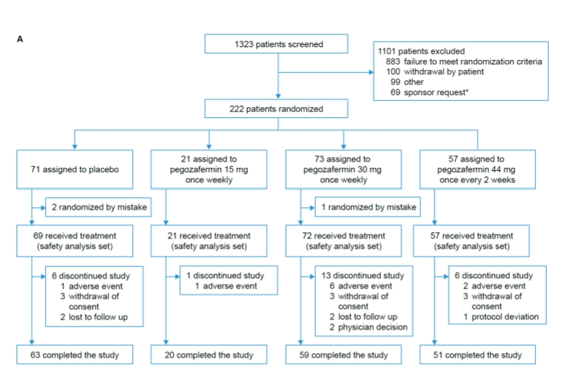

Slide 24
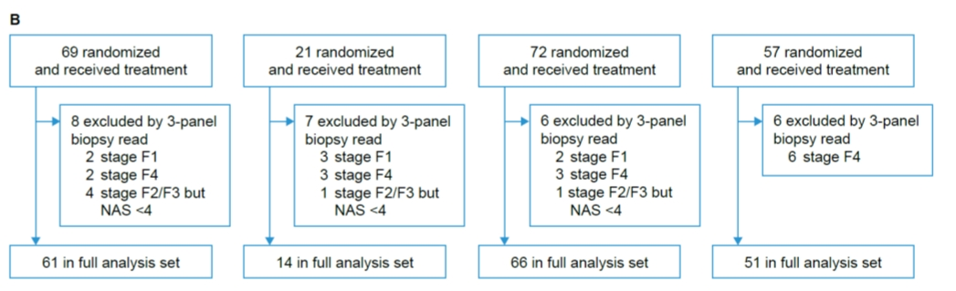

Slide 25
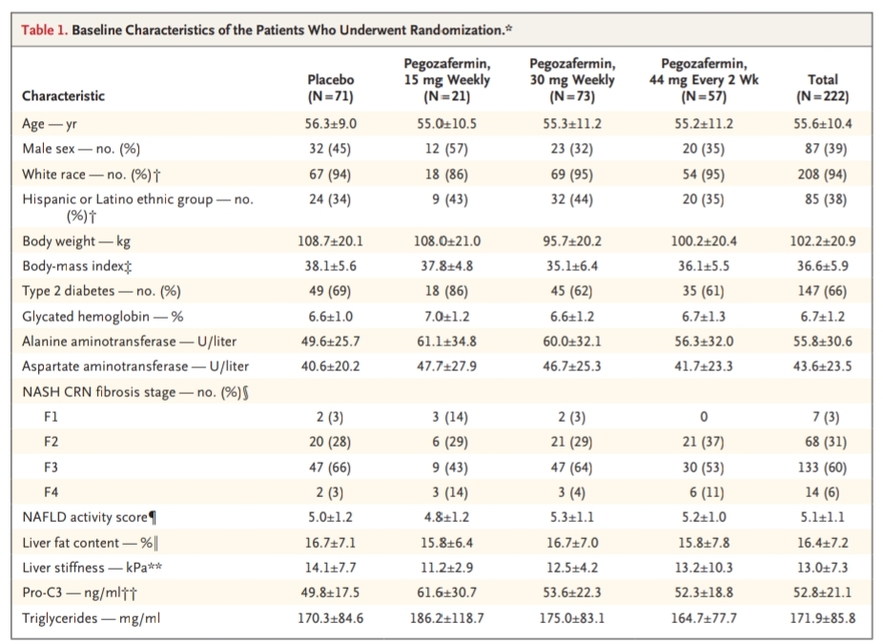

Slide 26
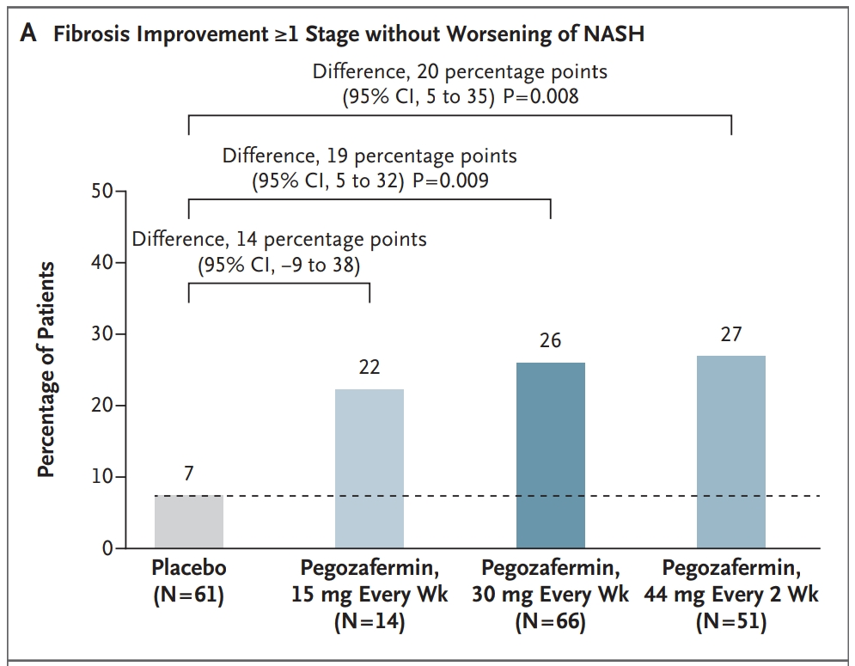

Slide 27
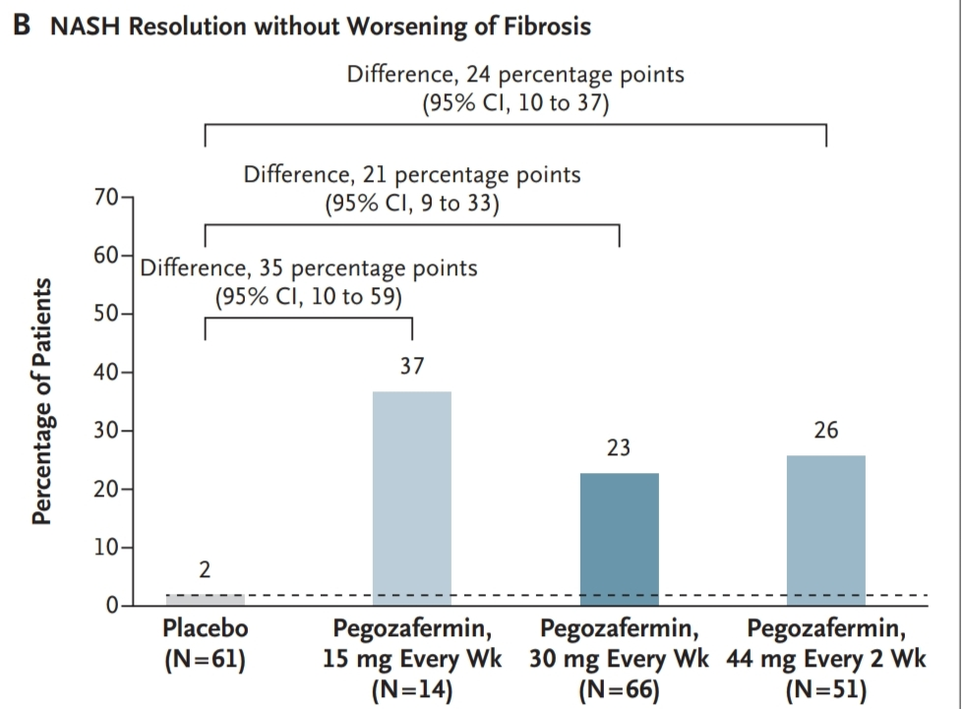

Slide 28
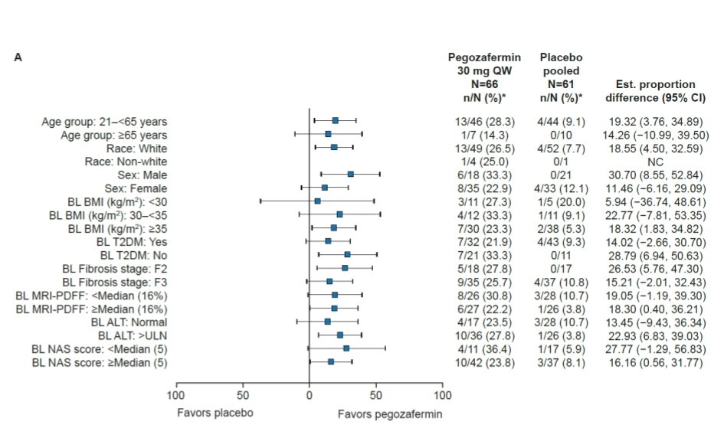
FIBROSIS IMPROVEMENT WITHOUT WORSENING OF NASH

Slide 29
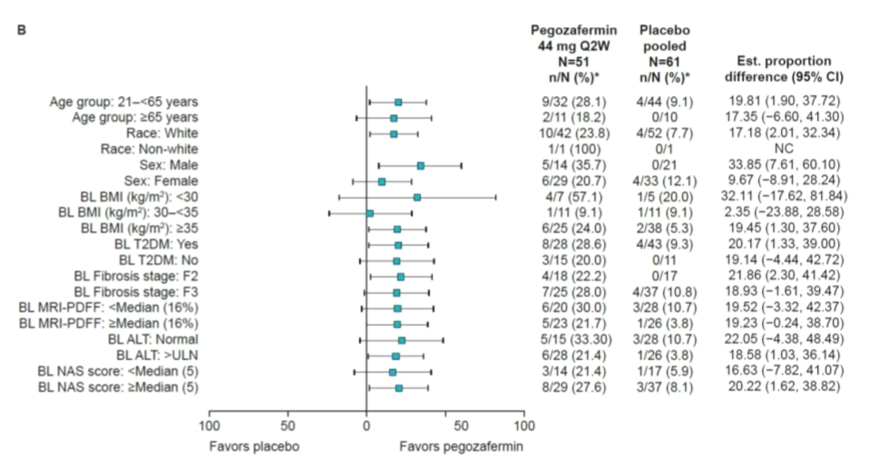

Slide 30
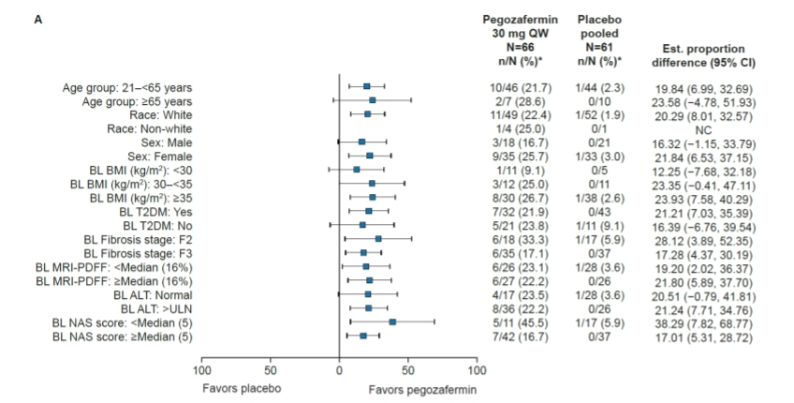
NASH RESOLUTION WITHOUT WORSENING OF FIBROSIS

Slide 31
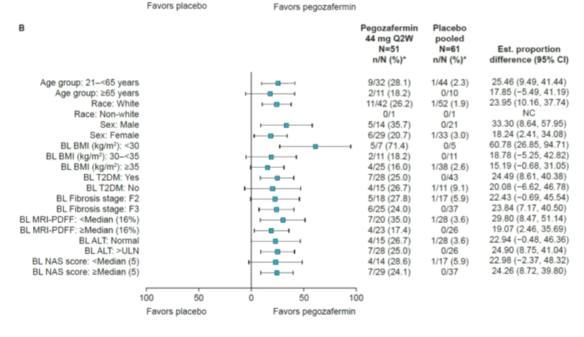

Slide 32
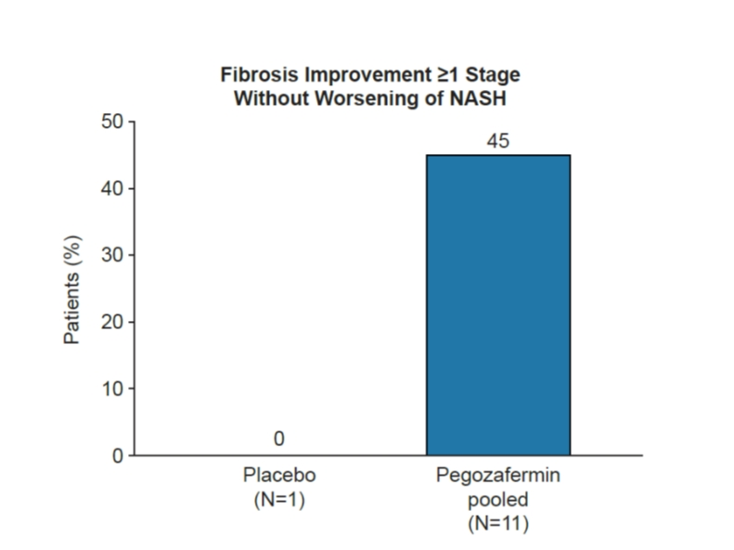
Fibrosis improvement without worsening of NASH in patients with F4 fibrosis

Slide 33
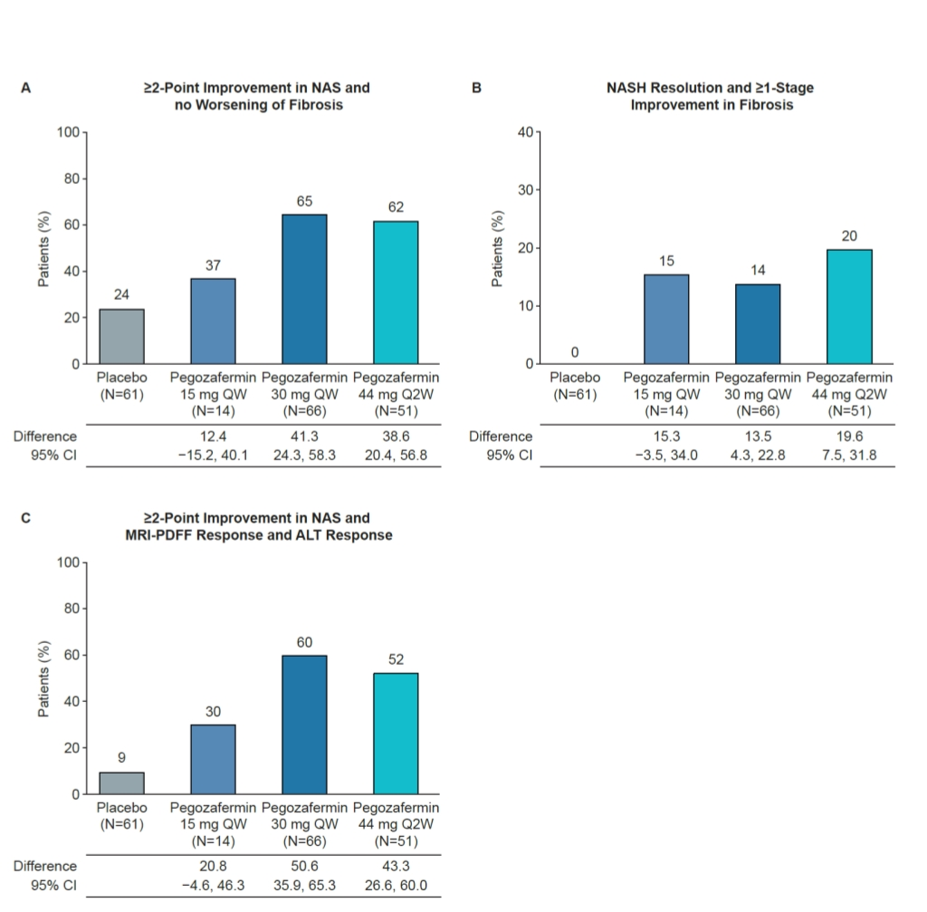

Slide 34
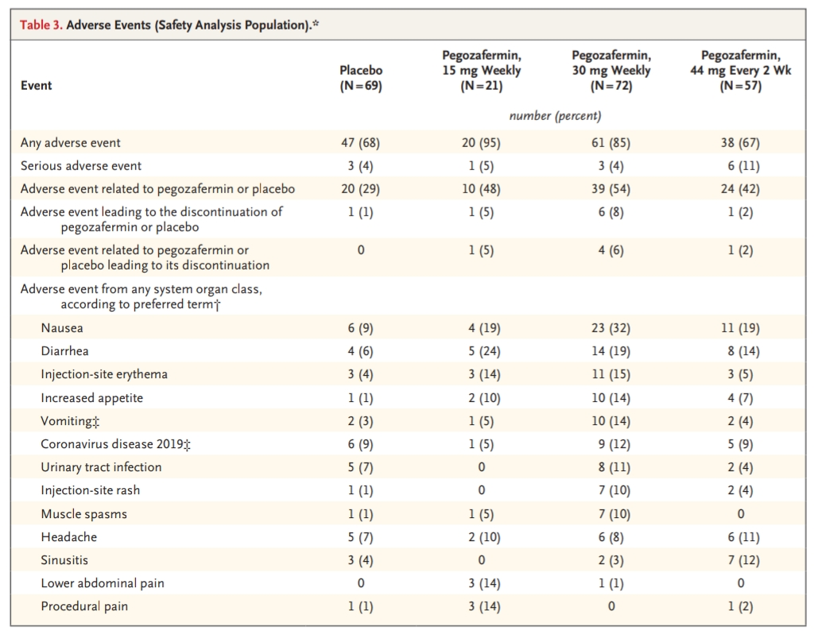

Slide 35
CRITICAL APPRAISAL
TITLE
Is it interesting? YES
ABSTRACT
Will the conclusions likely to be useful to you, in your area of clinical practice or research? YES
Whether the settings in the material methods are similar to your own settings? YES

Slide 36
REFERENCE QUESTION
Is there a clear cut / specific research question? YES
Was it feasible for the authors to study this question given there with the technical expertise and available facilities? YES
Does the research question has some element of novelty? YES

Slide 37


GATE Framework Assessment: PECOT
P
PARTICIPANTS : 222
PEGOZAFERMIN : 151
E
C
PLACEBO : 71
PRIMARY ENDPOINT
O
T
DURATION : 24 WEEKS

Slide 38
ASSESSING VALIDITY

Slide 39
The RAMMbo acronym : Assessing study bias
P
E
C
O
T
P
Recruitment
Allocation
Maintenance
Measurement of outcome
Blind or Objective
E
C
O
T

Slide 40
RAMMbo : Recruitment
Study setting & eligibility criteria well described ? YES
Participants representative of eligible ? YES
Prognostic/risk profile appropriate to study question? YES
Randomization process described adequately? YES

Slide 41
RAMMbo: A is for Allocation
222
16:8:6:24:15 ratio for baseline randomization
Randomization
PEGOZAFERMIN- 151 PLACEBO - 71
O

Slide 42
RAMMbo
Good Maintenance ?
Did most participants remain in allocated groups ? YES
Participants &/or investigators blind to exposure (and comparison exposure)? YES
Compliance high & similar in EG &CG? YES
Completeness of follow-up high & similar in EG &CG? YES
O

Slide 43
RAMMbo
P
Measurement of outcomes
blind or objective?
EG CG
Outcome measurements were OBJECTIVE
Authors reviewed all results YES
O
T

Slide 44
Recruitment
Bias: No bias
P
Allocation : Adequate
E C
Maintenance: High Retention
O
Measurement : Right Statistical tools (of outcomes)
T

Slide 45
LIMITATIONS
Short duration
Lack of racial diversity

Slide 46
CONCLUSION
Pegozafermin treatment for 24 weeks led to improvement in fibrosis with both weekly and every 2 week administration in patients with biopsy confirmed NASH
Once every 2 week administration may increase patient convenience and adherence to treatment
Results of this trial may be informative for dose selection for phase 3 trials involving patients with NASH

Slide 47
THANK YOU

