Slide 1



PHASE 2 TRIAL OF BAXDROSTAT FOR
TREATMENT-RESISTANT HYPERTENSION
JOURNAL CLUB
PRESENTER: MODERATOR:
MAJ SURBHI SAXENA COL VISHESH VERMA

Slide 2
PREVIOUS TRIALS
PATHWAY-2 TRIAL
PRECISION STUDY
PHARES STUDY

Slide 3
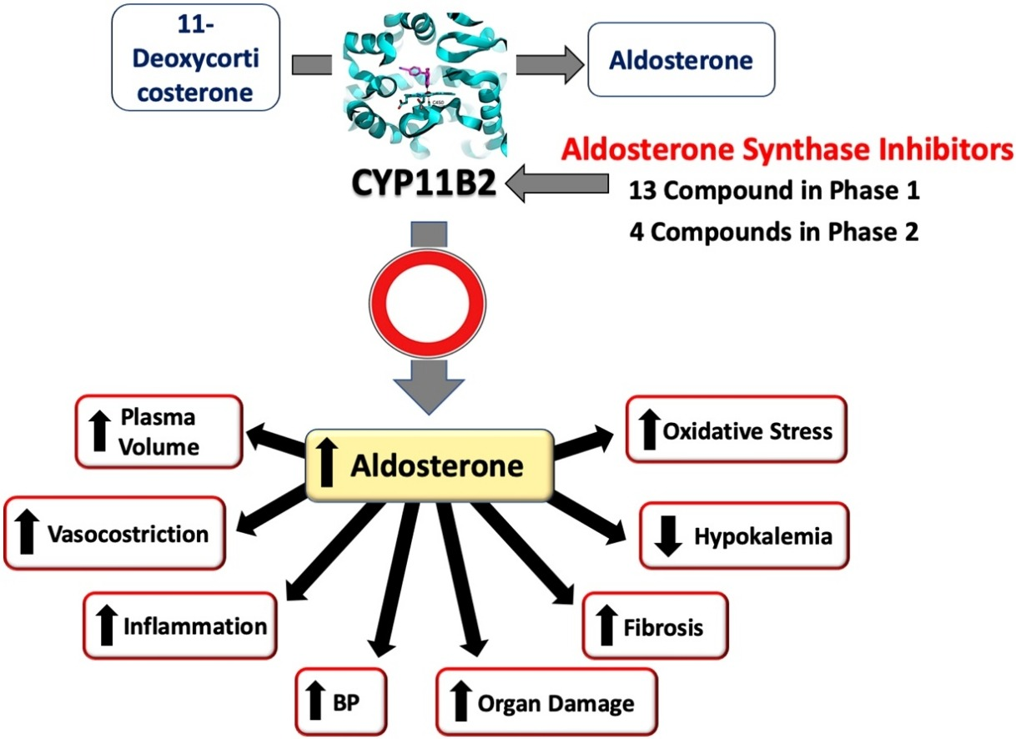

Slide 4
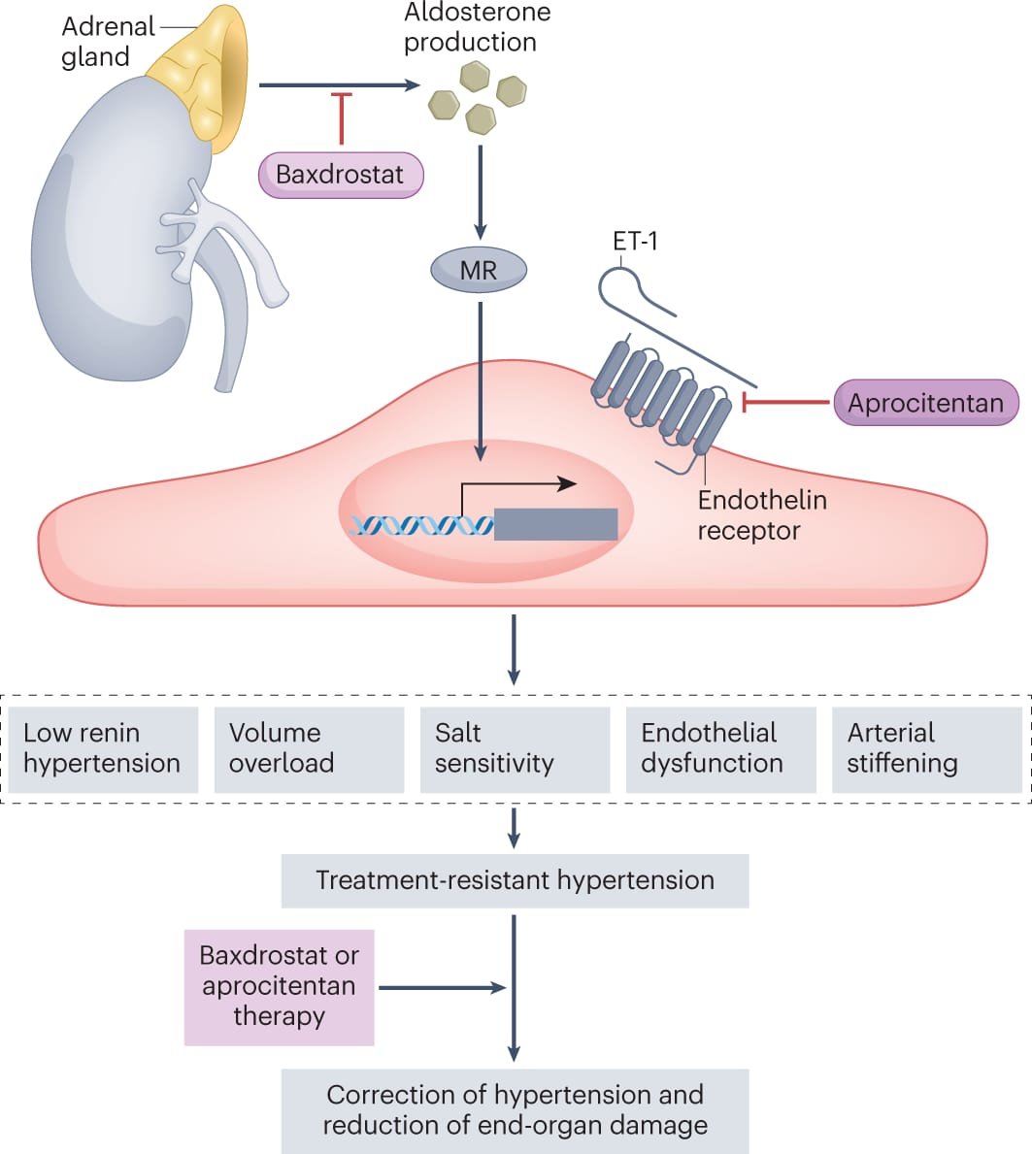

Slide 5
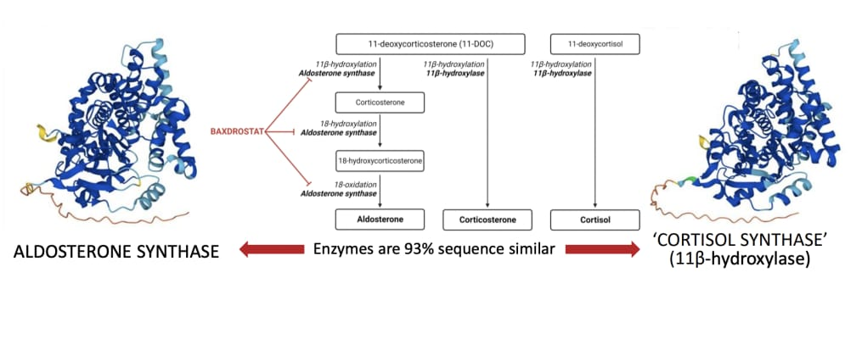
Baxdrostat is a selective inhibitor of aldosterone synthase which reduces aldosterone but not cortisol

Slide 6
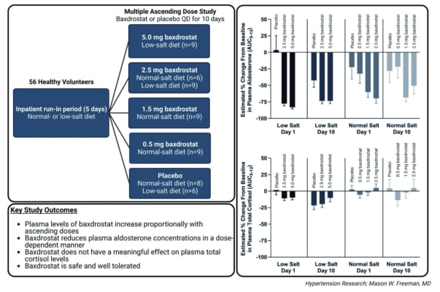
PHASE 1 TRIAL

Slide 7
AIM
To evaluate efficacy and safety of Baxdrostat among patients with treatment resistant hypertension

Slide 8
METHOD
Study design :
Multi-Center Placebo controlled
Randomized Parallel group
Double Blinded Dose ranging
Phase 2 study
Funded by : CinCor Pharma

Slide 9
METHOD
Inclusion Criteria :
  Age ≥18 years
  Receiving stable dose of at least three anti-hypertensive medications
  Mean Systolic blood pressure ≥ 130/80 mm of Hg

Slide 10
METHOD
Exclusion Criteria
  SBP > 180 mmHg, DBP ≥ 110 mmHg
  Estimated GFR <45 ml/min/1.732m2
  Uncontrolled Diabetes
  Has a BMI >45 kg/m2 at screening
  Has been on night shifts at any time during the 4 weeks before screening
Has secondary causes of hypertension
Has had a stroke, TIA, ACS, or heart failure within 6 months before screening
Has planned or had any coronary revascularization within 6 months before screening
Has planned dialysis or kidney transplant
Has known hypersensitivity to CIN-107 or drugs of the same class

Slide 11
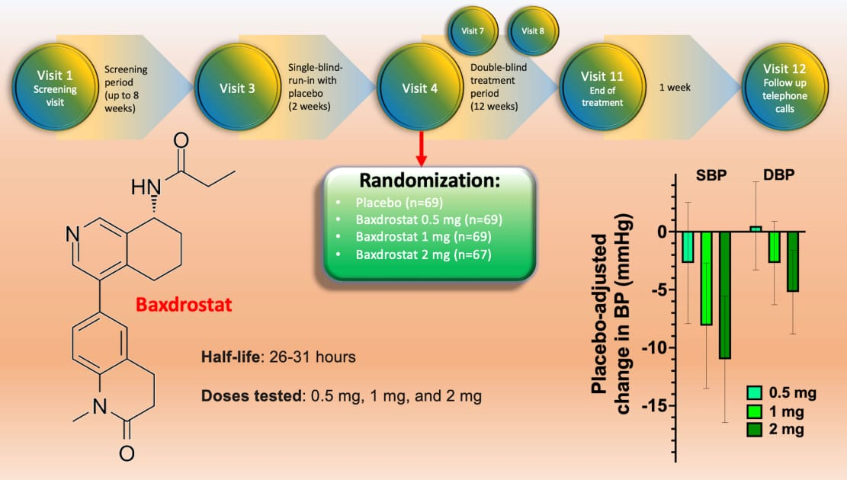
METHOD

Slide 12
METHOD
Recruitment and Randomization :
  Patients were 1:1 randomized to Baxdrostat 0.5 mg, 1 mg , 2 mg and Placebo
Duration : 12 weeks
Mean patient Age: 62 years
Clinical visits:
  On day 03,08,15,22,43,64 and 85
Follow up :
  Telephone call after 1 week of last dose

Slide 13
METHOD
Primary Outcome:
  Change in the mean systolic blood pressure from baseline to the end of the 12 weeks treatment in each of Baxdrostat group as compared with placebo group.
Secondary Outcome:
  Change from baseline in the mean seated diastolic blood pressure
Safety Outcome :
  Adverse events, vital sign, result of laboratory tests, electrocardiogram and physical examination

Slide 14
METHOD
Adverse Events:
  Hyperkalemia
  Hyponatremia
  Hypotension warranting clinical intervention
  Hyperglycemia
  Acute Kidney Injury
  Dizziness
  Syncope
  Urinary Tract Infection

Slide 15


Slide 16
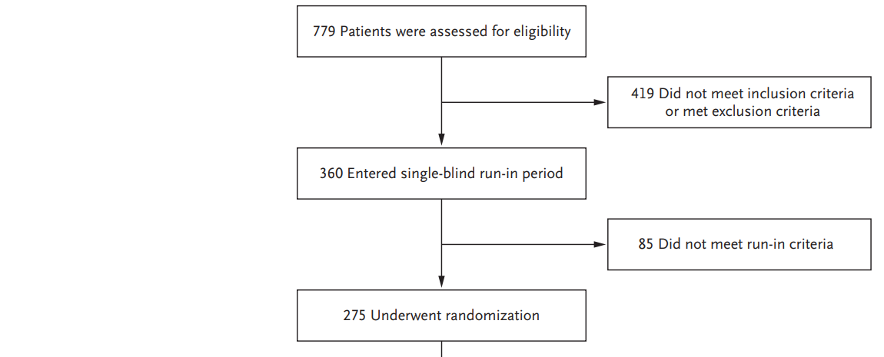
Study Profile

Slide 17
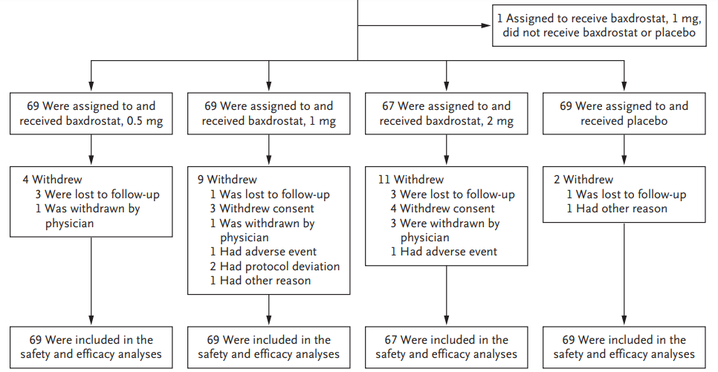
Study Profile

Slide 18
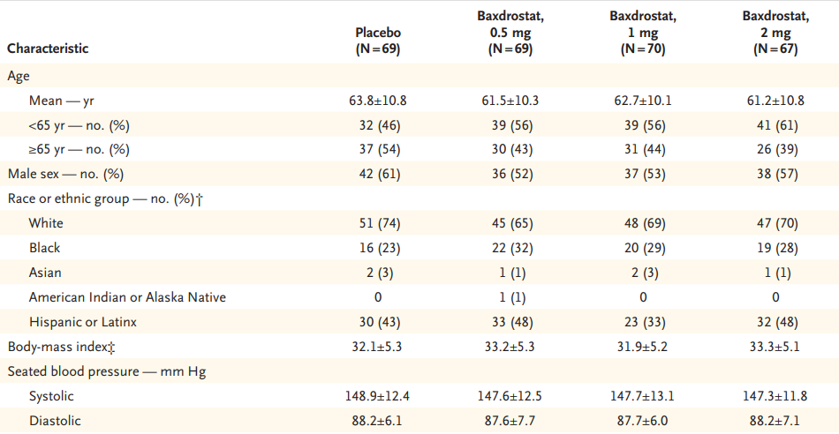
Demographic profile

Slide 19
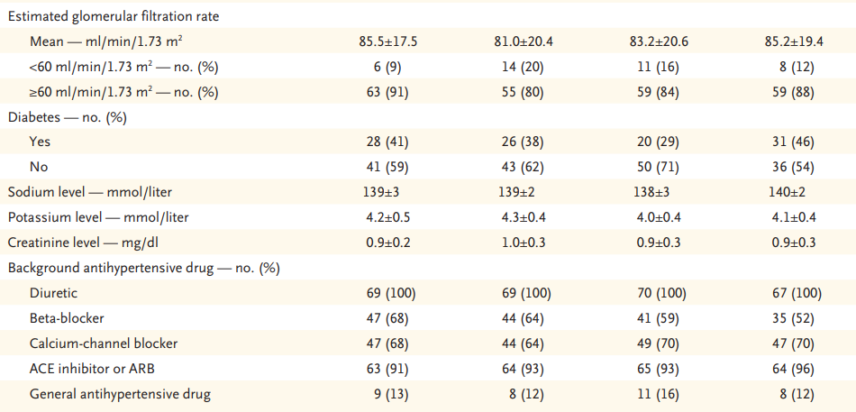
Demographic profile

Slide 20
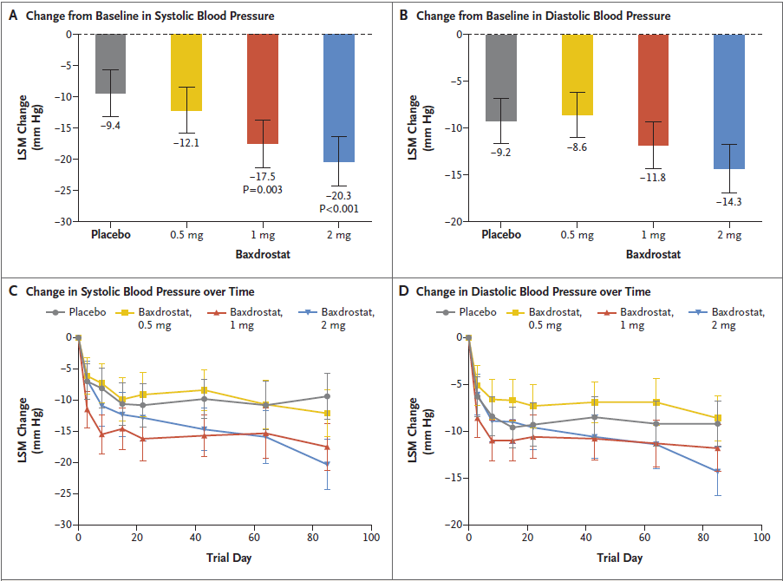
RESULTS

Slide 21
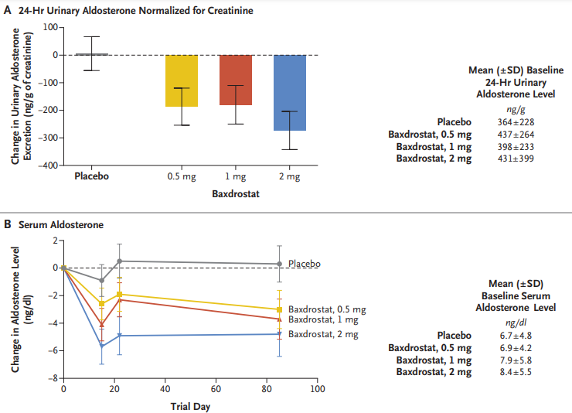
EXPLORATORY END POINT
RESULTS

Slide 22
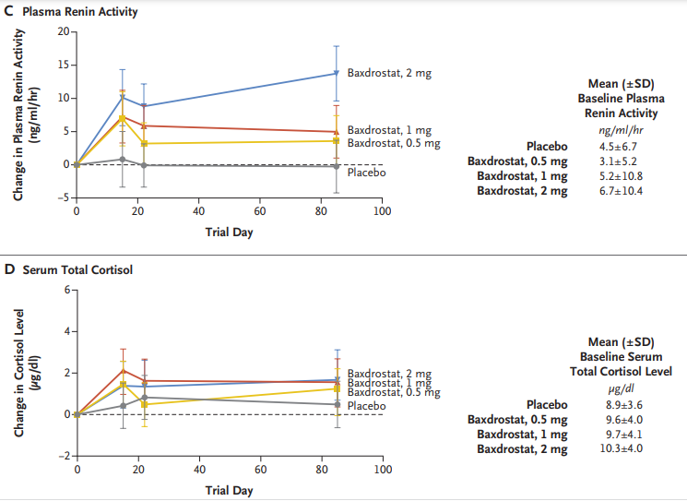
EXPLORATORY END POINT
RESULTS

Slide 23
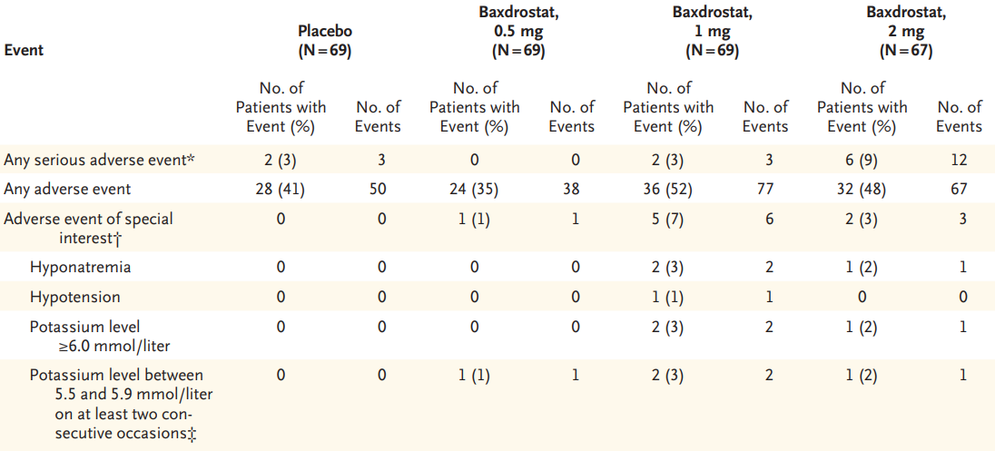
ADVERSE EVENT

Slide 24
CRITICAL APPRAISAL

Slide 25
TITLE
  Is it interesting? YES
ABSTRACT
  Will the conclusions (if valid), likely to be useful to you, in your area of clinical practice or research? YES
  Whether the settings in the material methods are similar to our own settings? YES

Slide 26
Is there a clear cut / specific research question? YES
Was it feasible for the authors to study this question given their technical expertise and available facilities? YES
Does the research question have some element of novelty? YES

Slide 27
Have the authors made a mention of Actual / Study Population ? YES
Is the method of sampling been described? YES
Whether a mention of all the potential confounding factors been made? YES
Any selection or information bias could have occurred? Possible

Slide 28


GATE FRAMEWORK OF ASSESSMENT: PECOT
PARTICIPANTS:
275
EXPOSURE GROUP:
Baxdrostat 0.5 mg (69)
Baxdrostat 1.0 mg (69)
Baxdrostat 2.0 mg (67)
COMPARISON GROUP:
Placebo (69)
OUTCOME :
Reduction in Systolic BP
Baxdrostat 0.5 mg (69) : –12.1± 1.9 mmHg
Baxdrostat 1.0 mg (69) : –17.5 ± 2.0 mmHg
Baxdrostat 2.0 mg (67) : –20.3 ± 2.1 mmHg
Placebo( 69) : –9.4 mm Hg
Duration :
12 weeks
T

Slide 29
ASSESSING VALIDITY

Slide 30
THE RAMMBO ACRONYM : ASSESSING STUDY BIAS
P
E
C
O
T
P
Recruitment
Allocation
Maintenance
Measurement of outcome
Blind or Objective
E
C
O
T

Slide 31
RAMMBO : Recruitment
Study setting & eligibility criteria well described ? Yes
Participants representative of eligible ? Yes
Randomization process described adequately ? Yes

Slide 32
RAMMBO: A is for Allocation
275
Randomization
E1-69 C-69
E2-67
E3-69
1:1 ratio for baseline randomization
O
T

Slide 33
RAMMBO
P
Good Maintenance ?
Did most participants remain in allocated groups ? Yes
Participants &/or investigators blind to exposure
(and comparison exposure)? Yes
Compliance high & similar in both group? Yes
Completeness of follow-up high & similar in both group?
Yes
O

Slide 34
RAMMBO
P
Measurement of outcomes blind or objective?
EG CG
Outcome measurements were Objective
Authors reviewed all results
O

Slide 35
RAMMBO
Recruitment
Bias: No bias
P
Allocation : Adequate
E C
Maintenance: High Retention
O
Measurement : Right Statistical tools
(of outcomes)
T

Slide 36
LIMITATIONS
Study was not designed to test the benefits and risks of aldosterone synthase inhibition beyond 12 weeks
Study does not compare aldosterone synthase inhibition with alternative antihypertensive agents
The selection of patients with an estimated GFR greater than 45 ml per minute reduced the likelihood of hyperkalemia

Slide 37
CONCLUSION
Aldosterone synthase inhibition with Baxdrostat led to substantial reductions in systolic and diastolic blood pressure in patients with treatment resistant hypertension

