Slide 1
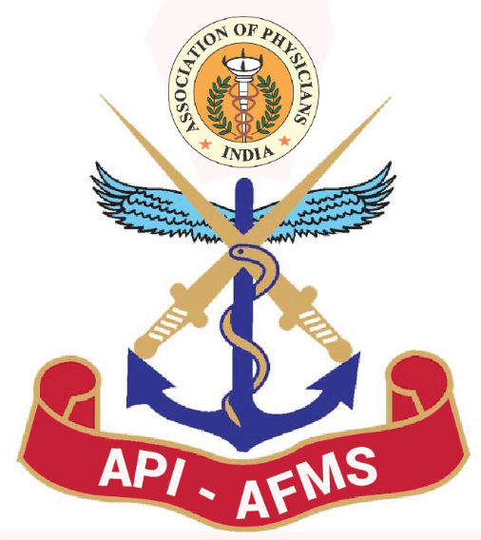

Lt Gen M P JAIPRAKASH (Retd)
National Medicine Update- 2023
&
API-AFMS: First Annual Conference
PHOTO
APPOINTMENT :
QUALIFICATIONS: MD (Gen Medicine) AFMC (1974)
Trained in Med Oncology at Tata Memorial Hospital & Royal Marsden Hospital (London)
SPECIAL ACHIEVEMENTS:
PUBLICATIONS: Eight in National and 1 in International journal.
AWARDS & FELICITATION: Lt Gen RS Hoon Memorial award for best paper in Blood Related diseses-1991
AVSM -2006

