Slide 1
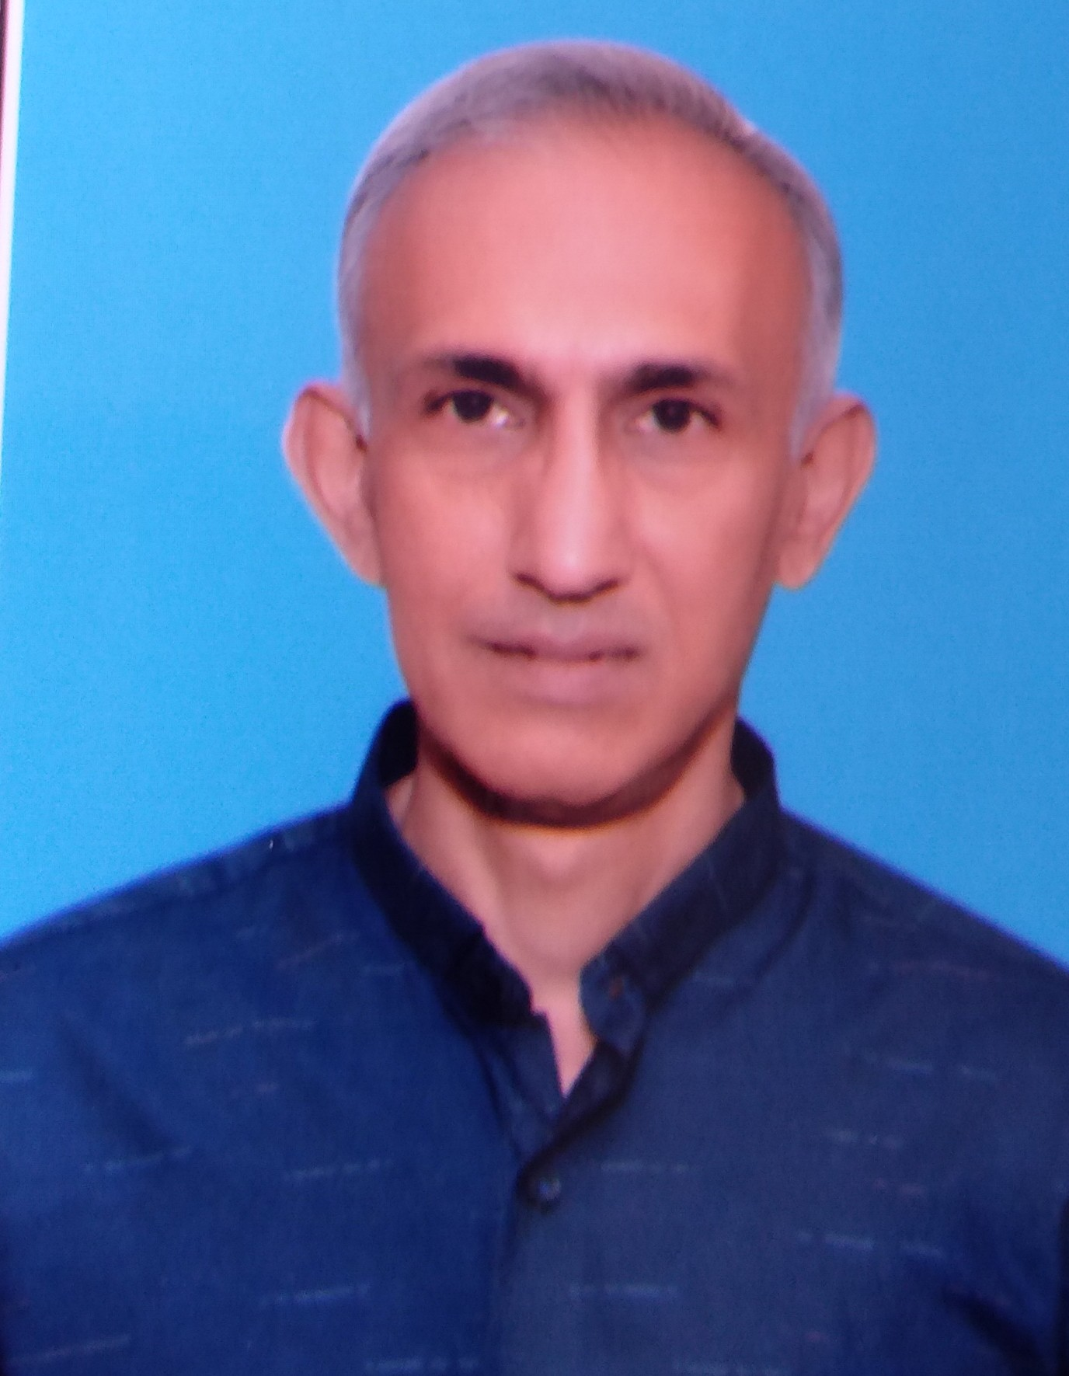
Professor VK Sashindran,
MD, DNB (Med), MSc (Inf Dis), FRCP Edin
  Academic Credentials
  Academic Credentials
    Prof Medicine & Director Postgraduate Studies K S Hegde Medical Academy, NITTE University, Mangalore India
    Dean DY Patil School of Medicine, Navi Mumbai - 11 m
    Professor Medicine - 17 yrs
    Member: Technical Resource Group and Drug Forecasting committees of NACO since 2010
    Jury member, Medical Sciences for International Undergraduate Awards, Ireland since 2018
    Alumnus of Armed Forces Medical College, India
    NIH-Fogarty Fellowship in AIDS Research at Univ of California, Los Angeles
    Mentor for medical research by faculty and students for 20 yrs
  Clinical Work
    HIV/AIDS, geriatrics
  Area of research interest
    HIV/AIDS-TB, ageing biology, metabolic syndrome, public health
  Publications
    Book chapters 9, papers 58
  Other interests
    Mountaineering, mountain philately

